Slide 1
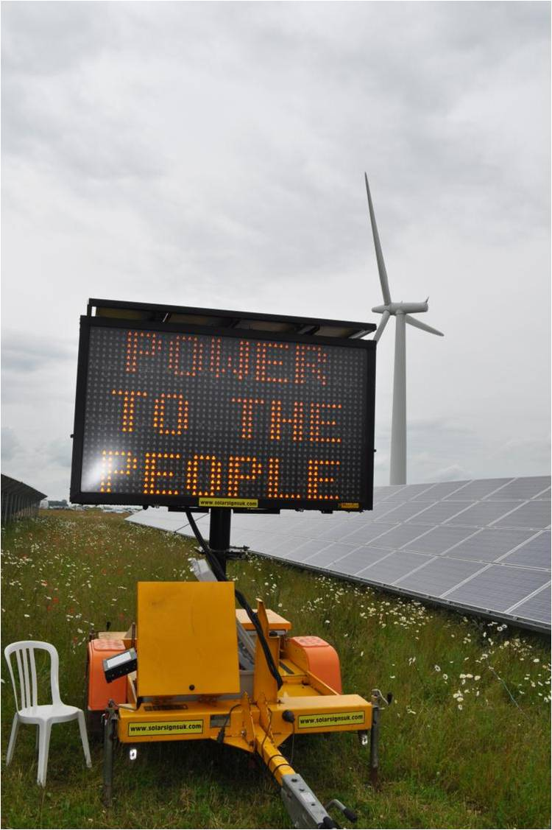

Slide 2
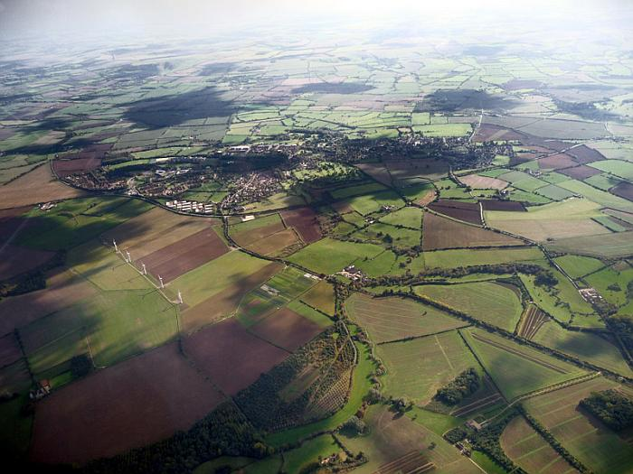

Slide 3
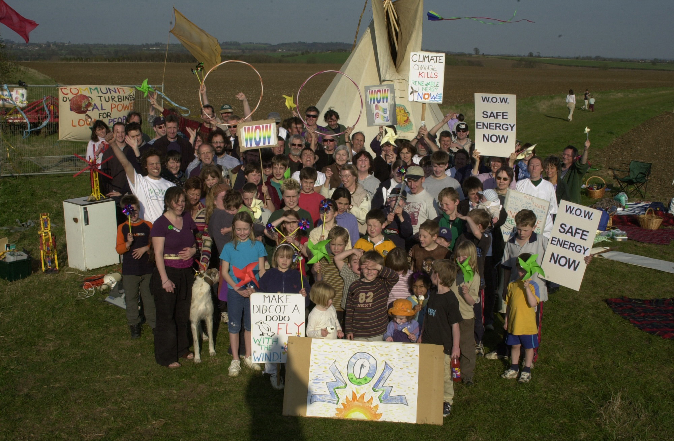
April 2003 – launch of WOW

Slide 4
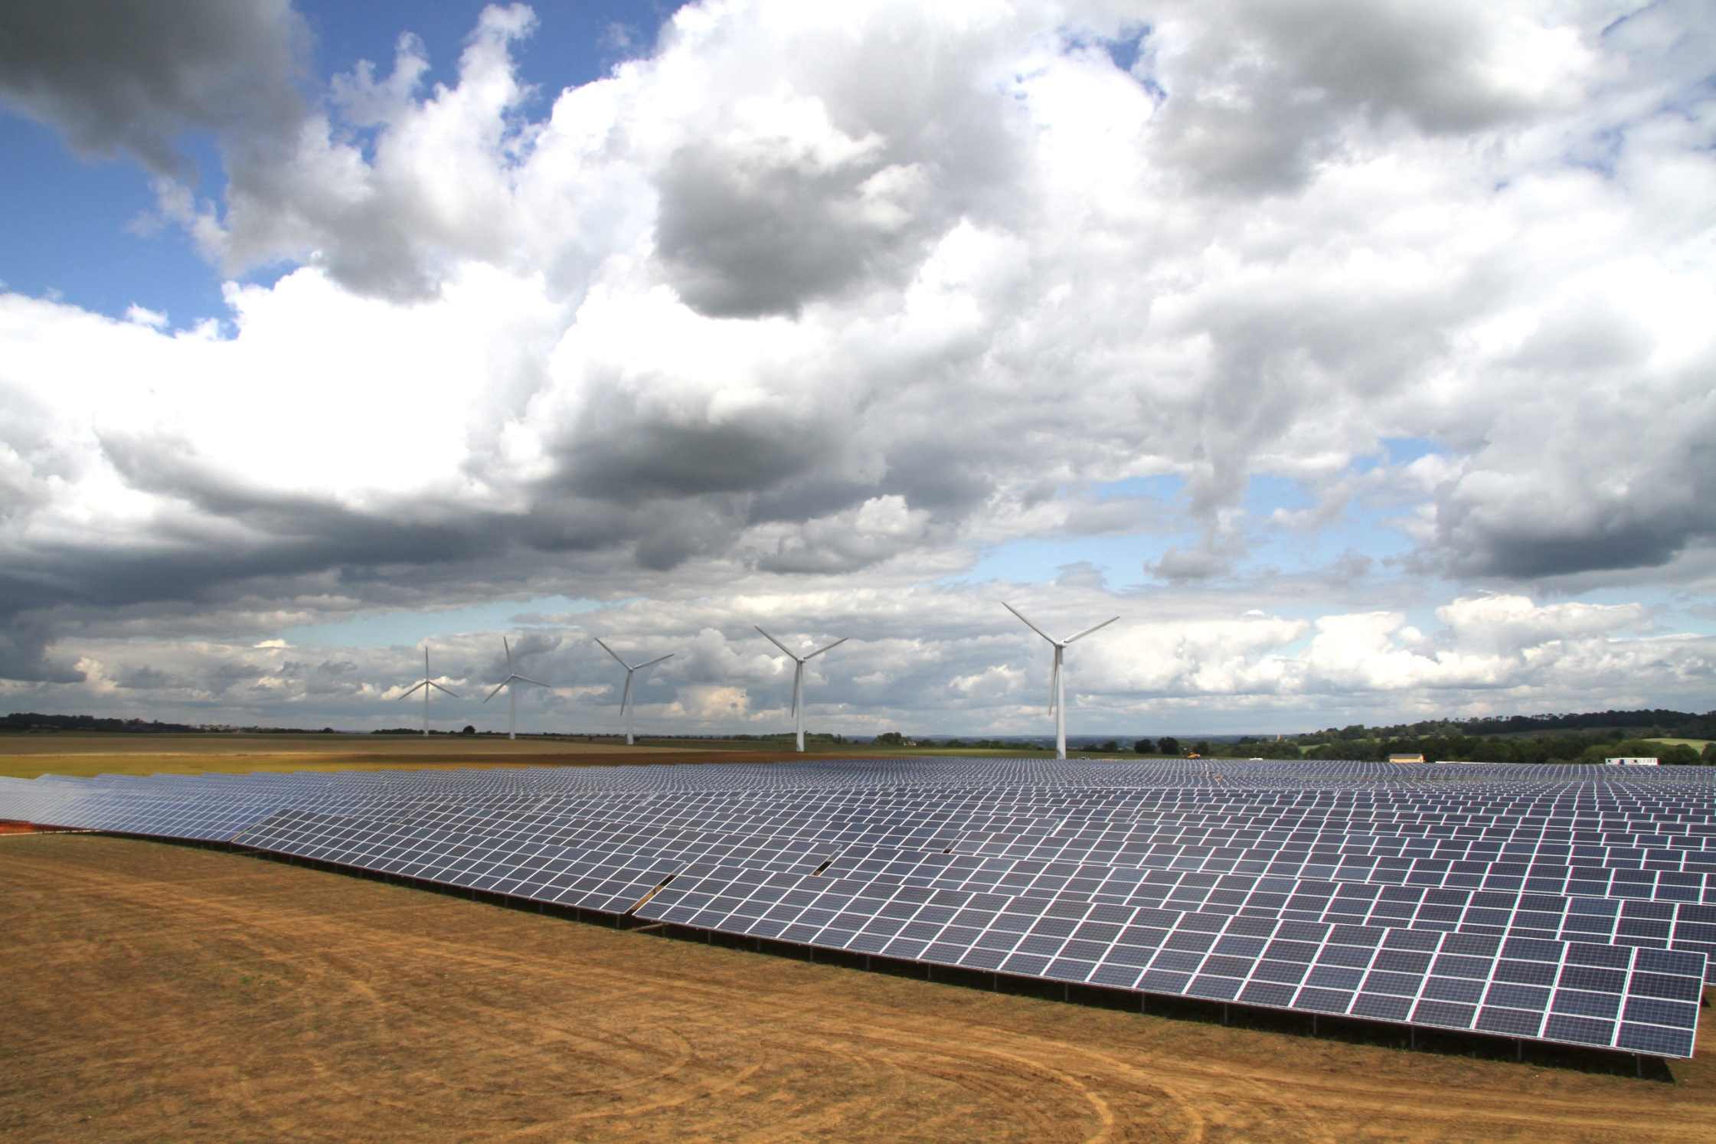

Slide 5
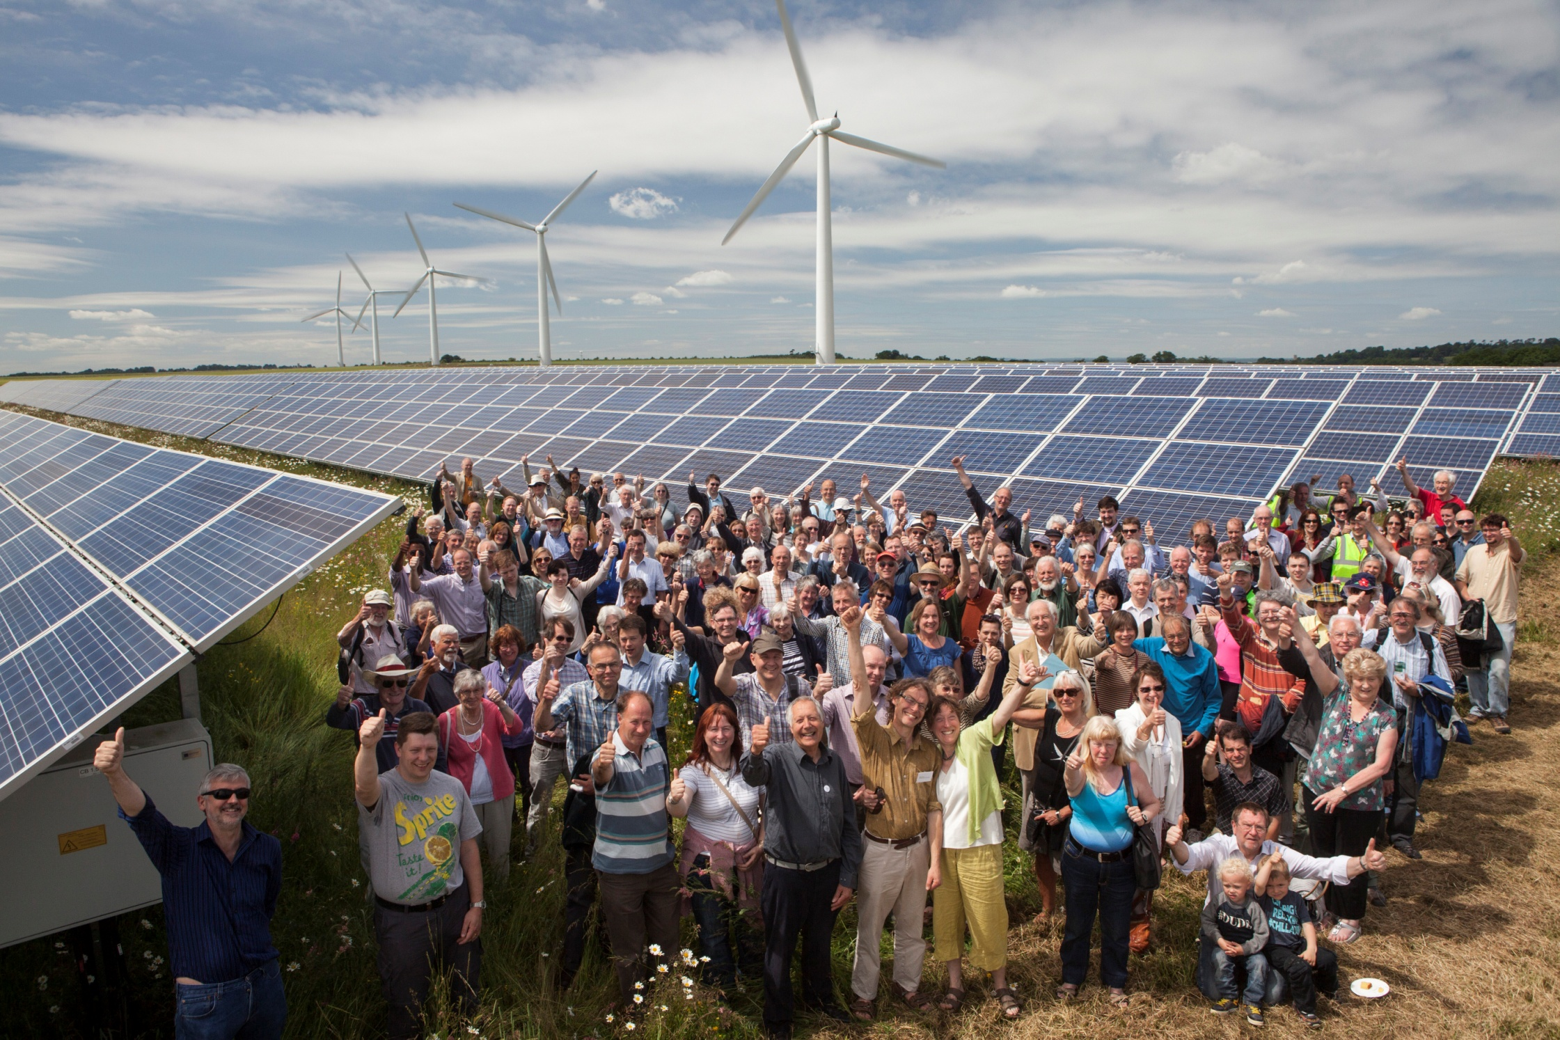

Slide 6
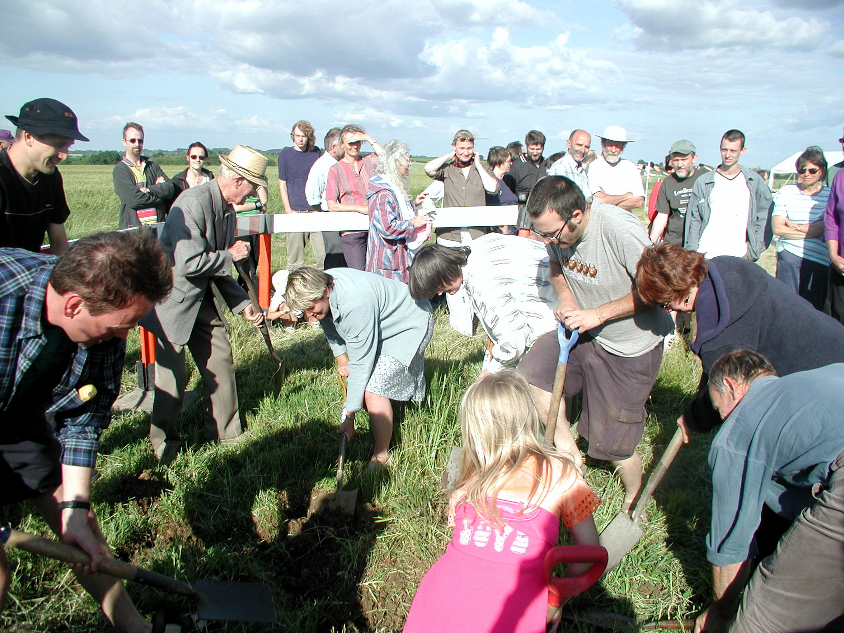

Slide 7
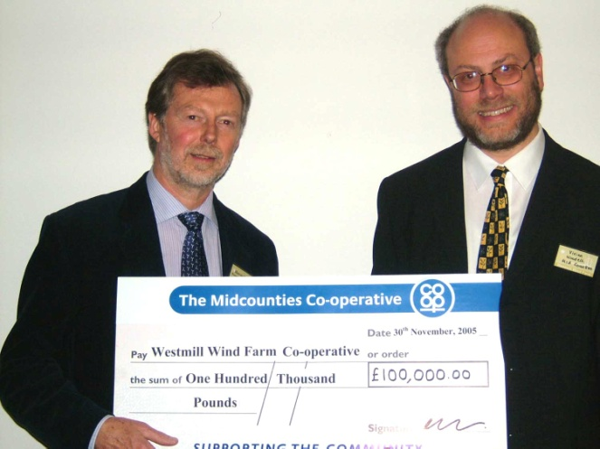


Share Offer
Notes:
organised by E4A – barrow in furness
minimum – £250 – maximum - £ 20 k
Predicted return 16% or 9% (fall back if insufficient raised )average over 25 years (length of planning consent and lease – also turbine life)
Mid counties support - £100k - credibility
Open for 3 months
FSA approval – long delay
National – local priority
Largest Co-op share offer
Over subscribed (£4.5 million)
Can trade informally but money locked for 25 years
Had offer - failed would have returned all bar costs of share offer
Order complications… handed back £ 750k and then asked for it + more 9 months later

Slide 8
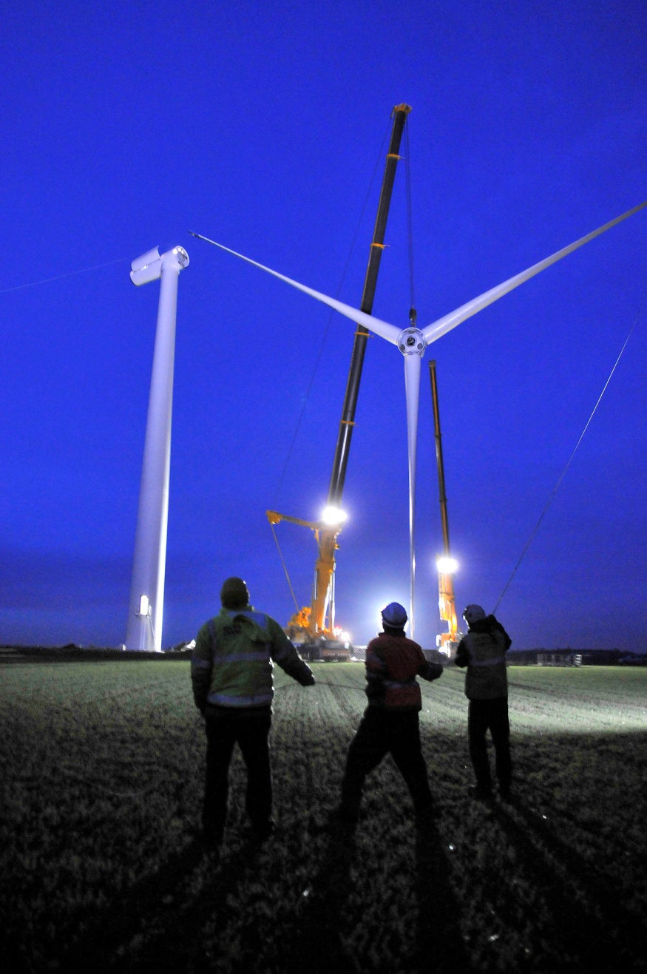
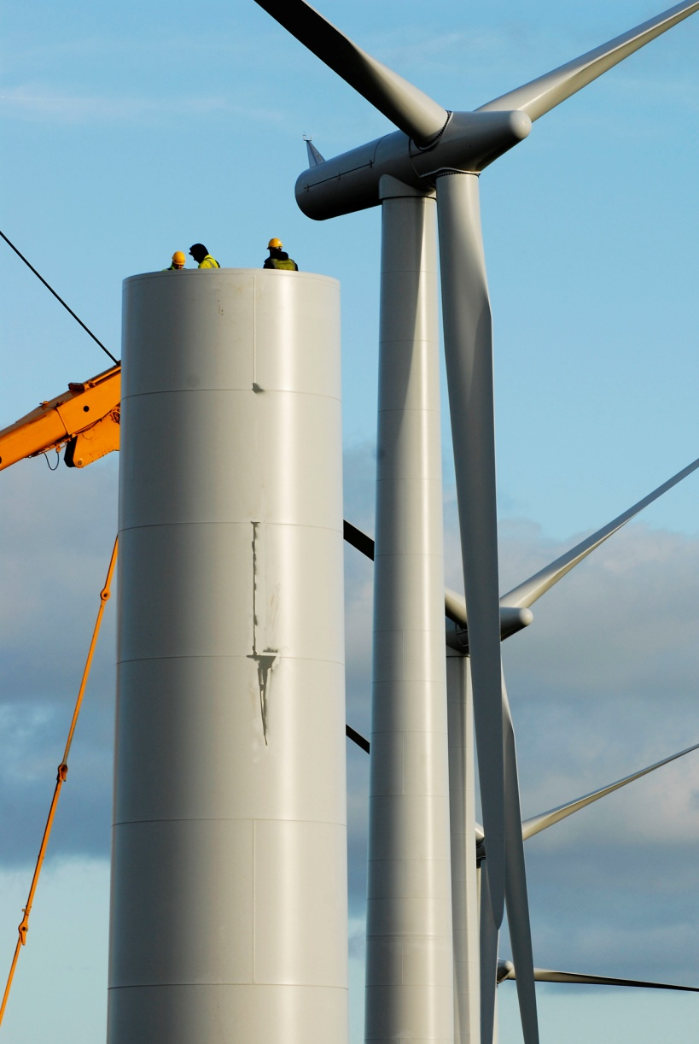
Notes:
Started August 2007
Completed March 2008
Last turbine assembled from 13.00 – 18.00 – cranes gone by 7am next day

Slide 9
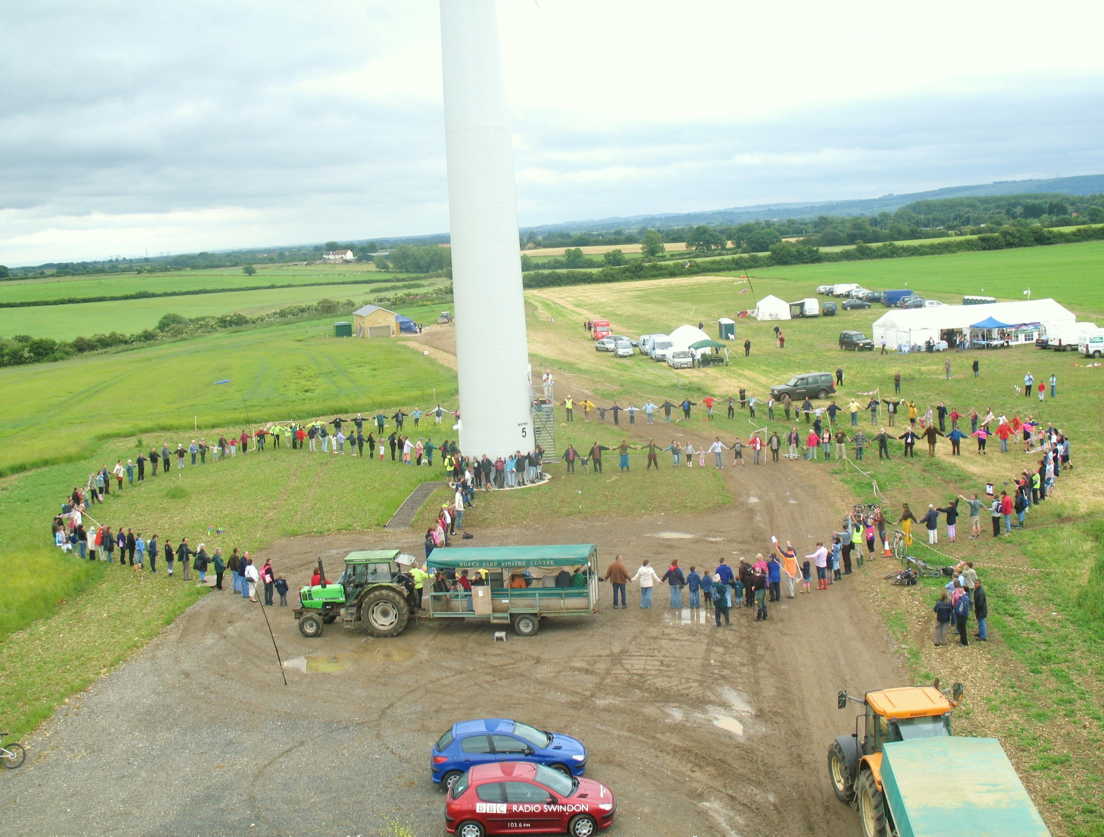

Slide 10
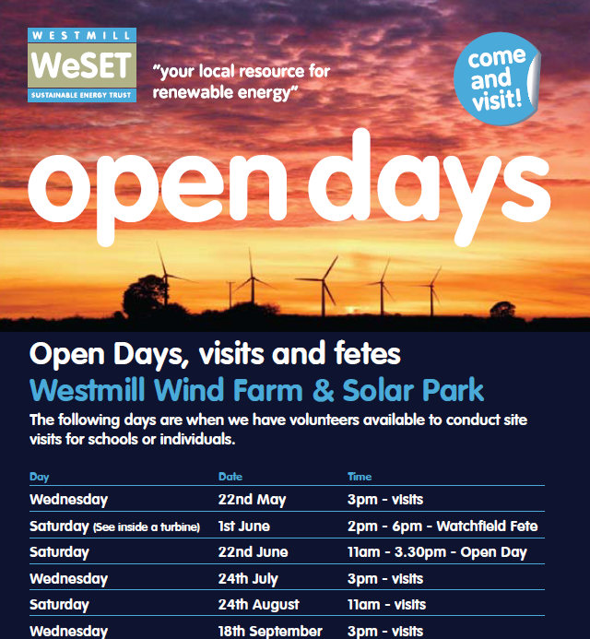

Slide 11
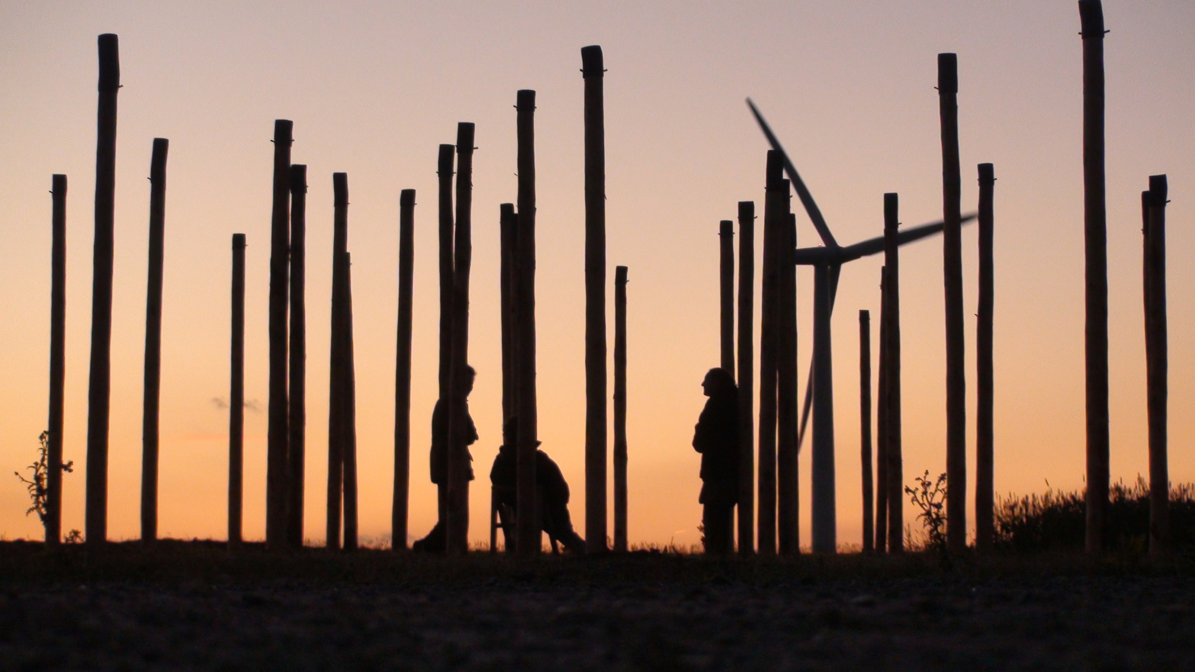
Field Notes

Slide 12
