Slide 1
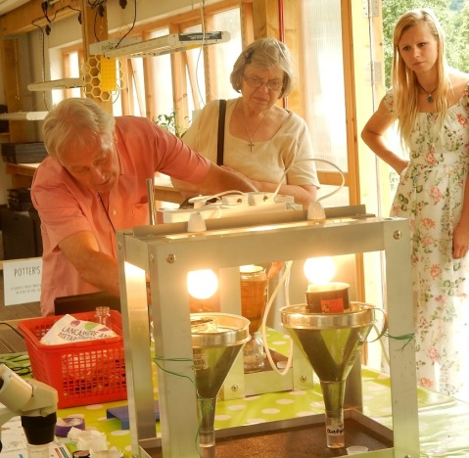
RadTech 2.0
Agribusiness
Dr Charlie Clutterbuck
(3 degrees in Agric Science. BSc in Ag Zoo, Masters in Plant Science Phd in Soil Zoology.
Lecturer @ ManchesterMet Uni, Fellow Food policy, City University London,).

Slide 2
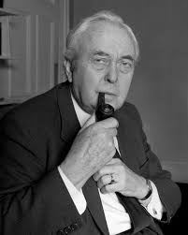


40 years ago
1976
TODAY
IMF just walked in to sort Labour…
New Tory Government
Efficiency
Pollution
Ecosystem
Labour
Power
Markets
Going to get worse
Better in some ways
(paradigm change)
Worse
Worse
Worse
Post Brexit..worse

Slide 3
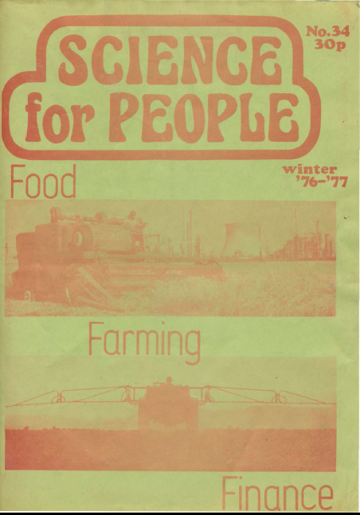
Efficiency
Yet they shout
More more!
Set up Agricapital group same year,
Looked at how ‘capital’ develops in relation to food/farming
Spawned many famous foodie activists..
Some capital has grown on land recently (Indoor cattle handling)
But still mainly in Major companies
‘F’ for Efficiency (Chapter in More than we can chew)
Productionist (produce more)
Productivist really (reduce costs of production)
Farming produces less than gardens/allotments..see
‘Garden Controversy’
All about profit – hard as when produce more, markets saturate, prices plummet. (Mad Food Markets)
Came from avowedly left wing stance
Would do same now
Lot of analysis now ignores role of Capital
Yet Service Capital still needs cheap food, just as industrial capital did.
Notes:
Above all else agribusiness is claimed to be efficient. But it is necessary to challenge the term ‘efficiency’. Efficiency in terms of what?
Not in terms of energy, anyway. British wheat growers produce 2.2 energy units for each unit expended; potato growers produce 1.1 units, and sugar beet, when refined to sugar, gains only 0.49 units. Battery eggs produce 0.16 and broiler chickens produce 0.11 units of energy for every one expended. Compare this performance with that of Yucatan maize farmers who produce 13-29 units of food energy, and primitive gardeners in New Guinea who produce 20 units, for each energy unit expended. Energy inputs into the agribusiness system are increasing enormously, but the food energy produced is rising only marginally. For instance in the US, food energy consumed has risen from about 150 kcal.10¹ ² in 1940 to about 250 kcal.10¹² in 1970, whereas energy input rose from 700 kcal.10¹² in 1940 to 2250 kcal.10¹² in 1970.
Nor is agribusiness efficient in terms of product­ivity— that is, output per acre. Yields in England and Wales of barley and wheat increased from 17.4 and 19.0 cwt per acre (cpa) during 1940-44, to 28.5 and 32.1 cpa for 1961-65. Production of wheat rose from V/2 million tons to 3.4 million tons, and output of barley from 2.2 million tons to 5.7
million tons, during the same period. These increases were accompanied by extensive mono- culturing of crops and the establishment of larger farms as the main food producers.
Since then, however, yields have stabilised. The five year average for 1966-70 of these crops was down on the previous five year average in England and Wales. The yield per acre was 27.9 cwts per acre for barley, and 31.4 cpa for wheat. It is true, however, that yields have now improved slightly, the 71-73 average being 34.6 cpa for wheat, 31.3 cpa for barley.
It is not even true to say that the ‘efficiency’ of agribusiness is determined solely by economic criteria. Agribusiness is efficient by only one economic criterion-the ratio of gross monetary out­put to input. All other considerations, including productivity, are secondary. Thus, following the definition of the Ministry of Agriculture, Fisheries and Food, there are two sorts of farms: high- performance (HP) farms—those with the highest ratio of output per £100 input—which have “higher net incomes, specialise more and have lower labour, rent and machinery costs per acre”; and low- performance (LP) farms-the quarter of farms with the lowest such ratio. The advantage of large farms is clear—reduced labour and machinery costs per acre. But the productivity (i e. output per acre) bears no relationship to this measure of performance. Low-perfromance dairy, livestock and cropping farms produce outputs comparable to similar ‘high performance farms’, for most size groups. So-called ‘low-performance’ mixed farms (of all sizes) consistently outyielded ‘high- performance’ farms during 1970-72. LP farms produced £85 per acre, HP farms £65 per acre on average. The greatest discrepancy occurred on the larger farms (over 1800 acres), where high- performance farms produced only 70 per cent of the output of low-performance farms. High- performance farms had, of course, a higher return on labour input (about £550 compared to £410 per £100) and higher net farm income (about £29 compared to £7 per £100). And these are the determinants of efficiency.
Thus, talk of making ou? farms more efficient in order to provide for increased food demands is pure mystification. Agribiz efficiency does not produce more food automatically, nor is that a measure of its success. It produces more efficient labour, more efficient capital, and if it produces mort food, well so much the better, but that is a secondary consid­eration. The drive to increase the technical efficiency of the food production process is in fact a drive to maximise the creation of surplus value, or profit.

Slide 4
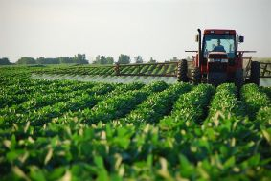
Direct pollution
Fertilisers
Still too much..EU NVZs helped reduce N fertiliser, esp. on pasture.
Nitrate problem now part of Global Warming scenario.
Phosphate still seems on backburner when shouldn’t be.
Pesticides
Lots of campaigning
The ‘Drins’ now gone.
Spent many years on HSE ‘Chemag;
And ACP. Legal requirement to approve
Things better in UK – Requirement to have NVQ in order to spray
Notes:
4 Exploitation of Nature: direct pollution. The most widely known pollutive effect is that caused by pesticides, the major undesirable properties of which are persistence, broad range of activity, and widespread use. All the members of the organochlorine group, which includes DDT and Dieldrin, are powerful and persistent. It was the use of Dieldrin, Aldrin, and Heptachlor as seed dressings on wheat that first aroused attention as to possible side effects of insecticides in this country. In the springs of 1960 and 1961 bird deaths increased alarmingly, causing a public outcry. Game birds and predatory mammals and birds were affected. It was shown that the deaths were not solely due to the oral toxicity of pesticides, but that certain predators had been declining in numbers since World War II. This decline was linked with a reduction in the shell thickness, caused by increase in the production of enzymes—which broke down the oestrogen necessary for controlling calcium deposition. Thus, instead of simply asking the question “how much pesticide will kill an animal?” it became clear that the possible long term effects on animal populations had to be investigated.
Attention was then focused mainly on DDT, as it was the most widely used of the powerful and persistent pesticides. The main cause for concern was its build up in food chains, especially in aquatic fauna. The effects on soil fauna could still be measured even 12 years after application. The main drawback to DDT use became the build up of resistance among insect populations to the chemical. Thus, the withdrawal of use of DDT in the US was due more to the recognition of its future non­profitability than to the recognition of its harmful effects on biological systems.
Long term studies concerning other pesticides’ effects on soil populations have been notoriously sparse, and often poor. Most soil micro-biological work has been carried out totally ignoring the role of soil mesofauna. Thus, the long term effects of medium persistent herbicides (eg. Simazine) or soil sterilants have yet to be established. Much basic re­search needs to be done before the bland reassur­ances of the Agribiz companies can be accepted.
Serious short term problems have so far occurred only rarely in practice. All insecticides are highly soluble in fatty tissues and kill by disrupting nerve impulse transmissions. Schradan, an organo- phosphate, caused many bird deaths in the 50’s, but was replaced by more selective compounds of low toxicity.
Fertilisers, too, cause pollution problems.
Artificial nitrates, unlike their organic counterparts, are not retained by the soil. Thus, they are essent­ially ‘leached’ into waterways. Not only is this a waste-which, considering that it takes five tons of oil to produce one ton of fertiliser, cannot be afforded—but it creates overfertilisation of vegetation in waterways. This process is called eutrophication, and it reduces the available oxygen for fish life. Nitrates can also be transformed to nitrites, which are a threat to watercourses, and are especially dangerous to children. This possibility is likely to increase as nitrates are being used in ever- increasing amounts, despite price rises due to increased energy costs.
FOOD
The effects of continued fertiliser dressings can also cause two further sorts of damage to the soil. When acidification, caused by leaching, is not rectified by liming, damage to soils may ensue. Long lasting damage has also occurred by excessive application of micronutrients such as Boron.
The recent change to using excreta as unamended fluid slurry, instead of good old straw-composted material (farmyard manure), has also brought its pollution problems. These include transfer of organic material to streams via surface runoff, accumulation of elements in plants at concentrat­ions undesirable to animal health, and further leaching of nitrates to groundwater. It can also block soil pores, reducing aeration, and thus reducing the nitrification process. Carryover of disease is also encouraged by the loss of oxidation properties.

Slide 5
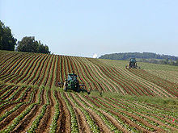
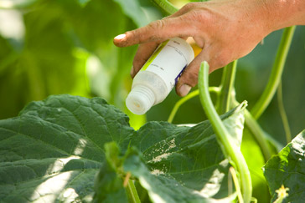
Ecosystems
Biological controls
Monoculture
Most successfully introduced in modern carefully controlled glasshouses.
Thanet Earth
Predominantly in East of country, where same crops grown continuously
Developed considerably in last 40 yrs.
Mixed Farms virtually disappeared in Mainland Britain.
Notes:
Exploitation of Nature: degradation of ecosystems While pollution affects ecosystems directly, there are other ways in which natural balances can be affected. The most profound alteration is caused by the very nature of agriculture—the aeration of large areas of single crops. Without agriculture there would be no such thing as pests.
That said, however, there is no need for Agribiz to exaggerate the problem by its insistent mono- culturing, whether it be by the yellow peril of monotonous barley or by the green slums of commissioned forest.
Biological controls have been degraded in various ways. The one that has attracted most attention is the removal of hedgerows. Although the president of the National Farmers Union has been heard to remark that “evidence shows that there is no loss of natural controls by removal of hedgerows, providing there are other hedgerows nearby”, there is a lot of evidence to the contrary. In some studies yields have been improved by 20 per cent. Another method of degradation is straw burning after cropping. This was only made ‘economic’ when the carryover of stem pathogens, due to continuous corn crops, increased. Such measures are bom of economic necessity rather than sensible husbandrv or sane ecology. It is interesting to calculate the energy wastage in straw burning.
Another example of how modern methods create problems rather than solve them, is provided by the use of insecticides which may kill the natural predators, thus giving rise to new pests which avoid the primary insecticide. A classic example of this is the appearance of red spider mites in orchards, as a major pest. Similarly, the ability of insects continually to become immune to insecticides means that ever-new formulations are required. “Still, it makes for good business—if what you need is another pesticide, sir!”
A final word on the subject of natural controls. Imagine you do find that dream dome with a plot of land of your own; you may well be unable to grow anything organically, especially if your land backs onto a pea farm. Even if you manage to avoid the spray, and your plants are kept covered, the natural predators probably won’t escape the ugly fingers of capitalism.

Slide 6
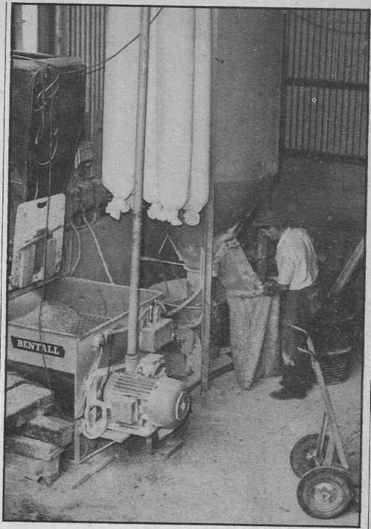
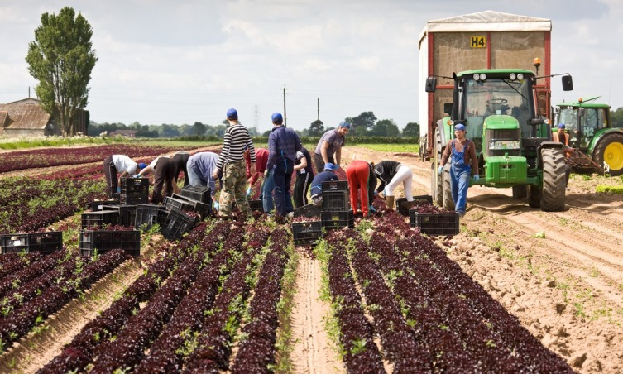
Labour
Safety
Migrant
Dreadful record then
Now the most dangerous (in terms of killing)
Twice Building Sector
Last 10 yrs Building Unions & big employers have saftey passports.
(spent years getting nowhere..pressures too high).
Not mentioned 40 yrs ago,
Yet one of main factors in Brexit..
Highest polls (3-1) near ‘Plantations’ in East
Notes:
Exploitation of Labour In the past 20 years, halt of the workforce—a total of 400,000 people—has moved from the land: a telling indictment of the outdoor conditions created by agribusiness. Although some see this as a move to greater labour efficiency, it is probable that the total number of people involved with food production is still the same—the rest being employed in factories producing fertilisers, pesticides, and lots more surplus value.
Since 1956, according to the statistics, 2009 people (over two per week), including 334 children under the school-leaving age, have lost their lives through accidents on farms in England and Wales. The largest proportion of these have been caused by tractors overturning, or from falls. Legislation has now curbed this figure. Since the introduction of the Agriculture Act (1952) there has been only one fatal accident due to pesticide use up to 1972. Prior to the bill there had been eight fatalities on farms. But in 197 2 there were four fatalities.
Most accidents with pesticides, however, have occurred away from the land. Nearly a hundred people have died from accidentally drinking Paraquat, for instance. The dangers of liver damage due to long term, low level exposure to DDT (and other chlorinated hydrocarbons) is most acute to those manufacturing the compound. The dangers of liver damage have now been underlined by the iscovery that another chlorinated hydro- : Vinyl Chloride) causes liver cancer. The - - xicity of organophosphates has likewise issociated with dangers of handling, rather term ecological damage, rultural workers are prone to other diseases ae ot their contact with soil and animals, yet -v diseases recognised as occupational hazards =titis, Weil’s disease and Farmers Lung, tral workers are in fact subject to many leases, including brucellosis and tetanus.
~ess techniques have also exposed workers a-"₅ed periods to severe dust hazards in — -ers and silos. The long term hazards of are not known. And any chance of - workers being afforded the same is industrial workers (meagre though :-^{ii} l'-*st been eliminated by the exclusion of ~raral Inspectorate from the New Safety ‘i at Work Bill. _ mechanisation has brought with it the have been associated with automation in ries. Regard for profits rather than has meant that many older tractor trom back complaints, and deafness, -usly, machines have created job isolation, repetitive tasks, so that oi work bear little resemblance to ‘the — * A more realistic view of modern contented cows portrayed in butter i'verts, would be of the dairyman in his 1=1d steel ‘herring bone’ parlour milking Trr times a day, with the only respite the vet.
~ s worst exploitation is concerned it . radition has required that farm- 2: me place of employment, often in a Because of this, and the acute housing :dt in rural areas, workers have to conditions that elsewhere would be cottages are too often damp, cramped : proper sanitation. There are also L-'-idvantages regarding shopping, education.
The tied cottage is also at the base attribution of power in landed man being paid a respectable wage, '-nrmed to having a tied cottage.
~ -tv lack bargaining power, since a: risk as well as their jobs. nca_ isolation between workers on sarins has been further exaggerated by ::® labour within each farm. Whereas ^Fjobs were carried out communally,
-- to harvest times: and even here ition of driving, gathering, and tssm has led to weak unionisation, cy. The one area where significant ¹ seems to be in the orchards
in Belgium recently 4000 wim flails and bird scarers.
— - tarmers are now acquiring a ~ -=^.7. It is not difficult to see —ev are caught in a bind.

Slide 7
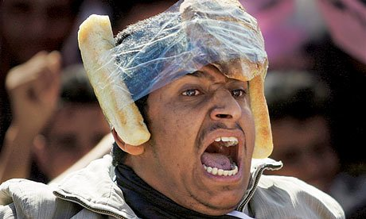
Politics & Power
Food Prices
Corporate Control
Followed 1972 food hikes.
Similar 2007/8..led to
Arab uprising
Whim of speculators
‘Forward’ markets now open to all.
In every sector not just chemical eg Most UK machinery is US, foods..
Chemical giants took over seed companies in 80-90s (used Hybrids in ‘Green Revolution’ to gain dominance
Biotechnology has married the chemistry of pesticides with the genetics of crops,
Syngenta (was part ICI) largest recently bought by ChemChina.. Jealotts Hill
Massive decline in land based public science research Institutions – now a quarter of 30+ 40 yrs ago..
Thatcher started sell off – PBI + NIAB to Unilever who sold on to …Monsanto.
Notes:
Food prices continue to soar, yet produce prices are controlled by other interests—the government, the Common Market, and the food companies. Not only are they shackled by world capitalist forces and speculation, they are increasingly being reduced to the status of technicians/sharecroppers for industry. They have become dependent on food processors (for example, pea industries) not only to buy their crops, but also to tell them when to plant and to supply the capital to buy their package deal. Farms have had to increase in size (the number of farms in Canada, for instance, declined by 20 per cent from 1961-71) to withstand fluctuations in return on capital, and to make possible the necessary investment in machines and fertilisers in order to guarantee high yields.
In doing so, farmers become further dependent on the farm supply sectors of industry. It is dependency on virtual monopolies in each area; Massey-Ferguson, David Brown, Ford, and John Deere dominate farm machinery; ICI, Fisons and Shellmex control fertilisers; Fisons, May and Baker, Geigy and Shellstar are the leaders in pesticides; and the infamous seven major oil giants, control the fuel supplies.
The centralisation of power from the land to the boardrooms of Agribiz is exaggerated still further by the system’s dependence on one man for the supply of phosphate rock. Mohammed Lamrani of Morocco controls a third of the exports, and more than one half of the export growth, of phosphate rock. And as for oil ..
The influence of Agribusiness also dictates governmental research to such an extent that virtually all money in this field goes to ‘articulating the paradigm of pesticide and fertiliser usage’. Rothamsted Research Station is built on super­phosphate. Virtually no research is undertaken on organic husbandry, and very little on biological control mechanisms. Yet again, the economic method is propagated under the guise of the scientific method.

Slide 8
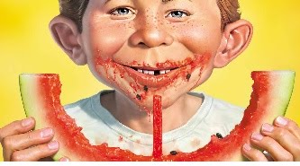
Future…
Post Brexit
Free Market Madness
More trade deals with Commonwealth countries..
Subsidised EU food
Expect more imports
In 1980s we produced around 80% of food we ate (Food Security)
2010 = 40% imported
Latest 50% now = 65% of our Ag GHG abroad)– was ..then)
So drive for ‘more more more, more efficiently, will increase..
Keep your eyes on Russia (now producing more of its own..Crimea) and China – 100 million internal migration from land to factories)
Less State Research/Investment.
Can alternatives do more than show the way?
Food Markets usually saturated – so low end prices, satisfies rest of Capitalism
We need to stop talking about need to produce more food – but go on about ‘Overproduction’ consequences
Notes:
PROSPECTS FOR THE FUTURE?
It is now recognised that energy is power—that energy is just as unequally distributed as wealth, and lies in the same few hands. It is not so widely recognised that this truth applies equally to food.
The staggering increases in food prices in the last two years are not due to a sudden increase in the world population. Something new is happening to World food supplies. It started in 1972 when three problems emerged. For the first time, the USSR entered the US market and purchased 400 million bushels of wheat. Secondly, the production advances that came to be lumped under the phrase ‘green revolution’ began to level off. Finally, the richer countries, all experiencing boom times, sharply increased their consumption of meat. This last factor may be the reason why the USSR decided to enter the wheat market at the time it did. The Russians needed greatly increased supplies of grain to produce meat; previous shortages had always been accommodated, and the ’72 harvest was the fifth best ever for them. But as a result of Russian purchases in ’72, the grain reserves in the US fell from 120 million tons to 21 million tons.
The USSR’s entry into the consumer and capitalist market has had two main effects. It has created such a sensitivity in the market that speculation is widespread, and it is better to invest in food than in money. This sensitivity has exposed the weakness in the whole system. For instance, when the anchovies recently returned to Peru’s coast it meant that the underdeveloped countries would be better able to afford their own, much needed protein, but that soya bean farmers in the US would suffer.
It is clear, however, that underdeveloped countries are in general wot going to benefit. The change in the market has meant 'that the US has assumed greater control over distribution. The US was the main exporter for eight of the 20 commodities which showed the greatest increases in prices during 1972. The rest of the developed countries controlled a further eight. The under­developed countries controlled only four, but were the main exporters of the 20 commodities with the lowest price increases of all the 67 world commodities. Which isn’t much consolation for countries like 'Mozambique which have been ‘encouraged’ to produce cash crops at the expense of home-consumed food crops. The increase of control by the US also had more obvious political effects. Critical supplies of wheat were denied to the Chilean Government under Allende—even
though Chile offered to pay cash. When Allende was over thrown, the US approved the sale, and even offered credit.
Meanwhile, as a few businessmen made money and gained power from the market’s uncertainty, pressure was increased on producers to produce more. This was the case in the UK just as much as elsewhere. The recent inflation of land prices (prices tripled in two years), coupled with the annual loss of 50,000 acres of urbanisation, exacerbates the problem still further. These pressures will dictate that‘efficiency’ must become still more ‘efficient’ with all the absurd contradictions that that entails.
WHAT CAN BE DONE?
‘Alternative’ forms of agriculture, as outlined in the pages that follow, can and do challenge many of the implicit values of agribusiness. For instance, we pxe constantly reminded that we live in a consumer society. The public’s willingness to accept an homogenous final product is indispensable in the transition from labour intensive agriculture to highly specialised automated agribusiness. The manipulation is built into the final product itself. Thus, by creating an apparent choice in relatively unimportant aspects, such as the size and colour of eggs, the real choice of nutritive value, pr ice and ecological impact is obscured. But by insisting on consideration of these factors alternative agriculture can challenge the values of agribusiness.
However, it is not enough merely to pose the alternatives; it is necessary also to challenge the economic system within which agribusiness is founded. To do so from an agricultural perspective requires certain novel forms of organisation. Organisation around and among farmworkers is essential, but as we have seen, this is difficult because of problems inherent in the unusual position of such workers. Hence other challenges are also necessary. Two possibilities are open. The formation of cooperatives—not consumer cooperatives alone, but also productive and distributive cooperatives—needs to be encouraged in order to reduce the control of agrimonopolies. It will also be necessary to ignore all the rules of the capitalist game and just landgrab, in order to illustrate forcefully the inequities of land distribution. Both efforts should succeed in diversifying both the' means of production and the crops that it produces.
Indeed the emphasis throughout should be on diversification. Diversification in understanding the problems as being not merely technical or economic, but political too. Diversification in approach, not merely being towards alternatives but to challenging the system directly in as many ways as possible.
And diversification in the end product, away from monocultures and dependency on a few distant technocrats, towards natural systems controlled by the people working them.

