Slide 1
Community Energy to the rescue, local choices, global effects
Herbert Girardet

Slide 2
Notes:
Merthyr

Slide 4
Notes:
This is a picture of the port of Cardiff in the 1920, with anthracite as the primary export from the Welsh valleys.

Slide 5
Notes:
Everything changes when coal mining started in the 19th century. A hundred fold increase of the population occurred. Wales turned from being an exporter of wool and meat to an exporter of coal. Energy became the basis of its economy. But the ownerships of that economy was in the hands of a few entrepreneurs with no lasting benefit to the local comunities.

Slide 6
Source: Nakicenovic
2009
Notes:
The evolution of energy technologies

Slide 7
Notes:
7

Slide 8
Shanghai Pudong 1978
Notes:
Shanghai. Pudong 1970
8

Slide 9
Shanghai Pudong 2013
Notes:
Pudong now, the new China, the new Manhattan
9

Slide 10
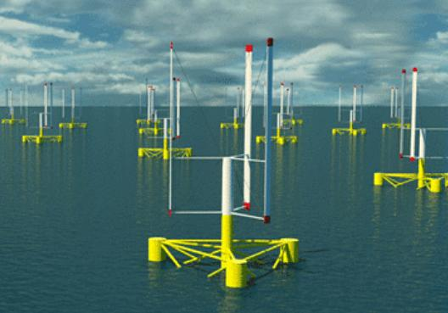
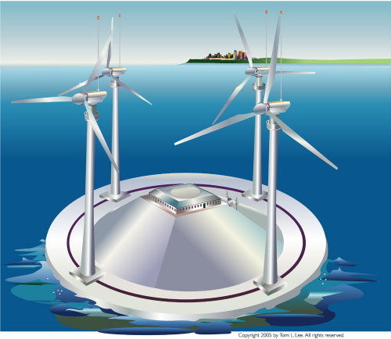

Slide 11
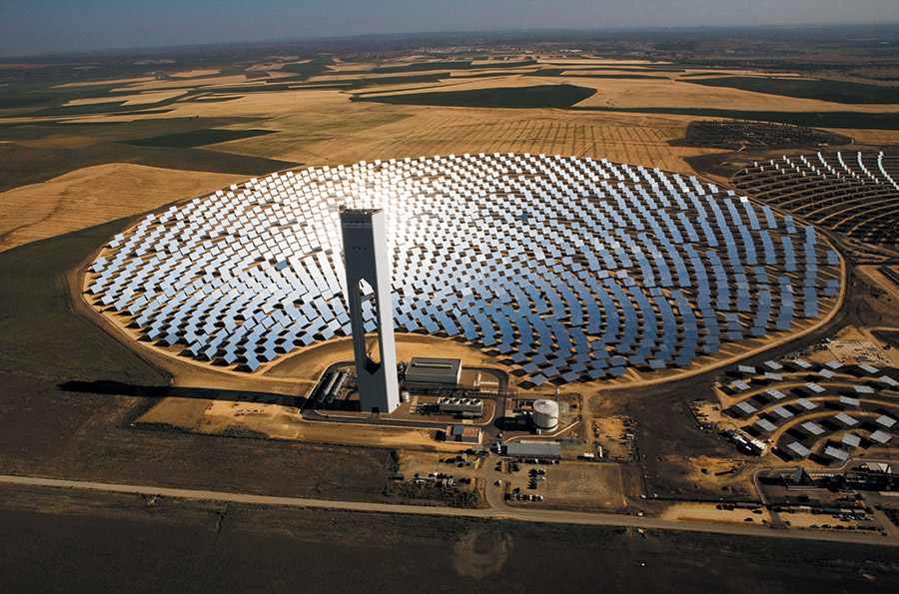
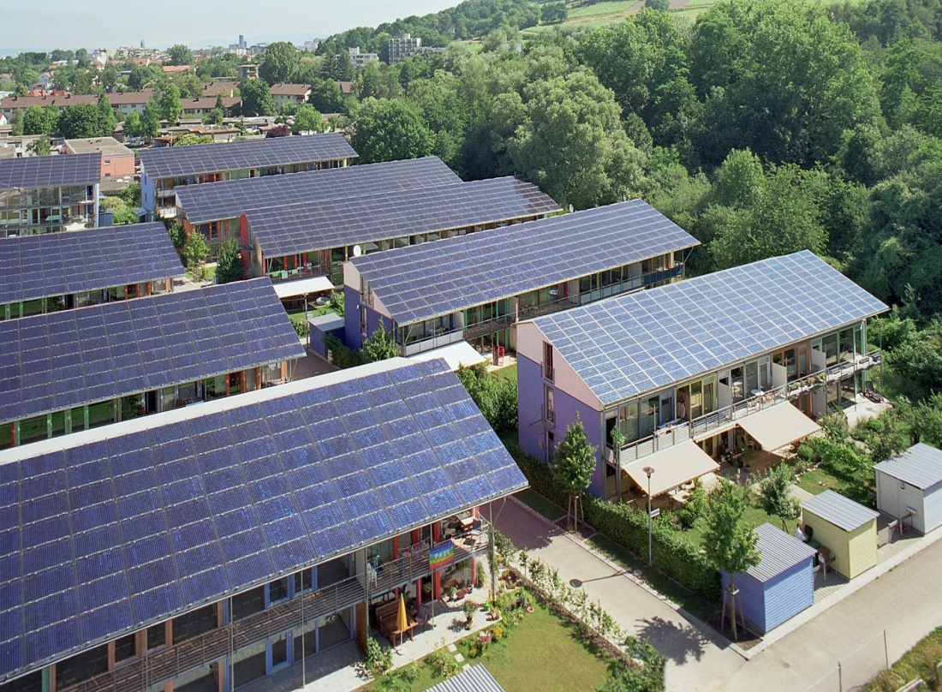
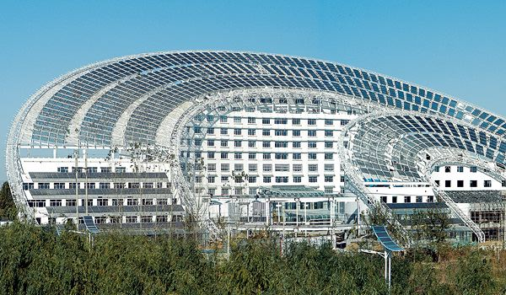

Slide 12
Pen y Cymoedd Windpower Project, Rhondda 76 turbines, 228 MW, 140,000 homes, Vattenfall

Slide 13
Gwynt y Môr wind farm, North Wales coast 160 turbines, 576 MW - Eon, Siemens and Munich

Slide 14
Westmill solar coop, Oxfordshire

Slide 15
Energy democracy?
From consumer to prosumer
New, cost-competitive non-fossil technology options
Community ownership, participation, shared interest in RE projects
Cooperatives, development trusts with tangible benefits to local people
National policies such as stable FITs as enabling tools
Examples: Danish Wind turbine Owners Association, 1978
Europe 2015: 2800 energy coops, half of these in Germany
Energy coops of development tool in Africa, Asia, etc.

Slide 16
Notes:
16

