Slide 1
Hope on the Slope
Jackie Carpenter
3rd September 2016
Notes:
This template can be used as a starter file for presenting training materials in a group setting.
Sections
Right-click on a slide to add sections. Sections can help to organize your slides or facilitate collaboration between multiple authors.
Notes
Use the Notes section for delivery notes or to provide additional details for the audience. View these notes in Presentation View during your presentation.
Keep in mind the font size (important for accessibility, visibility, videotaping, and online production)
Coordinated colors
Pay particular attention to the graphs, charts, and text boxes.
Consider that attendees will print in black and white or grayscale. Run a test print to make sure your colors work when printed in pure black and white and grayscale.
Graphics, tables, and graphs
Keep it simple: If possible, use consistent, non-distracting styles and colors.
Label all graphs and tables.

Slide 2
I have recently published a book, “Hope on the Slope”, which is available on Amazon Kindle:
https://www.amazon.co.uk/dp/B01KP6KMKQ
I have based this presentation, which is about the power to change to new radical energy technology, on the chapter headings of the book.

Slide 3
Power to Change
Notes:
Give a brief overview of the presentation. Describe the major focus of the presentation and why it is important.
Introduce each of the major topics.
To provide a road map for the audience, you can repeat this Overview slide throughout the presentation, highlighting the particular topic you will discuss next.

Slide 4
Power to Change
A plan? A book: Radical Technology 2?
Notes:
Give a brief overview of the presentation. Describe the major focus of the presentation and why it is important.
Introduce each of the major topics.
To provide a road map for the audience, you can repeat this Overview slide throughout the presentation, highlighting the particular topic you will discuss next.

Slide 5
Power to Change
A plan? A book: Radical Technology 2?
Change politics? A new political party?
Notes:
Give a brief overview of the presentation. Describe the major focus of the presentation and why it is important.
Introduce each of the major topics.
To provide a road map for the audience, you can repeat this Overview slide throughout the presentation, highlighting the particular topic you will discuss next.

Slide 6
Power to Change
A plan? A book: Radical Technology 2?
Change politics? A new political party?
Change people’s belief systems? A new religion?
Notes:
Give a brief overview of the presentation. Describe the major focus of the presentation and why it is important.
Introduce each of the major topics.
To provide a road map for the audience, you can repeat this Overview slide throughout the presentation, highlighting the particular topic you will discuss next.

Slide 7
Power to Change
A plan? A book: Radical Technology 2?
Change politics? A new political party?
Change people’s belief systems? A new religion?
Change culture? Change the paradigm? Through telling stories?
Notes:
Give a brief overview of the presentation. Describe the major focus of the presentation and why it is important.
Introduce each of the major topics.
To provide a road map for the audience, you can repeat this Overview slide throughout the presentation, highlighting the particular topic you will discuss next.

Slide 8


My book is an easy-to-read novel about a future in which there is a permanent economic decline. An old lady tells stories to a young man about how the future might turn out. She is very optimistic and feels that the future will be full of hope and happiness.
Notes:
This is another option for an Overview slides using transitions.

Slide 9
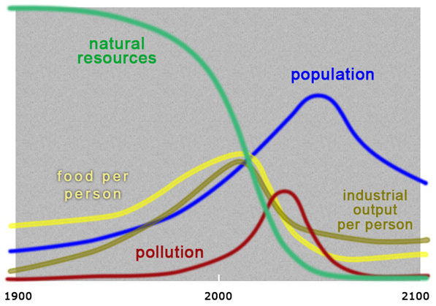
1. Declining Forever

Slide 10
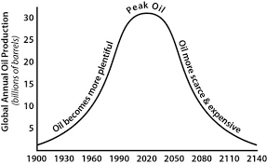
1. Declining Forever

Slide 11


2. Be Prepared!

Slide 12


3. Live in the Moment

Slide 13

3. Live in the Moment

Slide 14
4. Progress to the Best

Slide 15
4. Progress to the Best
Best technology of the past +

Slide 16
4. Progress to the Best
Best technology of the past +
Best technology of the present =

Slide 17
4. Progress to the Best
Best technology of the past +
Best technology of the present =
The best future

Slide 18

5. Love is all that Matters

Slide 19

5. Love is all that Matters

Slide 20
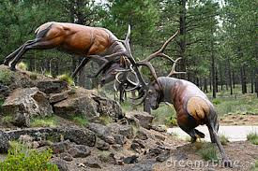
6. Cooperation, not Competition

Slide 21

6. Cooperation, not Competition

Slide 22

7. Materialism or God?

Slide 23

7. Materialism or God?

Slide 24

7. Materialism or God?

Slide 25

7. Materialism or God?

Slide 26
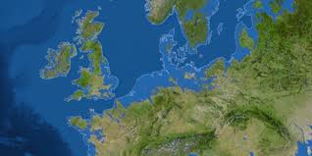
8. Life is an Adventure!

Slide 27
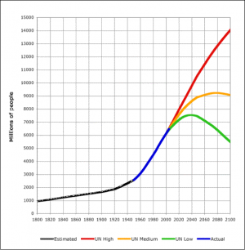
9. Death is OK

Slide 28
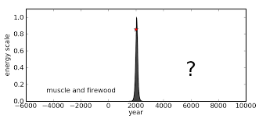
10. Democracy Can’t Help Us

Slide 29

11. The Logical Brain Plays Tricks

Slide 30
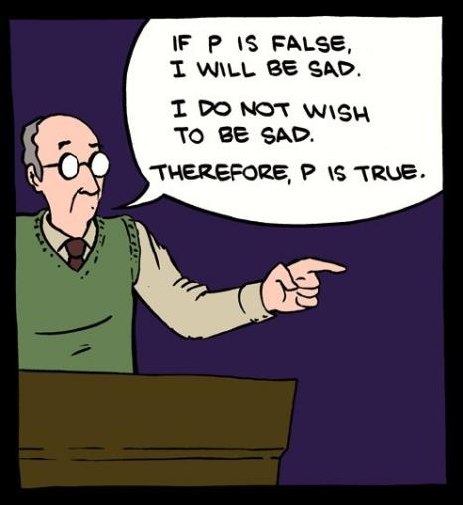
11. The Logical Brain Plays Tricks

Slide 31

12. Village Communities Will Endure

Slide 32
Conference Questions:
We cannot live without artificial energy – true or false?
How much do we need?
What shall we use to provide this energy?
How shall we use our power to make the change?

Slide 33
Jackie’s Questions:
We can live without artificial energy – but can we accept this?
How to navigate down the slope so there is hope?
Can we achieve a better balance of male and female energy?
How shall we use our power to make the change?

Slide 34

Notes:
This template can be used as a starter file for presenting training materials in a group setting.
Sections
Right-click on a slide to add sections. Sections can help to organize your slides or facilitate collaboration between multiple authors.
Notes
Use the Notes section for delivery notes or to provide additional details for the audience. View these notes in Presentation View during your presentation.
Keep in mind the font size (important for accessibility, visibility, videotaping, and online production)
Coordinated colors
Pay particular attention to the graphs, charts, and text boxes.
Consider that attendees will print in black and white or grayscale. Run a test print to make sure your colors work when printed in pure black and white and grayscale.
Graphics, tables, and graphs
Keep it simple: If possible, use consistent, non-distracting styles and colors.
Label all graphs and tables.

Slide 35

Notes:
This template can be used as a starter file for presenting training materials in a group setting.
Sections
Right-click on a slide to add sections. Sections can help to organize your slides or facilitate collaboration between multiple authors.
Notes
Use the Notes section for delivery notes or to provide additional details for the audience. View these notes in Presentation View during your presentation.
Keep in mind the font size (important for accessibility, visibility, videotaping, and online production)
Coordinated colors
Pay particular attention to the graphs, charts, and text boxes.
Consider that attendees will print in black and white or grayscale. Run a test print to make sure your colors work when printed in pure black and white and grayscale.
Graphics, tables, and graphs
Keep it simple: If possible, use consistent, non-distracting styles and colors.
Label all graphs and tables.

Slide 36

Why not buy a copy of my book?
Jackie Carpenter
3rd September 2016
Notes:
This template can be used as a starter file for presenting training materials in a group setting.
Sections
Right-click on a slide to add sections. Sections can help to organize your slides or facilitate collaboration between multiple authors.
Notes
Use the Notes section for delivery notes or to provide additional details for the audience. View these notes in Presentation View during your presentation.
Keep in mind the font size (important for accessibility, visibility, videotaping, and online production)
Coordinated colors
Pay particular attention to the graphs, charts, and text boxes.
Consider that attendees will print in black and white or grayscale. Run a test print to make sure your colors work when printed in pure black and white and grayscale.
Graphics, tables, and graphs
Keep it simple: If possible, use consistent, non-distracting styles and colors.
Label all graphs and tables.

Slide 37
Jackie Carpenter
3rd September 2016
Notes:
This template can be used as a starter file for presenting training materials in a group setting.
Sections
Right-click on a slide to add sections. Sections can help to organize your slides or facilitate collaboration between multiple authors.
Notes
Use the Notes section for delivery notes or to provide additional details for the audience. View these notes in Presentation View during your presentation.
Keep in mind the font size (important for accessibility, visibility, videotaping, and online production)
Coordinated colors
Pay particular attention to the graphs, charts, and text boxes.
Consider that attendees will print in black and white or grayscale. Run a test print to make sure your colors work when printed in pure black and white and grayscale.
Graphics, tables, and graphs
Keep it simple: If possible, use consistent, non-distracting styles and colors.
Label all graphs and tables.

