Slide 1
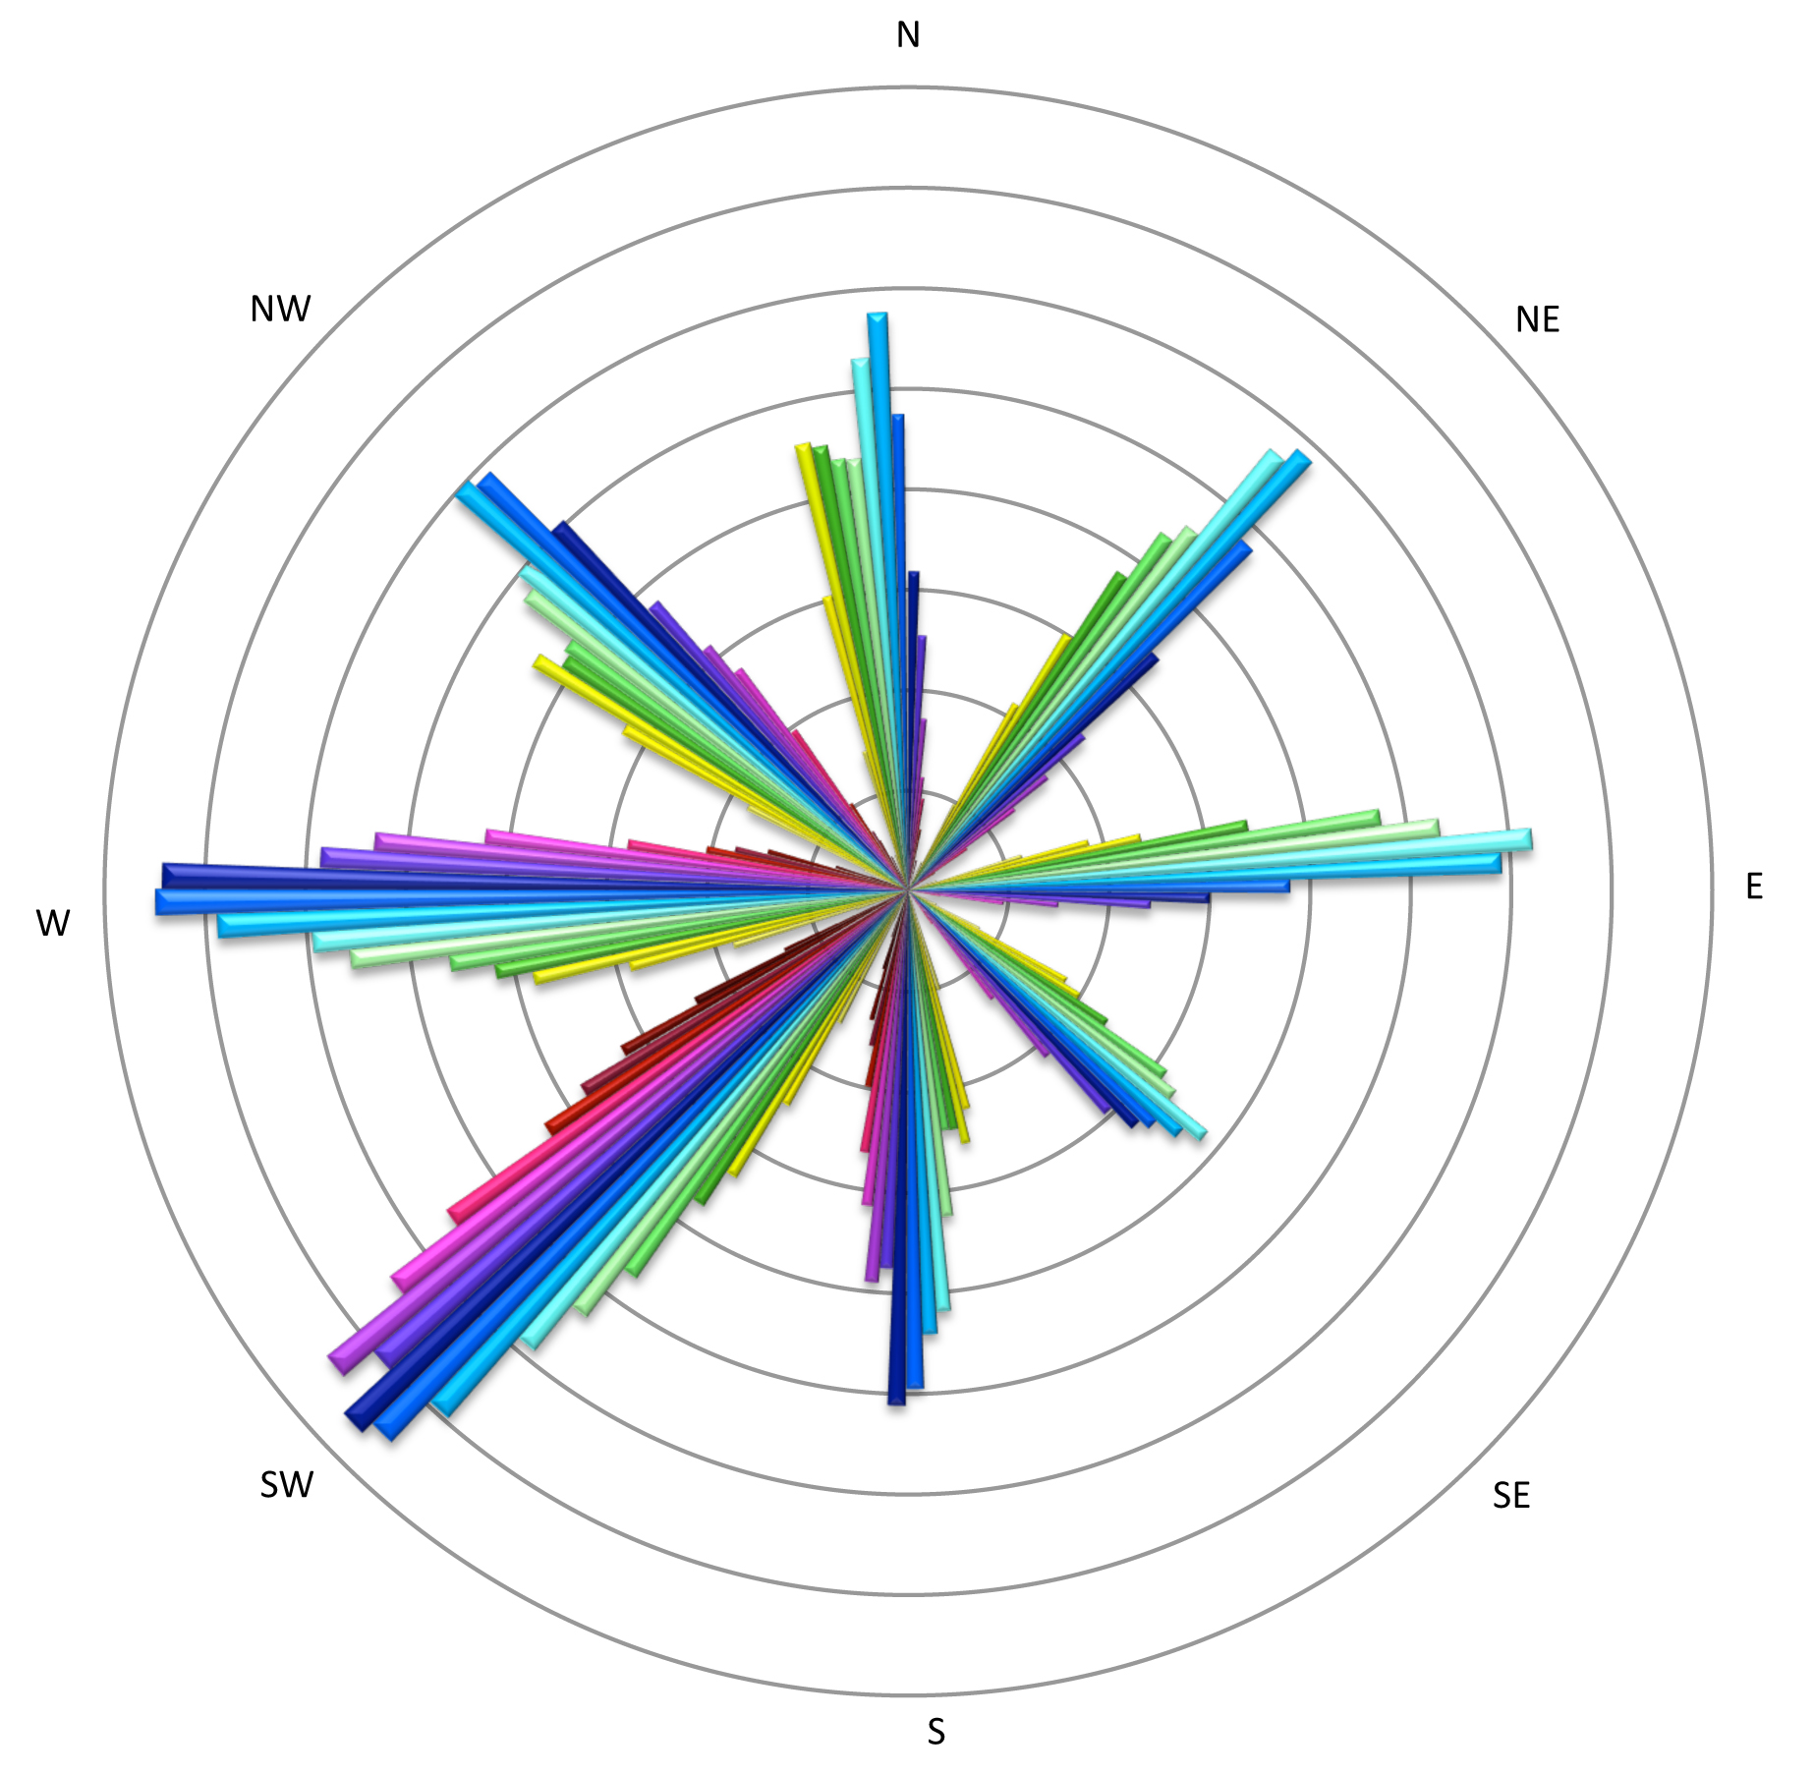
8Winds
A short introduction Jaap ’t Hooft

Slide 2
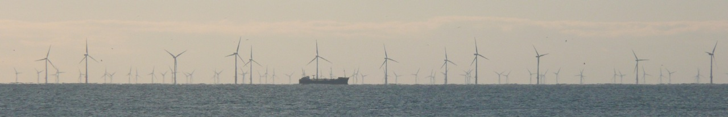
Background
Professional career
Electro-technical engineer (Ing. in 1969)
  Energy conservation (since 1973)
Renewables (since 1973)
Wind (since 1993)

Slide 3
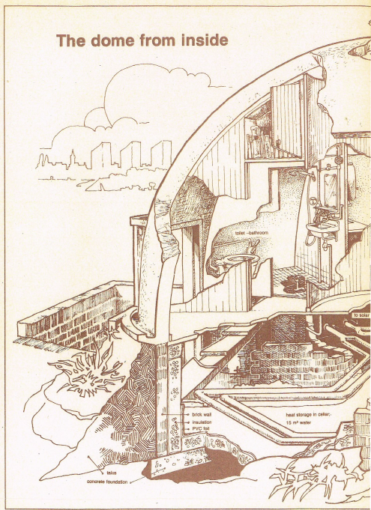
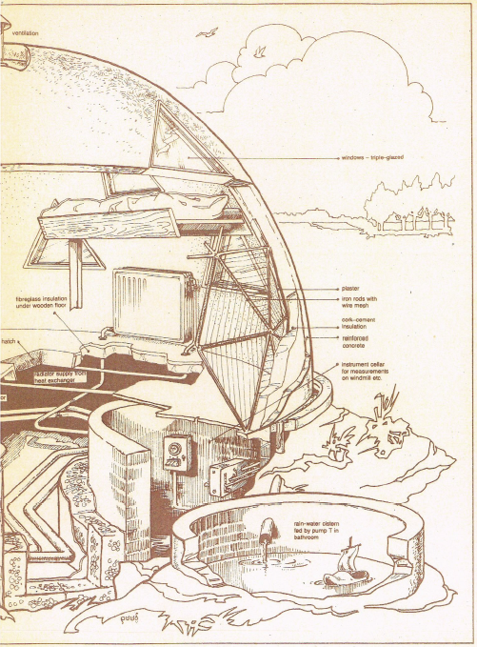
Activities
De Kleine Aarde (The SmalL Earth)
Working with Sietz Leeflang (RT. 1.0 pg 96)
First inhabitant of the Autonomous House

Slide 4
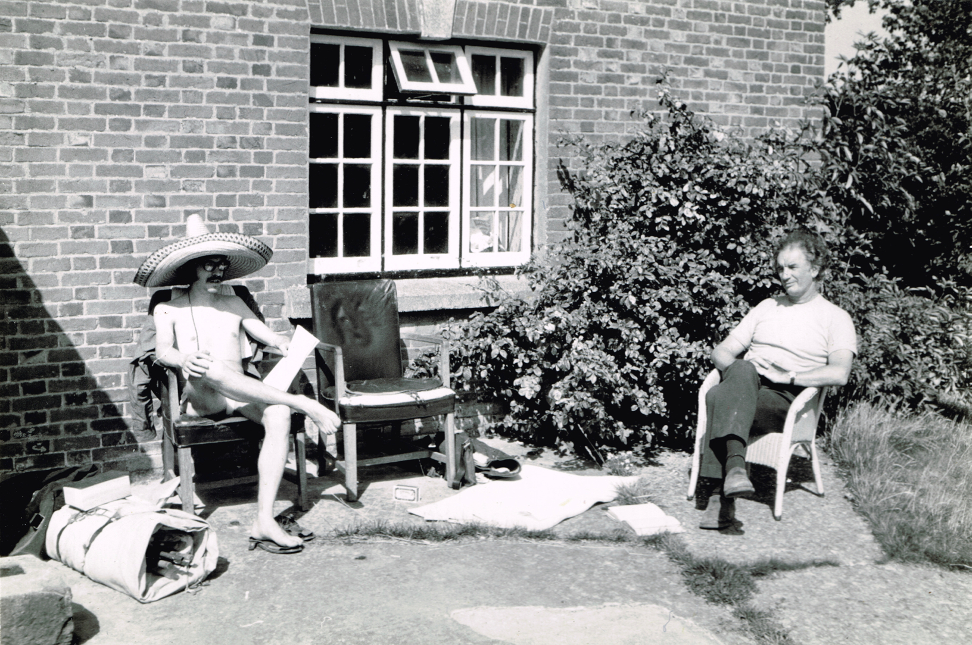
When I first met Godfrey and Peter
1975 Tour of alternatives in UK
Lower Shaw Farm

Slide 5
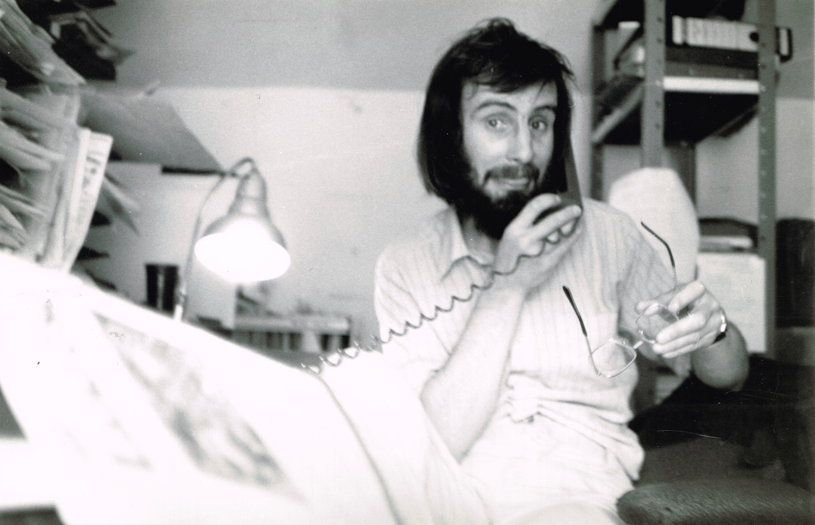
When I first met Godfrey and Peter
Godfrey editing Undercurrents

Slide 6
Experience
Experience between 1973 and 1993 was in energy consultancy and information dissemination on the subjects renewable energy and energy conservation.
Manager of R&D programs in Wind Power R&D with AgentschapNL (and its predecessors SenterNovem and Novem) since 1993.
Advised companies with numerous proposals and evaluated hundreds of proposals.
Reviewed hundreds of scientific reports of R&D projects.
Present independent consultant at 8Winds

Slide 7
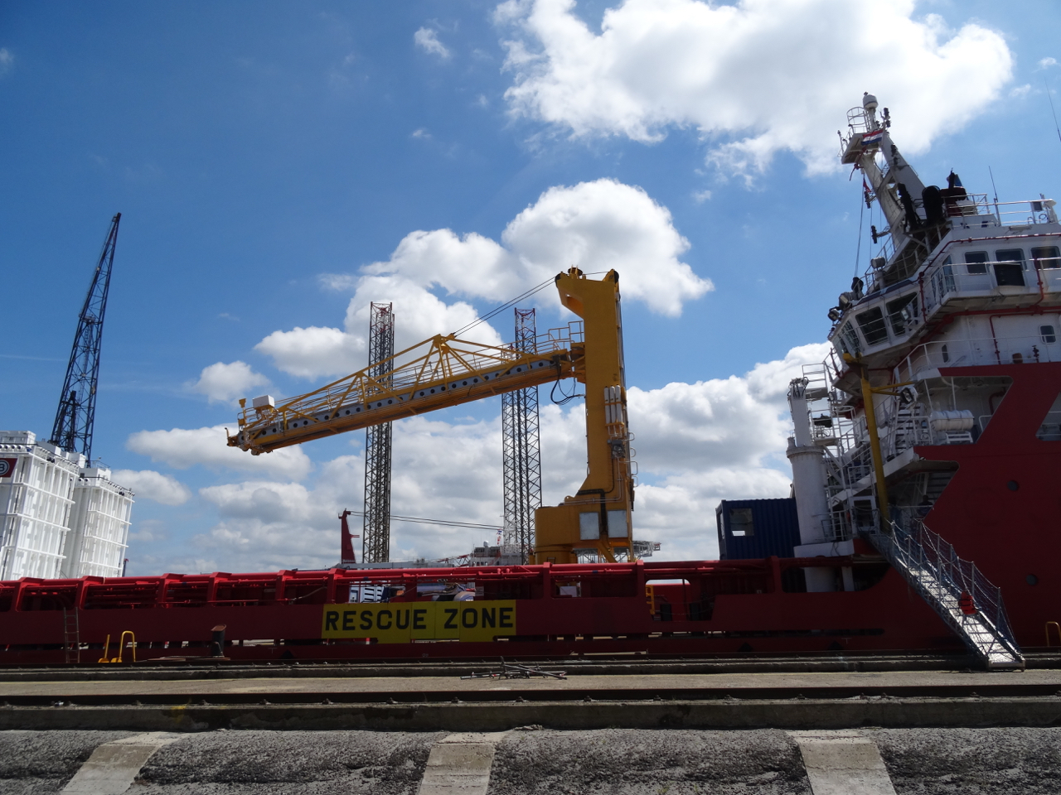
Recent work involved in
Z-Bridge motion compensation to access offshore wind turbines

Slide 8
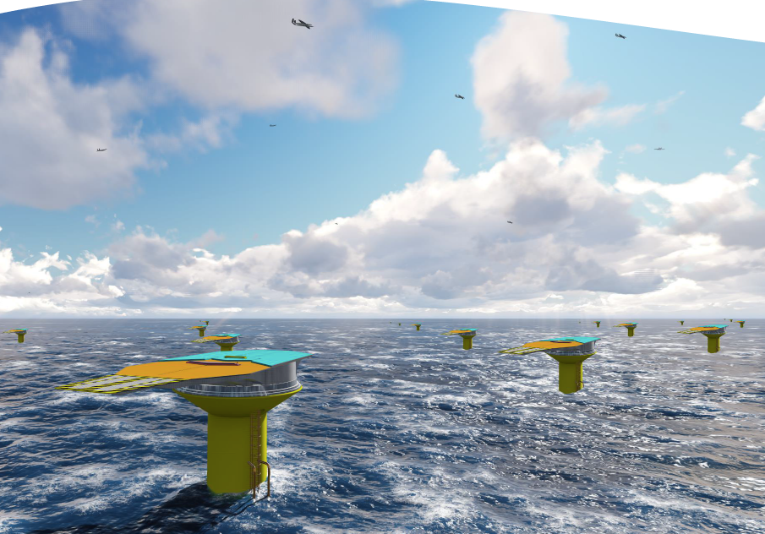
Recent work involved in
Ampyx Power. Offshore Airborne Wind Farm Study

Slide 9
Other fascinations
Zero energy housing
See www.urgenda.nl
Also known from suing the Dutch State for neglect of the climate on behalf of citizens.

Slide 10
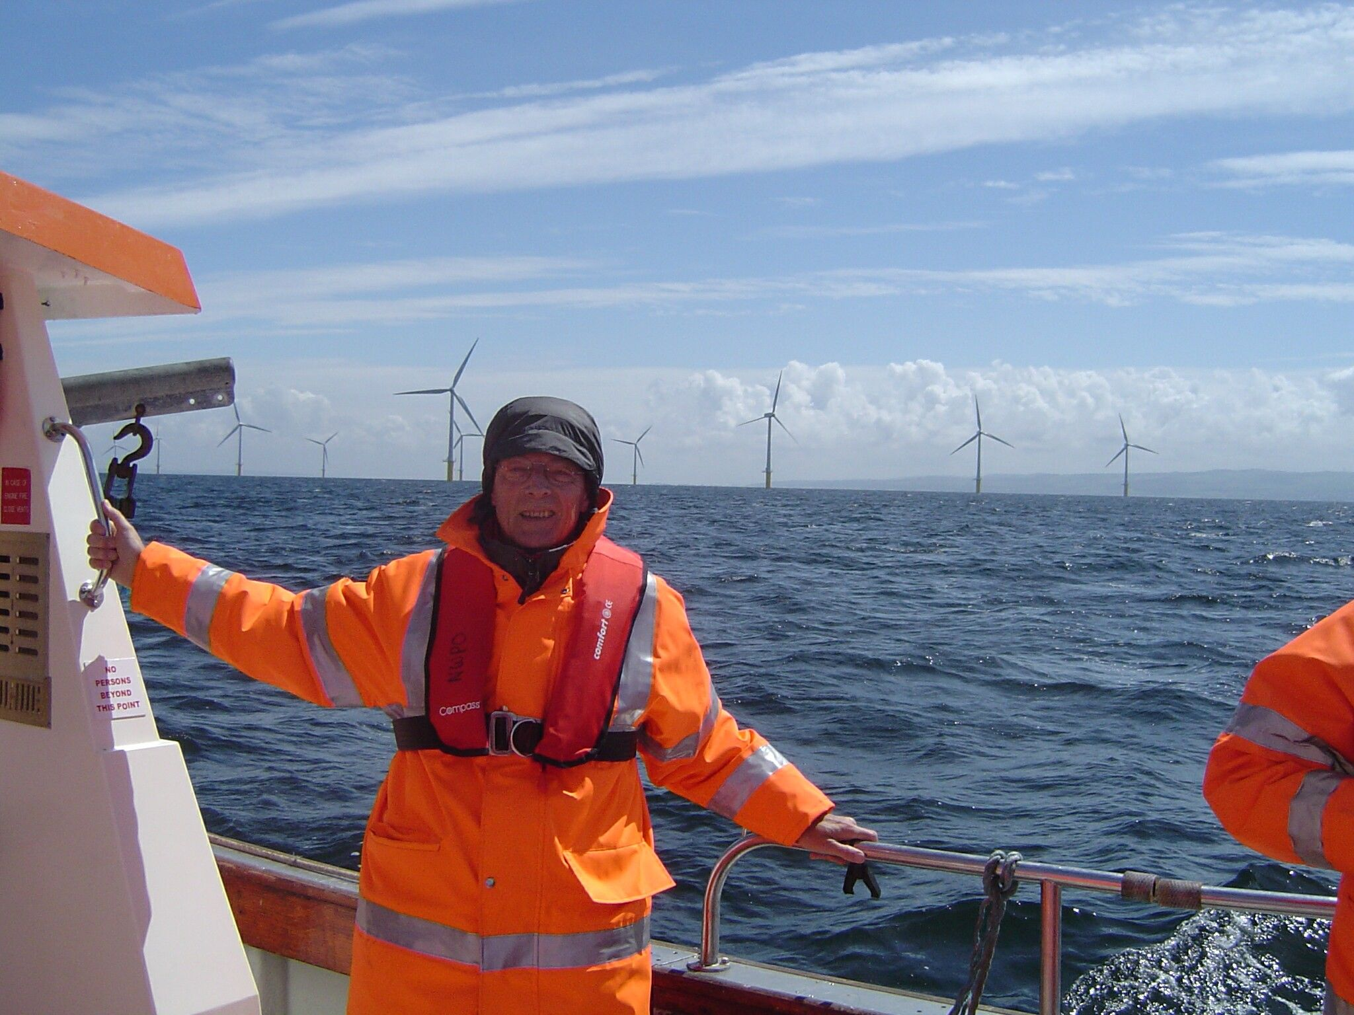
End
See also http://www.8winds.nl/experience.html

