Slide 1
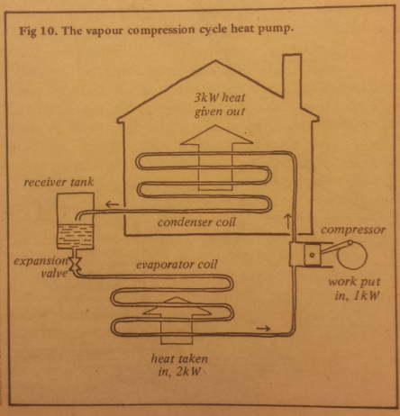
Radical Technology 40 Years On
Bristol.
Heat
Pumps
John Cantor
www.heatpumps.co.uk
Notes:
Hello, I am John Cantor

Slide 2
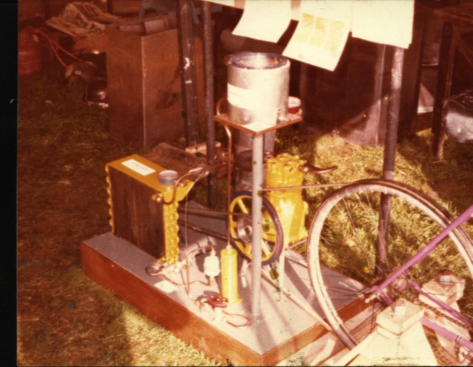
1979 Comtec festival Milton Keynes.
A cycle-powered demo of the heat pump principle.
Notes:
Very brief –
What I have been doing. Working with OEM. Why? Need to monitor what is happening.
Need to be a geek! Steep learning curve.
this is the sort of thing available on a website for analysis by home owner and installer.
Temperature graphs, power, daily kWh block graphs etc

Slide 3
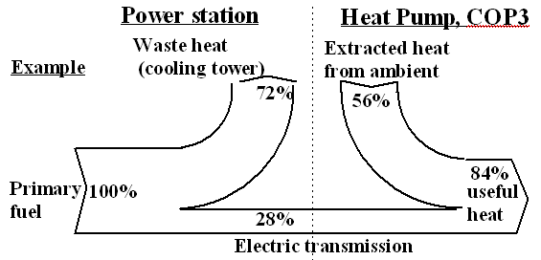
The situation 35 years ago

Slide 4
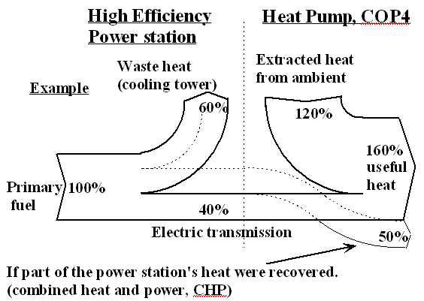
Best technology now

Slide 5
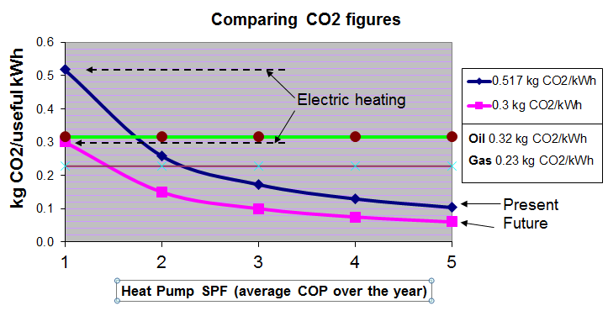
CO2 figures for heat pumps v oil and gas
Notes:
What can we glean

Slide 6
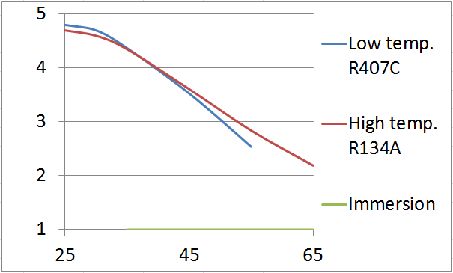

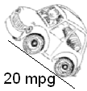
Operating the system at its best efficiency
Energy efficiency v Output temperature
COP
Degrees C
Notes:
Energy efficiency (COP) is dependant on output temperatures. Here showing typical heat pump.
In region around 35C, like driving up slight incline.. 50mpg
Up around 55C or higher, its like a steep incline… in low gear, maybe 20 mpg

Slide 7
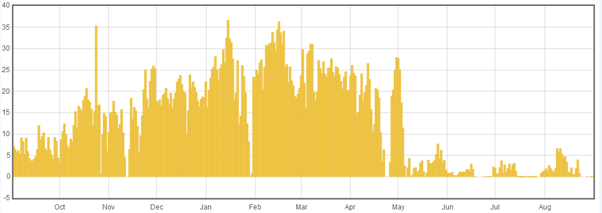
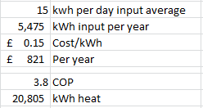
Power input of 5kW Ecodan ASHP– 1 years data
Average input
15 kWh/day
BUT significant wood burnt
DHW heated by gas
Heating back-up by gas
Total gas 20,000 kWh

Slide 8

John Cantor
www.heatpumps.co.uk
https://openenergymonitor.org/emon/
https://heatpumpmonitor.org/
http://johncantorheatpumps.blogspot.co.uk/
Author
Heat Pumps for the Home
(Gavin Harper)
(Crowood press)
Notes:
Brief intro, Hello, I am John Cantor
Background mechanical engineering and refrigeration.
First installed heat pumps in 1979 at BRE Watford.
Designed various one-off from component parts.
Author of ‘Heat Pumps for the Home’
Currently bit of consultancy and energy monitoring.

Slide 9

Available equipment
Sales hype!!
On a Hot Day Our Heat Pump can produce
the equivalent of a Solar Panel running for
24 Hours in just 12 minutes.
Can deliver COPs over 5
so for every 1 KW paid for the unit
can produce up to 4 KW Free
If you have a desire to use sustainable renewable energy
and you are looking at the options available then
Heat Pumps should be your first consideration.

Slide 10

Why haven't we all got them?
Difficult technology to utilise
When you most need the heat,
they are at their least efficient
They require a high-grade power input (electricity)
Notes:
There are lots of interrelated components. All have to operate within certain limits, there are potential pitfalls. Furthermore, the building type, and the way the system is used affects the system’s efficiency. Analogy to sailing boat. Lots of aspects to get right if you want to sail fast. That said (don’t panic), not necessarily hard to configure a good system.

Slide 11
Do they work??
Well established technology based on refrigeration principle
Basic operation not changed in 40 years
Yes they work, but are not always appropriate
They are NOT free to run – require energy input
Their efficiency and effectiveness can vary greatly
Notes:
Intro of what I will cover in the next 15 mins
Ask audience – who lives with heat pump heating system?
Who is involved with installation and design?

Slide 12
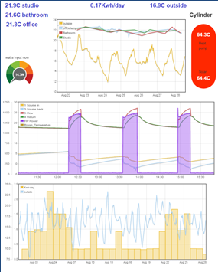
What is Monitoring
Collect operational data
Operating temperatures
Power consumption
Heat output
Display on a website
Notes:
What is energy monitoring?
Very brief overview

Slide 13
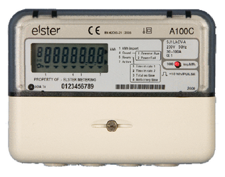
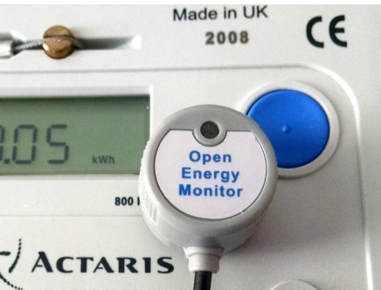
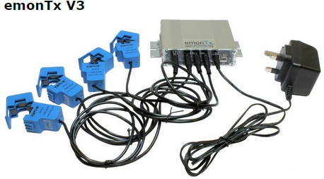
1) Electrical power input
Pulse
measurement
CT clamps
With
Voltage
sensing
Notes:
Very brief, power.
Pulse meter, CT clamps

Slide 14
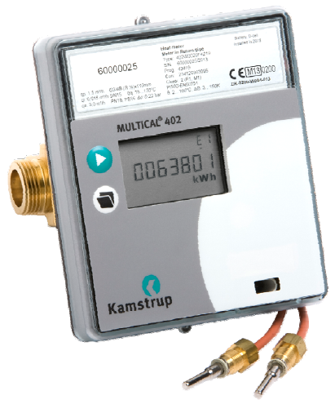
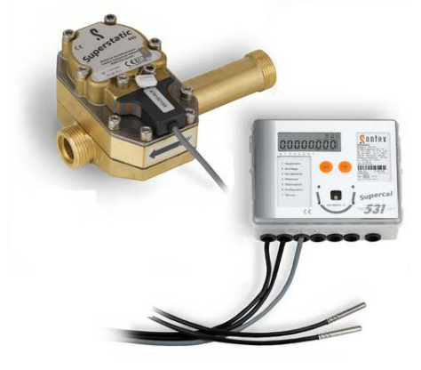
3) Heat output
Heat Meters
Water (glycol) flow rate
& temperature difference
Sontex
Kamstrup
Notes:
Standard Class2 heat meters. Data take off.

Slide 15
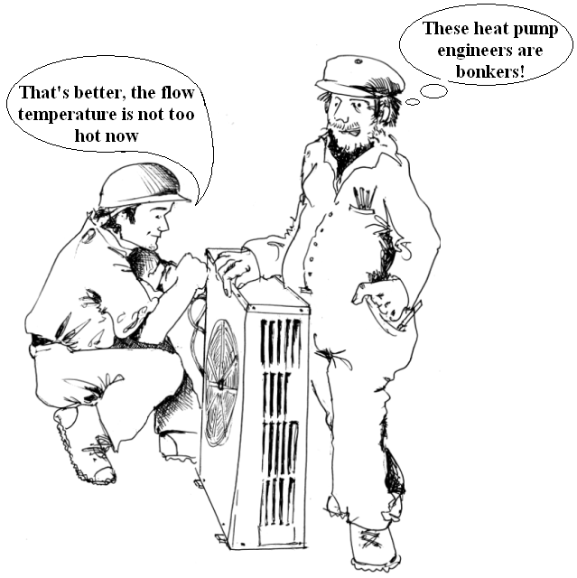
Lower water temperatures improve energy efficiency
Notes:
Heat pump technology is, at first sight, counter intuitive.
Here we have a young keep enlightened engineer saying something that baffles an old-school plumber.
The older engineer only knows ‘hot is good’.
Younger engineer knows implications of output temperature.

Slide 16
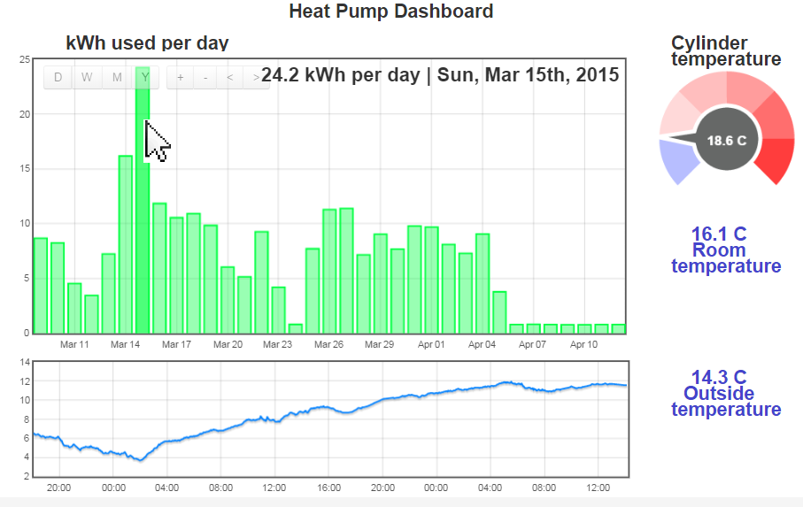
Simple dashboard for home owner
Notes:
What can we (or the home owner) learn?
Daily consumption/daily running cost. Alert high energy use. Is system running as expected? As normal?
Compare year on year.

