Slide 1
Radical Technology 3.0 vision
What technology mix did we use?
What social, cultural and political shift enabled it to happen?
Potential co-benefits?
What is life like once completed?
Back-cast a timeline to 2016

Slide 2
Key criteria
Maintain ‘Modernity’
Maximise positive co-benefits
Use only existing technologies
Carbon, plus other planetary boundaries

Slide 3


A rapid transition scenario

Slide 4
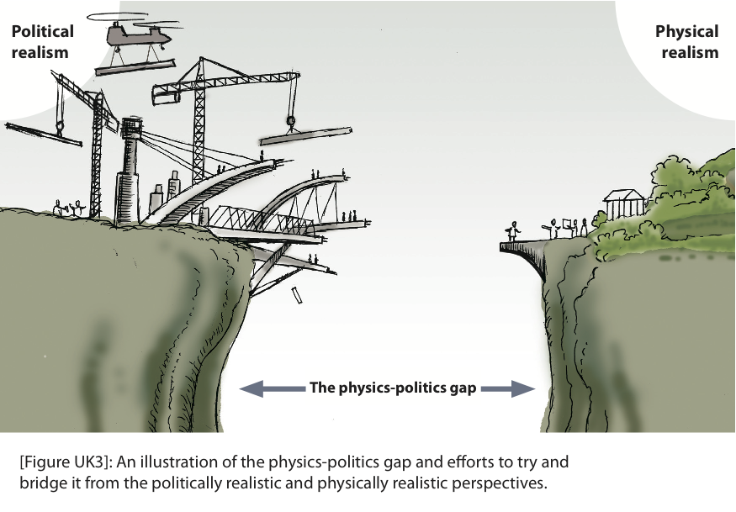
- but there’s a Catch-22
Notes:
There is a clear gap between what the physics demands and what is ‘politically acceptable’.
ZCB aims to build conversations which cross this chasm

Slide 5
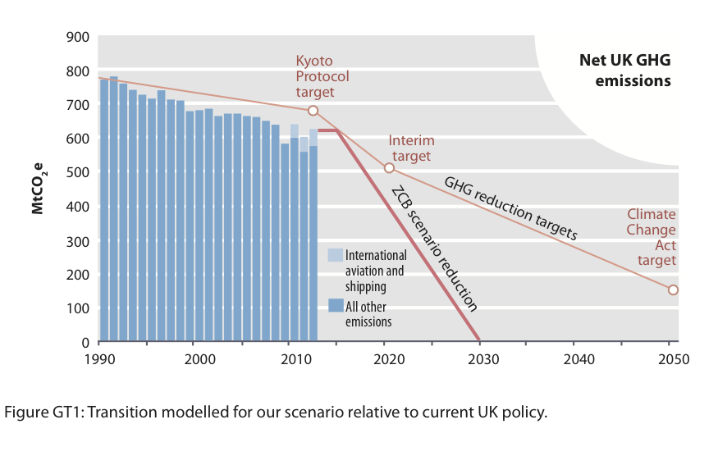
Roadmap to where we need to be
Notes:
We estimate a couple of decades are needed

Slide 6
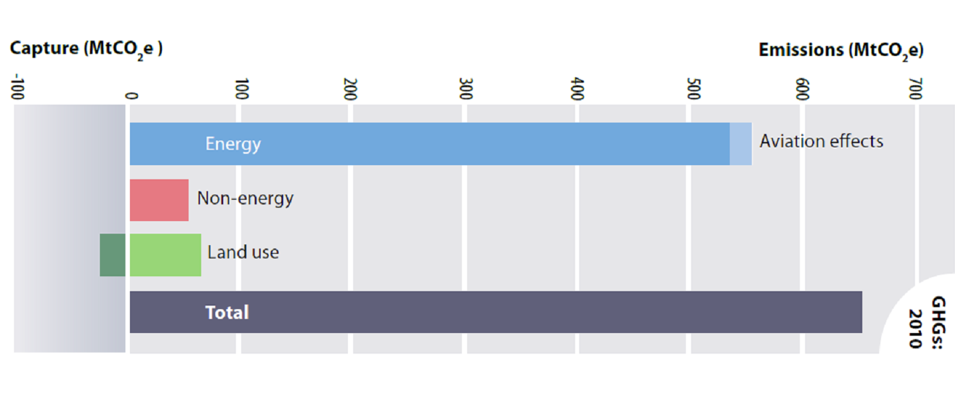
UK GHG emissions today
Notes:
To re-think the future , you have to know where you are now

Slide 7
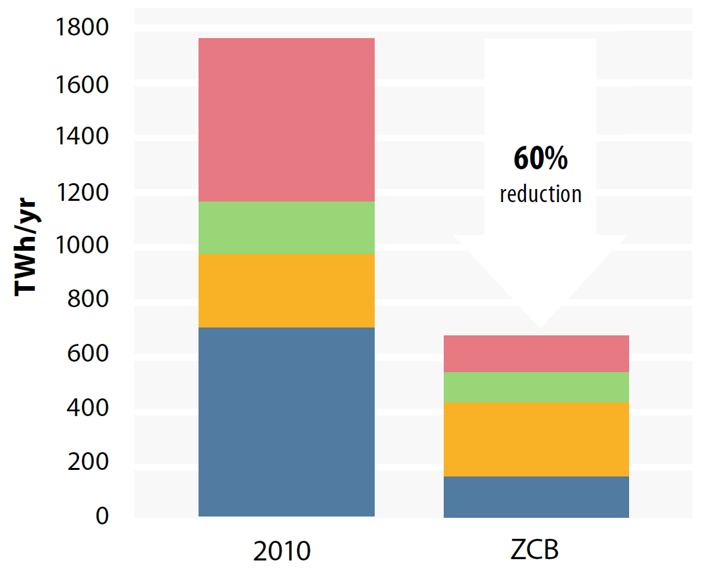
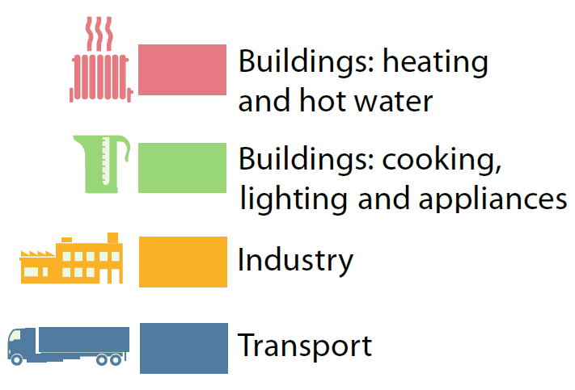
Powerdown
60% from present extreme energy normality
Notes:
Once we see todays strange normality as the energy extreme lifestyle that it actually is, Powering down from it seems a logical reaction
But it means re-shaping key parts of the physical landscape for C21st

Slide 8
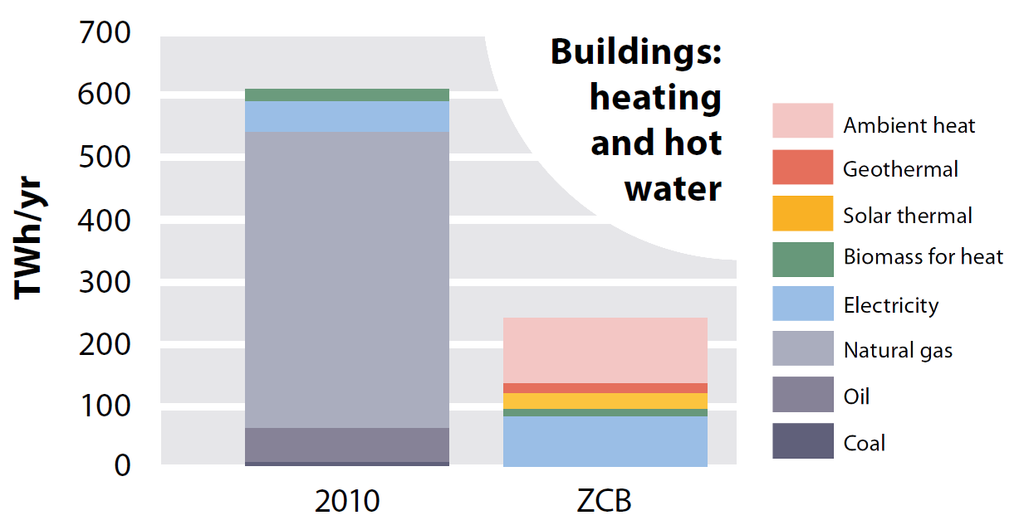
- 60%
From:
Notes:
But in terms of our buildings, we can make massive changes – reducing our demand for heating by about 60%. (it is mainly heating – we keep how much hot water we use the same in the scenario so we can still have hot showers!)

Slide 9
- 40%
- 50%
- 60%
Notes:
And the reason we can do this is that we have such a hideously terrible housing stock currently – poorly insulated and leaky!
So, what we have to do is basically to insulate, fit double glazing, and reduce draughts. So, we make our homes and the places we work more energy efficient, and we’re probably a lot more snug than we are currently.
This last part is ‘better temperature controls’. Instead of heating a whole building, lets control where we heat, and keep it where we need it.

Slide 10
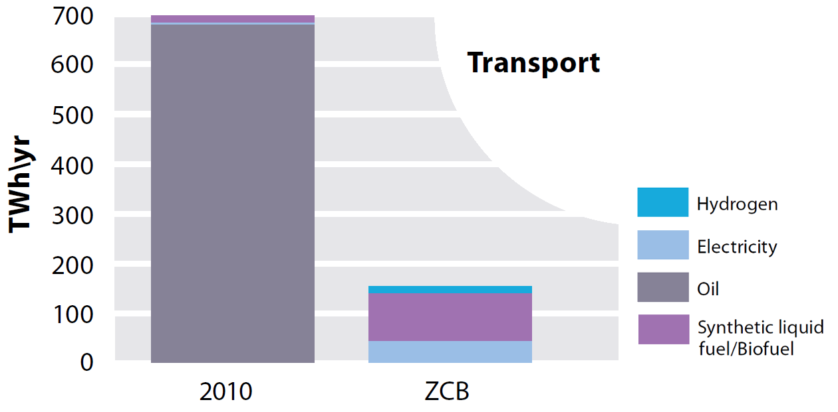
- 78%
Notes:
Transport is another area we can make massive energy savings. And how do we do this?

Slide 11
- 35%
Notes:
Well, in part, we just travel a bit less – perhaps we use teleconferencing and skype a bit more, or we live a little closer to where we work and hang out. We also say that we could travel differently. So, we walk and cycle more – and use public transport more. Although the amount we drive cars is reduced in our future scenario, we still drive a fair amount.

Slide 12
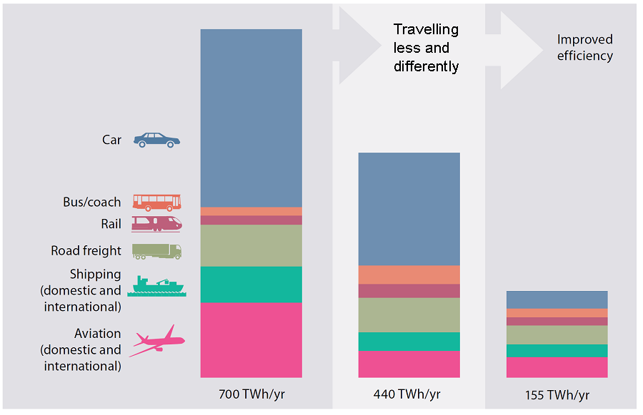
Today
- 35%
- 78%
Notes:
In our scenario we stop domestic aviation. We also have to reduce international flights – by two thirds. a small minirity of ‘frequent flyers’ use so much in the UK that even with this radical reduction, if we shared out all the remaining flights equally among the population, we’d all be able to fly abroad once every few years – and we’d still be able to go on holiday by Eurostar.
So, these kinds of things give us this first portion of energy demand reduction from transport, this 35%. The second part, Basically, Electric cars go about 3 times as far per unit of energy as petrol or diesel cars, which means we need much less energy to power them.

Slide 13
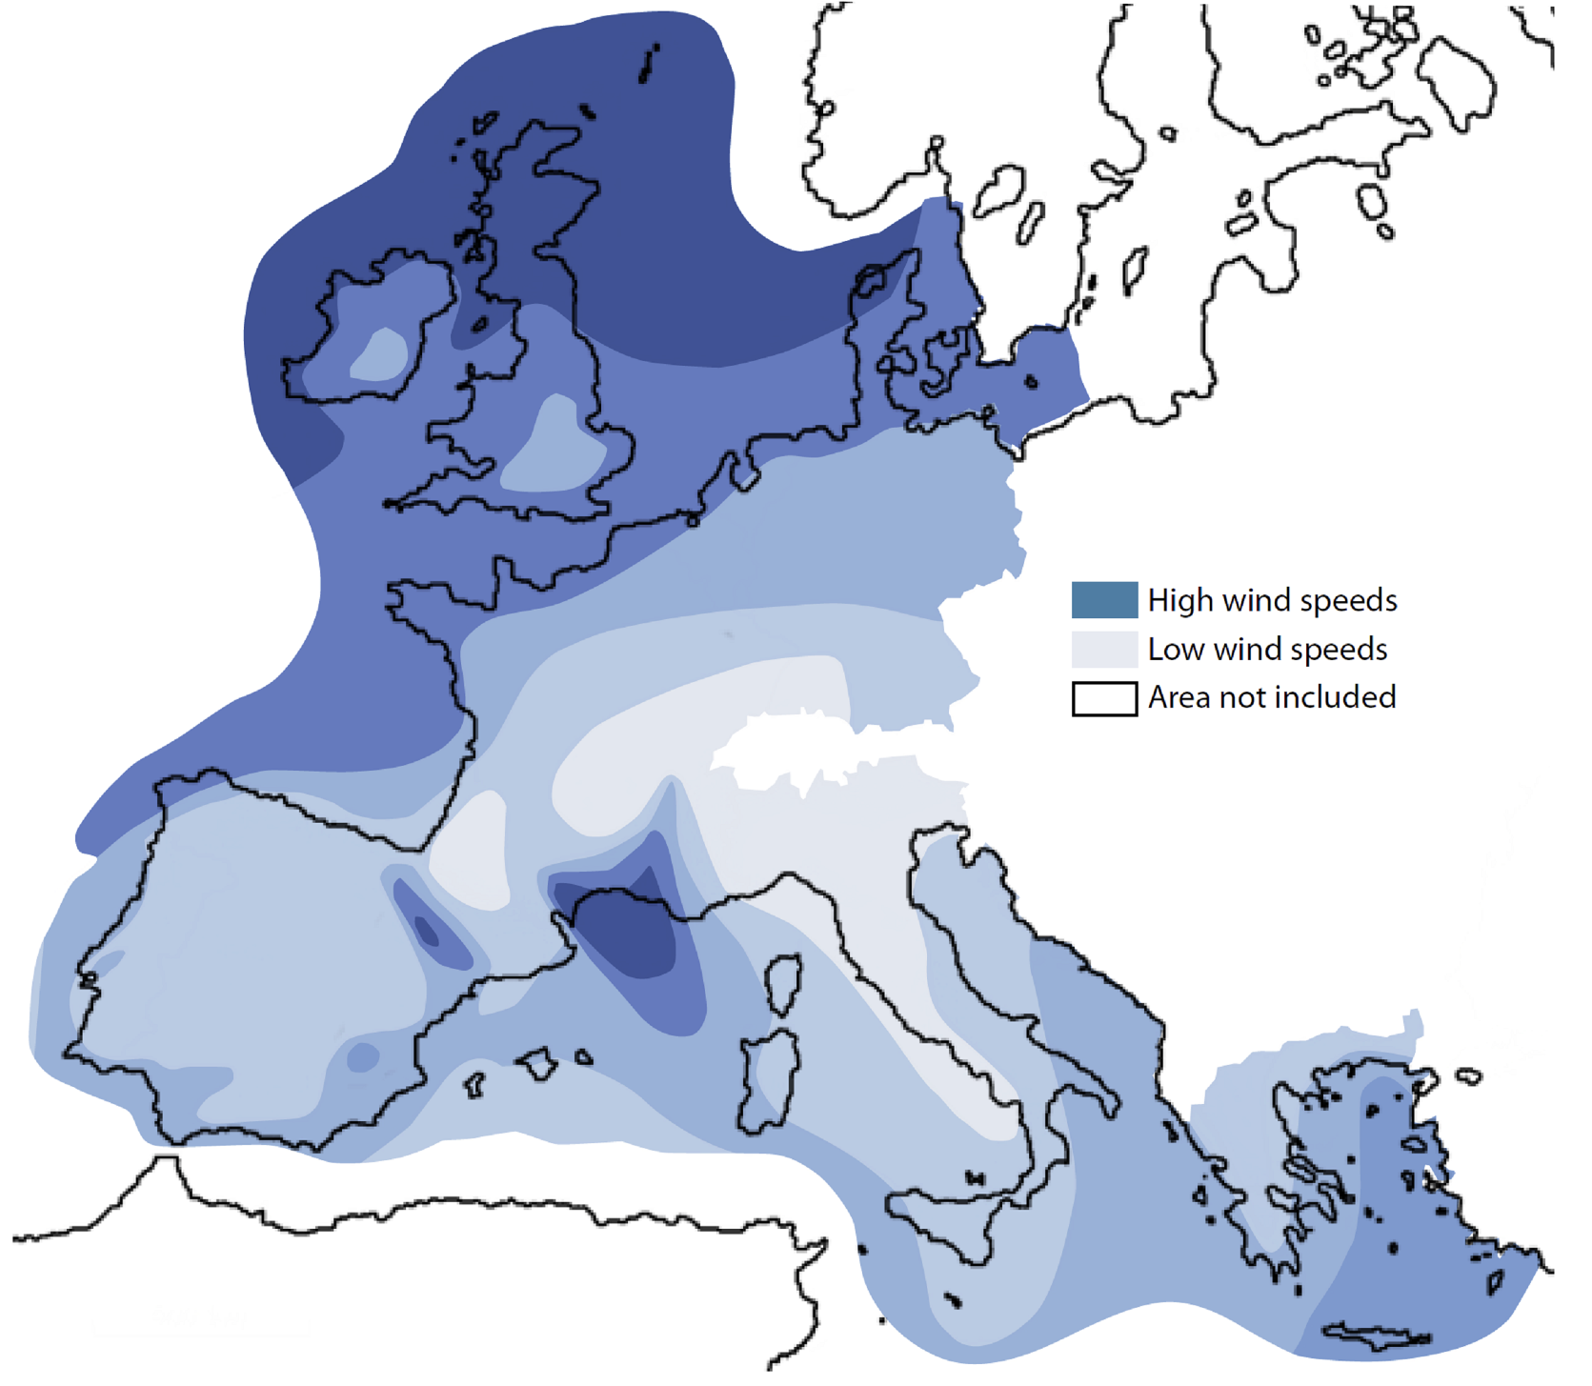
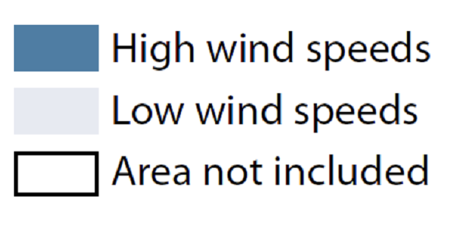
Power up
100%
renewable energy
(no new nuclear).
© Joanna Wright
Notes:
So, that’s half the story – or about 60% of it, I guess, with respect to energy.
The complimentary part is what we call ‘power up’ – producing the energy we still need (which is still a fair amount!).

Slide 14
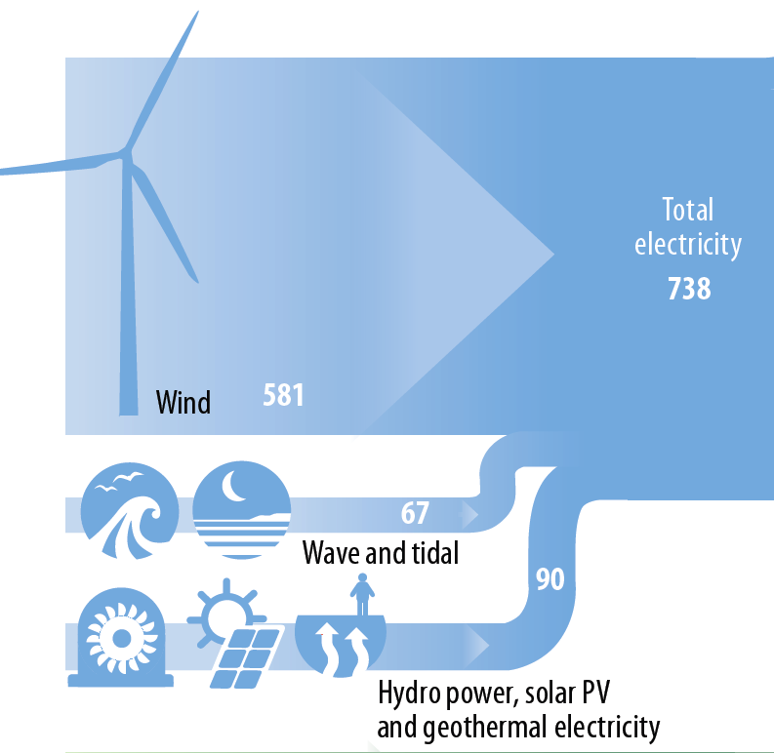
Key Question:
Can we
“keep the lights on”?
Notes:
14
This isn’t totally new, different researchers have come to very similar conclusions.But the big question always is: Can we keep the lights on?
What do we do on a day when the wind doesn’t blow and the sun doesn’t shine? Can we depend on British weather?
14

Slide 15
The ZCB Energy Model:
Based on ten years of
real-world
hourly data
2002 - 2011
87,648 hours
Notes:
15
Yes we can
15

Slide 16
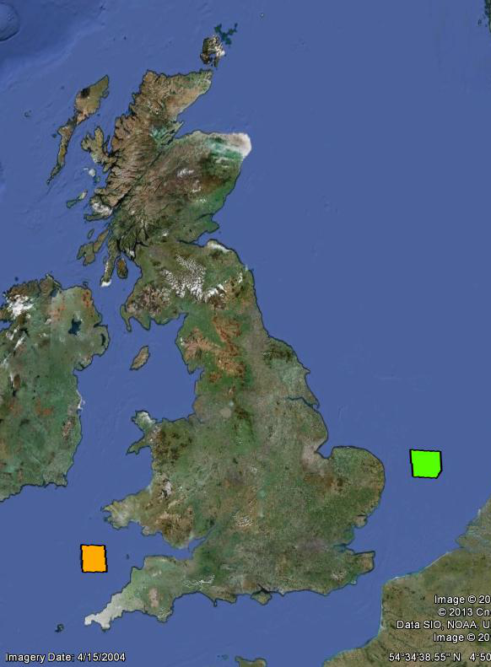
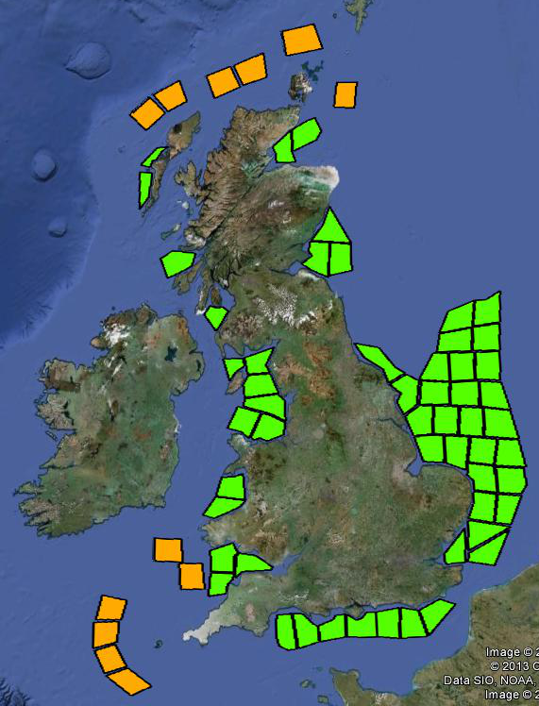
Notes:
16
What we see here are two offshore zones which we assume in our scenario will have some offshore wind turbines in the future.
For each of these zones we have obtained hourly offshore wind speed data for the last 10 years from NASA.
And we’ve used that to simulate how much energy these future wind farms would have produced, hour-by-hour, under the conditions from 2002 to 2010.
And we’ve done that for more than 60 offshore wind power zones.
16

Slide 17
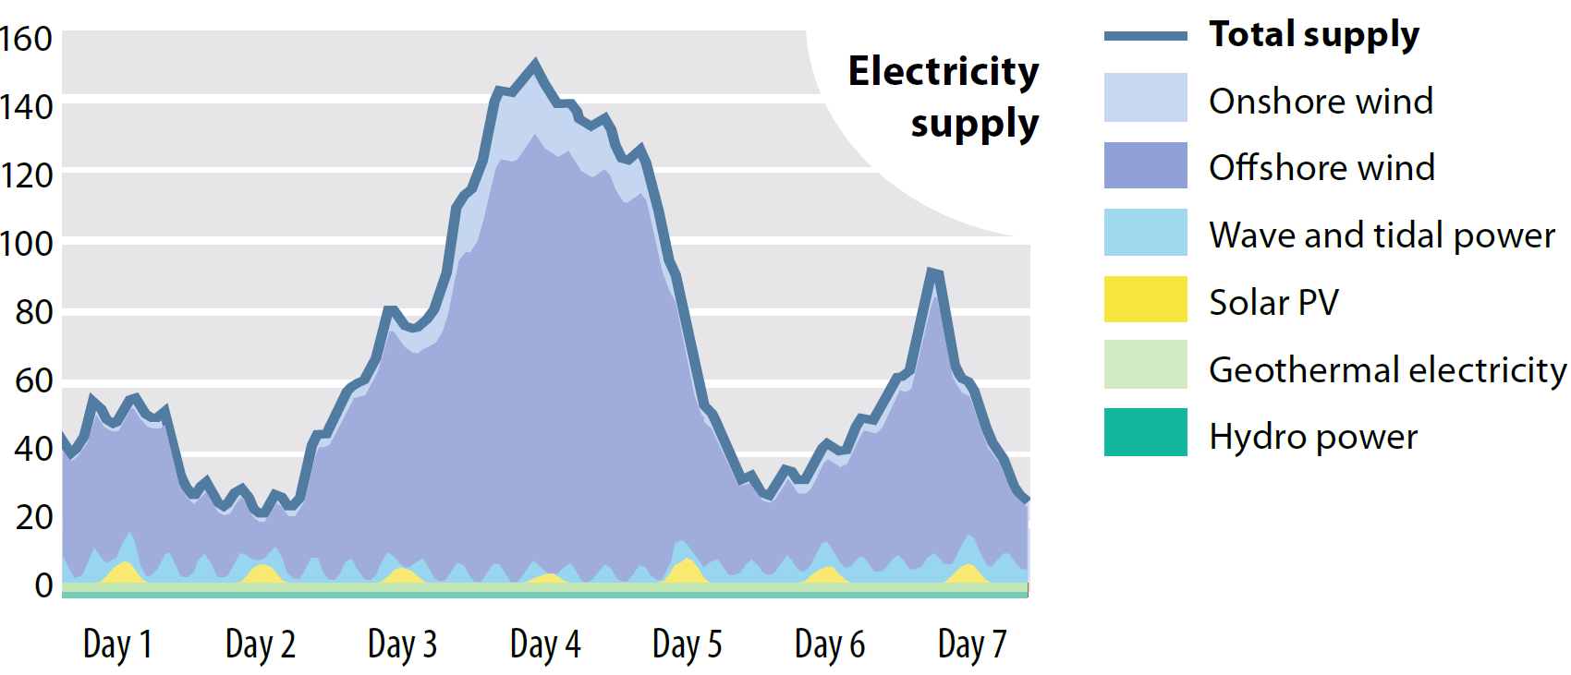
Notes:
17
And we’ve followed a similar approach for onshore wind and solar and wave and tidal and so on, using a wide range of data sources
17

Slide 18
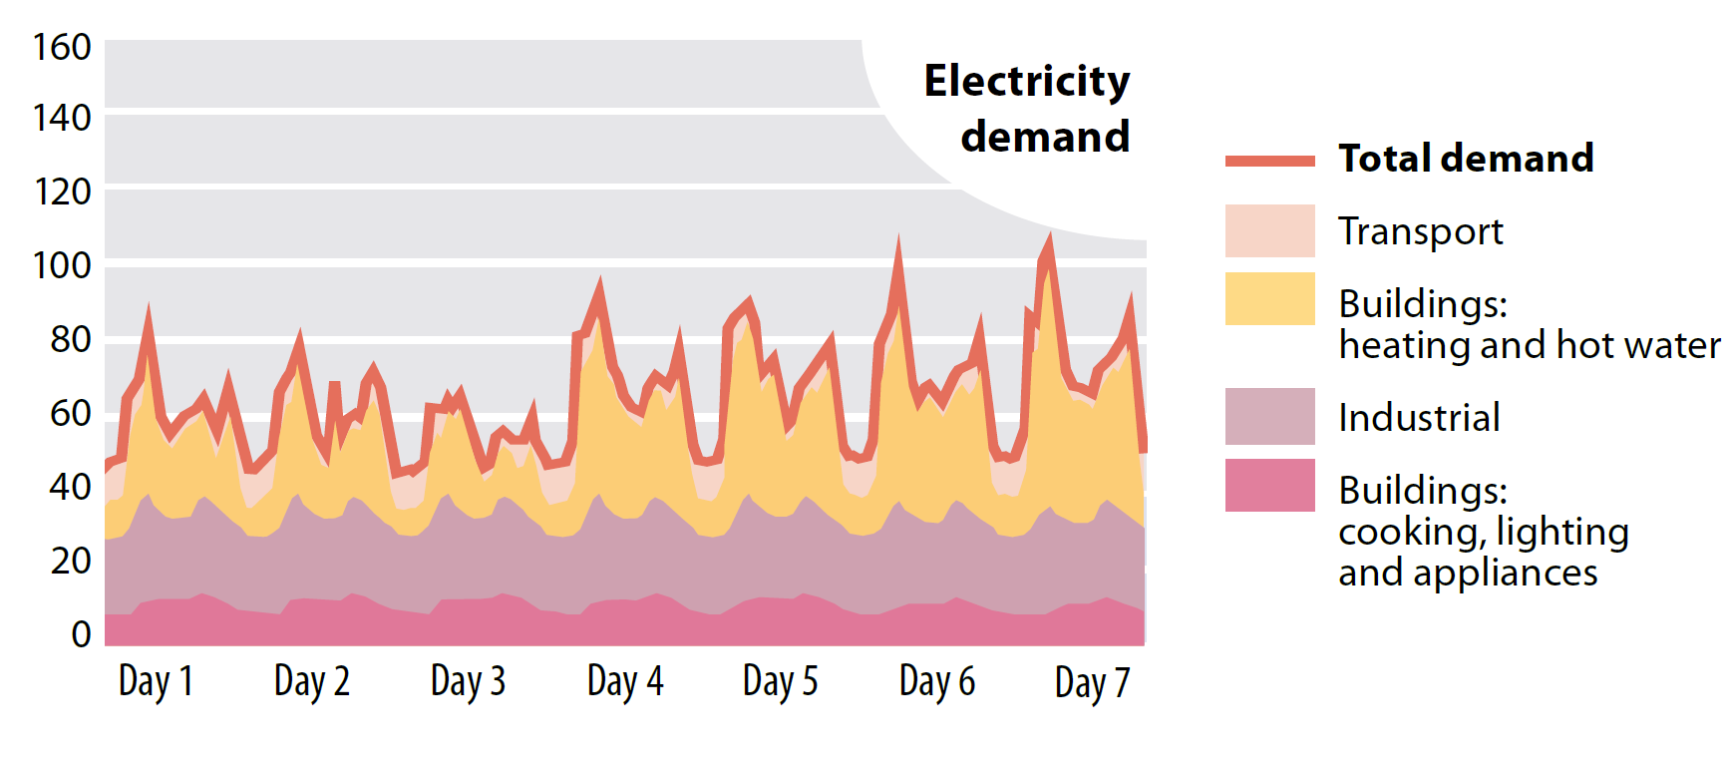
Notes:
18
And then we went and did the same for energy demand. Based on past electricity demand data from National Grid, based on temperature data, based on typical patterns for when we charge electric cars or run industrial processes and so on, we’ve build a hourly model for energy demand, again for all the 88,000 hours.
18

Slide 19
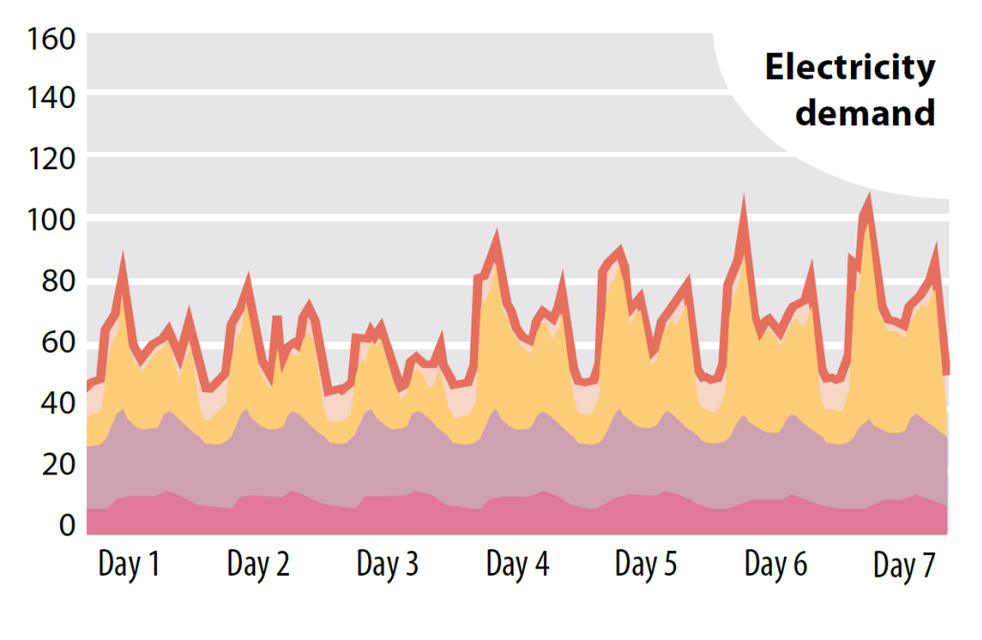
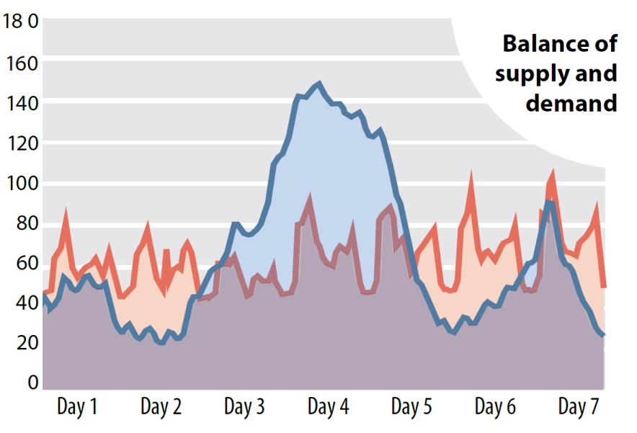
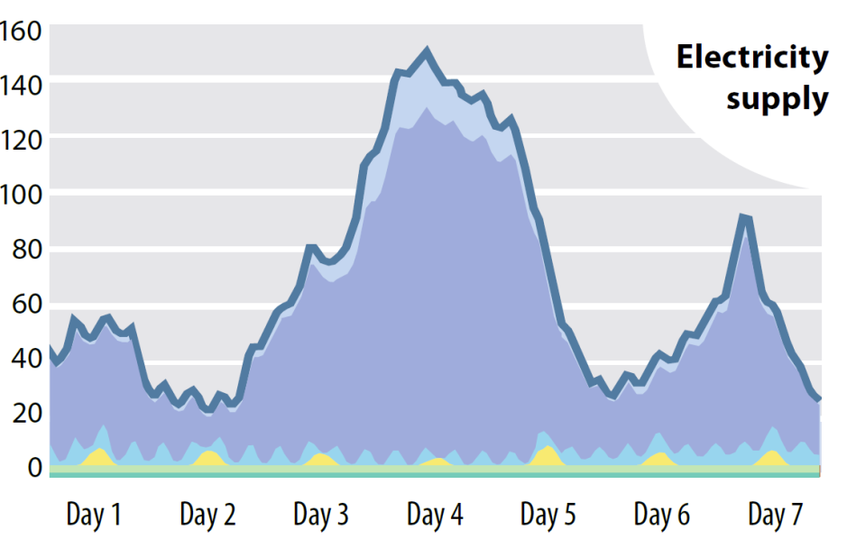
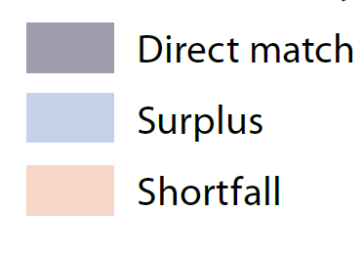
Notes:
19
And that allowed us to see how supply and demand would match, and when there is a shortfall, and when there is a surplus.
And one very important finding is that if you want to go 100% renewable energy then you will have times of shortfall, and you will have times of surplus.
In our scenario we use a wide range of different energy sources, we have our wind farms and solar panels spread across the width and breadth of the UK – and we still have some fairly dramatic fluctuations in the supply/demand balance. But the good news is, we have worked out how to deal with them!
19

Slide 20

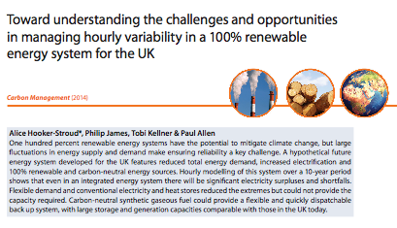
ZCB Scenario demonstrates
82% of the time, the supply of renewable electricity exceeds demand (including electricity for heating and transport).
However, 18% of the time, electricity supply does not fully meet demand.
Short-term storage & ‘shifting’ demand can reduce this from 18% to 15%.
Biogas and carbon neutral synthetic gas are burned in gas power stations to cover this.
Management of supply and demand with a 100% renewable energy system is possible with existing technology

Slide 21
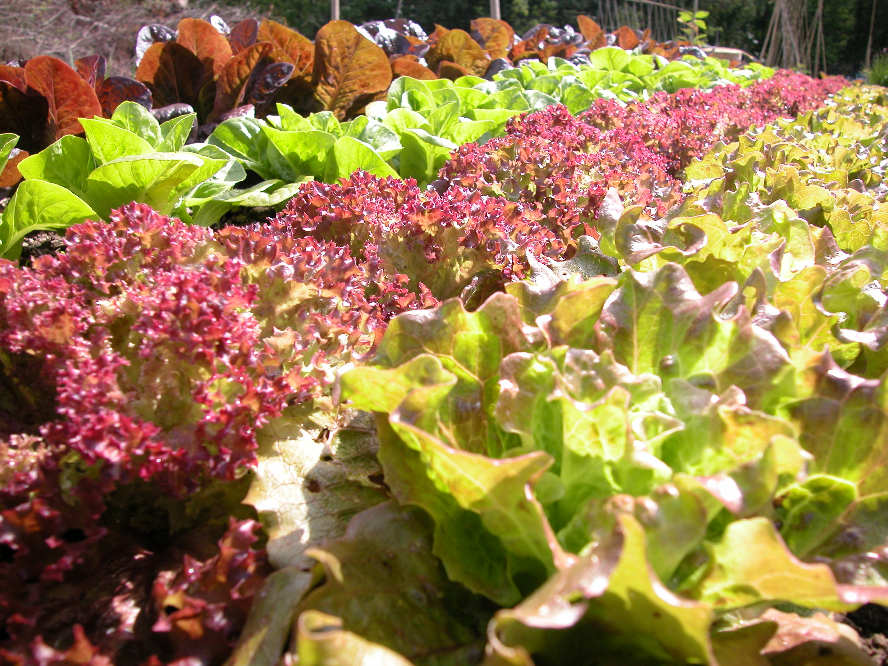
Land use
© All rights reserved by Centre for Alternative Technology
Notes:
So, that’s the energy story. But it links us to the way we use land.
Not only do we need to look at our land use because agriculture in the UK is responsible for about 10% of emissions in the UK, but we also need some biomass – trees, grasses etc – for our energy system. But first, food. We need to eat.

Slide 22

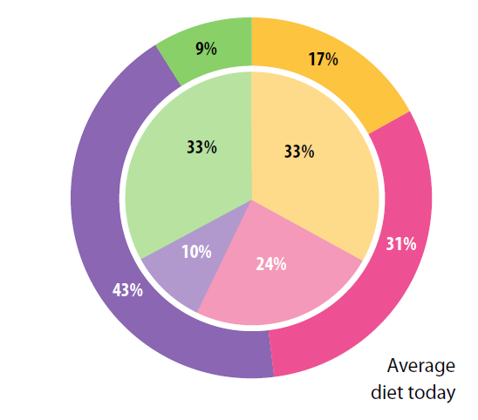
Current average UK diet
  64% of adults overweight/obese (Bates et al, 2011).
  71% of deaths in 2010 from diet- related disease (WHO, 2013).
Too much food.
An unhealthy balance.
  Too much HFSS and high protein foods.
  Too little fruit, vegetables and cereals.
Waste (30% in Europe (FAO, 2011)).
Notes:
our diets here in the UK are actually have a bad effect on us because we eat too much and the wrong balance of foods. the central circle shows us what we should be eating – the recommended portions of ‘starchy foods’ (potatoes, bread, cereals etc) [yellow]; high protein foods (meat, dairy, lentils, nuts, beans) [pink]; foods high in saturated fats, salts and sugars – HFSS foods (cake, biscuits, fried food) [purple]; and fruit and veg [green].
The outer circle shows the proportions of what we actually eat and drink today in the UK. Too many foods high in saturated fats, salts and sugars; more high protein foods than we need, and we completely under-eat starchy foods and fruit and veg. You understand why the government are keen on the ‘5-a-day’
Finally, we waste a lot of food. Whilst this doesn’t have an impact on our diet, it does mean we put unnecessary pressure on our food production systems – on our agriculture. And it contributes to the greenhouse gas emissions from agriculture as a result.
This figure – 30% is the amount of food produced in Europe that is wasted. About half of this we waste in our homes. Most of this food is fit for eating. It might be, for example, that supermarkets are only willing to buy apples that ‘look nice’ so that we’ll buy them. All the ones that are a bit wonky, or are too big or too small are thrown away.
Just look at how regular all the fruit and veg in the supermarket is next time you go – do you think everything naturally grows the same size and shape?

Slide 23
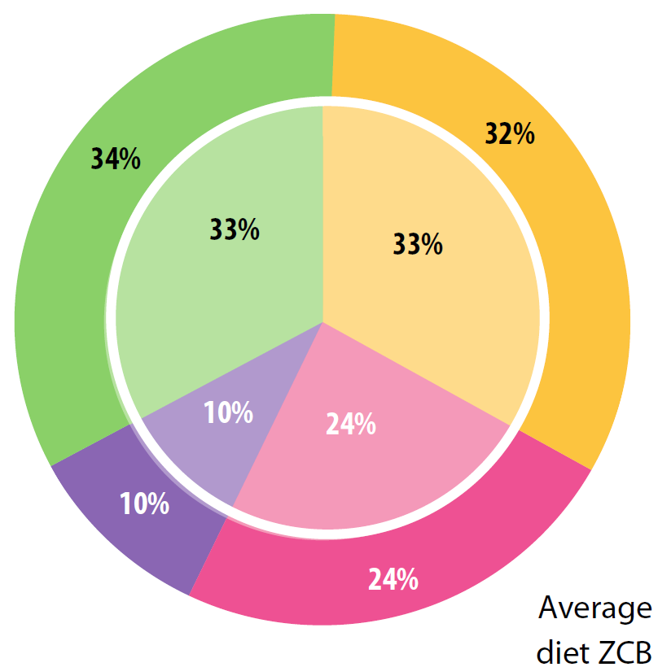
Notes:
So, the diet we design in ZCB is healthier, and much more balanced. The inside circles here represent the food group balance we should have, and the outer circles today’s average diet (left), and the diet we suggest in ZCB on the right.

Slide 24
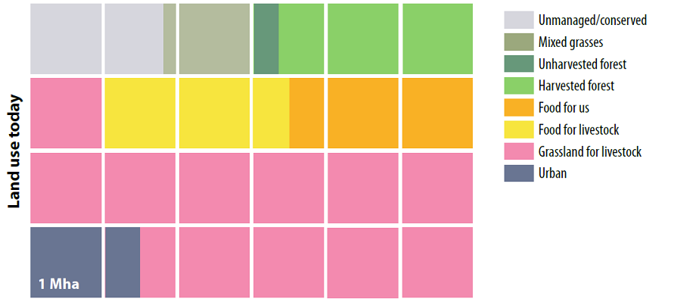
Notes:
So, in ZCB we have moved from land use that looks like the diagram above, to the one shown in the diagram below.

Slide 25
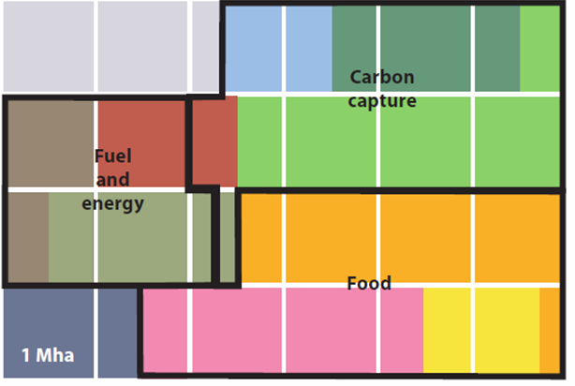
Notes:
We can actually provide almost everything we need on UK land, despite having a relatively small area compared to our population.
We end up with about a 1/3 dedicated to food production; 1/3 dedicated to carbon capture; and about 17% dedicated to energy/fuel.

Slide 26
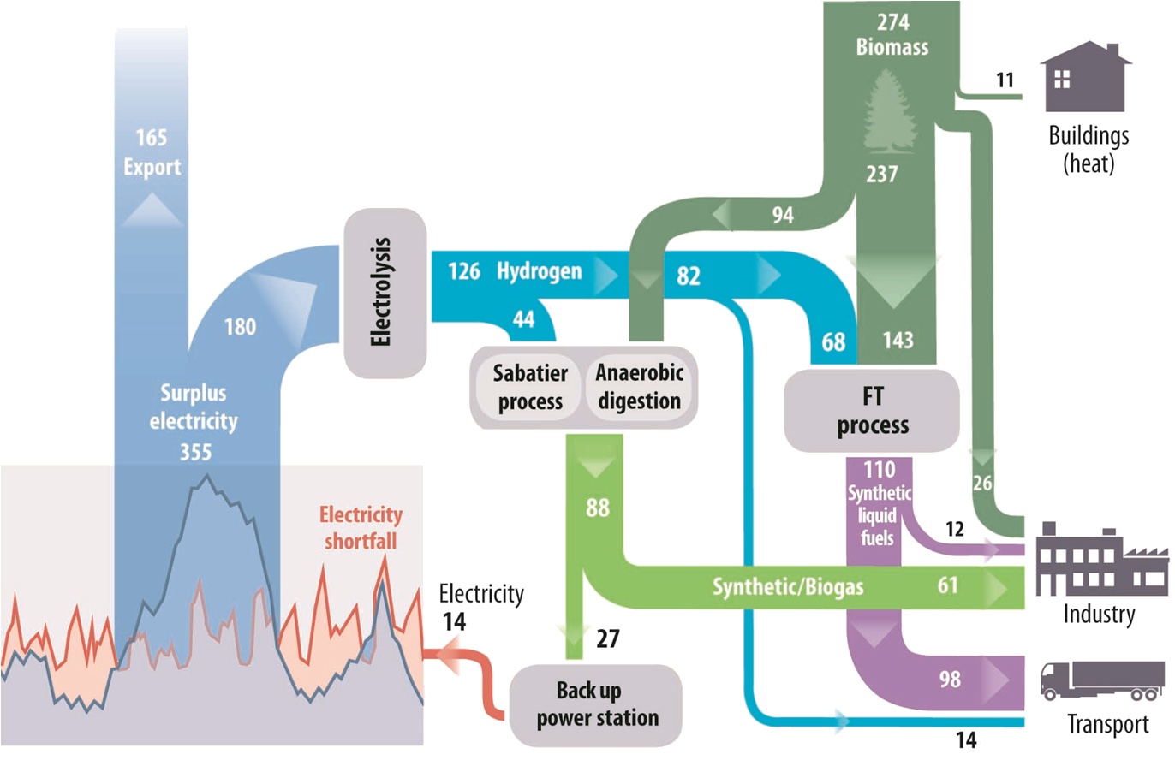
Synthetic gas storage
= Demand met 100% of time
Notes:
What this shows it that we can use the surplus electricity we produce (when demand is low, and supply is high), to create hydrogen through electrolysis (splitting water – H2O, into Hs and Os), and then combine this hydrogen with carbon from biomass (trees, grasses, some waste streams from agriculture). This combination of hydrogen and carbon creates synthetic liquid fuel and synthetic gas – hydrocarbons much like the fossil fuels we have today, but carbon neutral because the electricity is renewably produced, and the biomass is sustainably sourced (we plant it after we have cut it down).And these synthetic fuels are really useful – they are! We can use them for some parts of industry and transport that can’t be electrified – those planes for example. We don’t currently have the technology to make electric planes.
But a very small amount of the synthetic gas goes into back up power stations – much like the gas power stations we have today, but more responsive – we can turn them on and off quickly. These power stations exist elsewhere in the world currently.So, when we need extra energy, we turn on these back-up power stations to produce electricity. Which means that with this flexible storage and back-up system, we meet our energy demands 100 of the time.

Slide 27
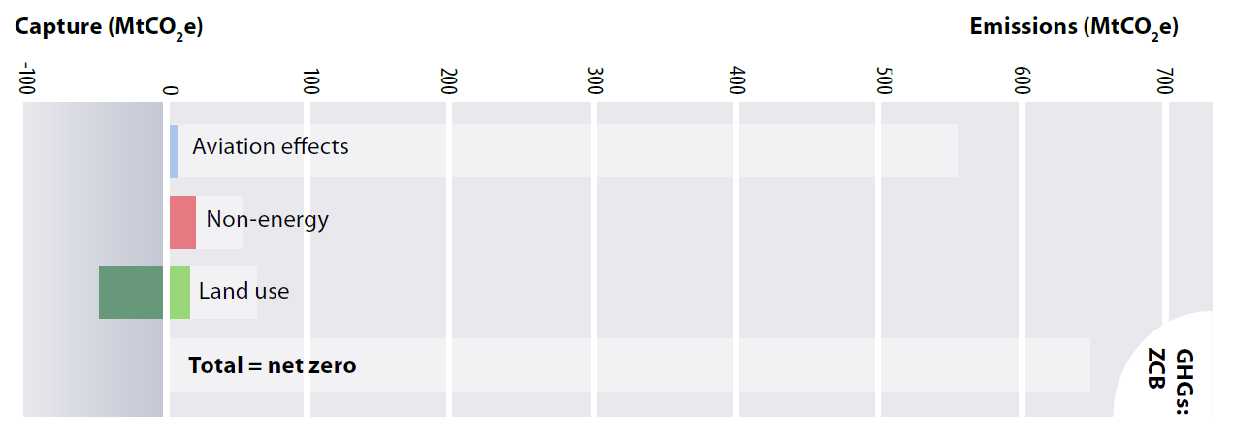
Net zero is achievable
Notes:
Once energy has been reduced, and non energy and land greatly reduced it becomes possible to balance out the residual emissions with natural net negative processes - and so reaching zero emissions

Slide 28
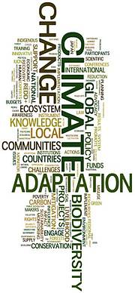
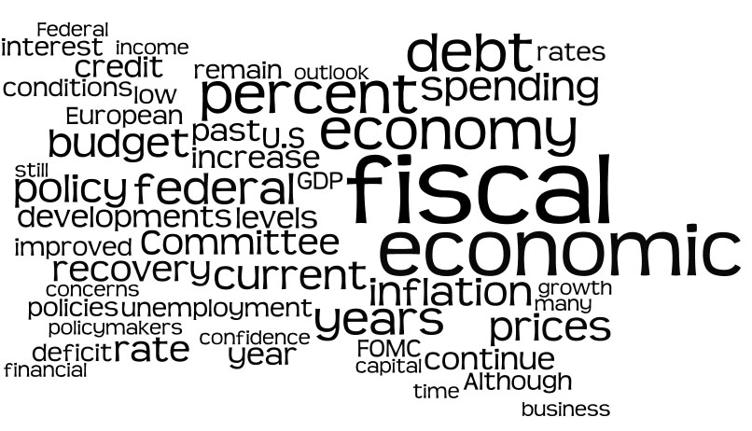
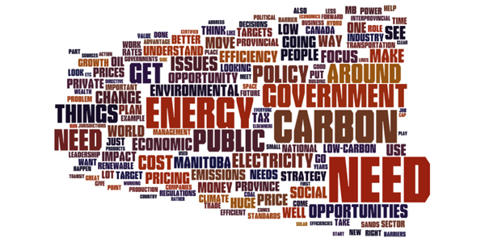

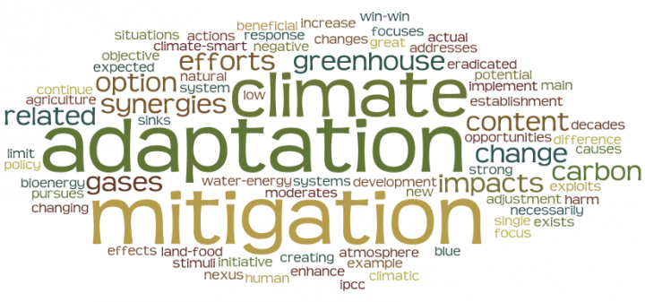
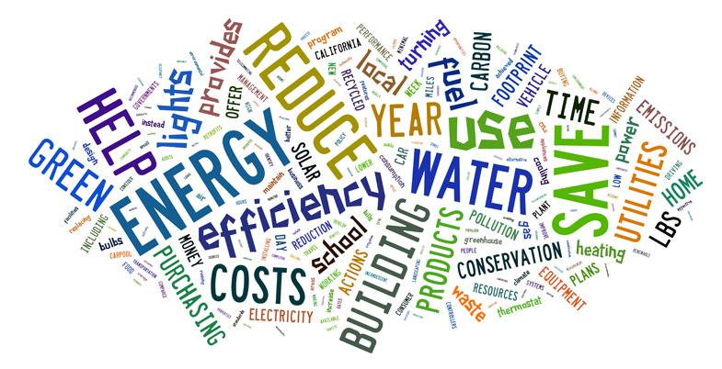
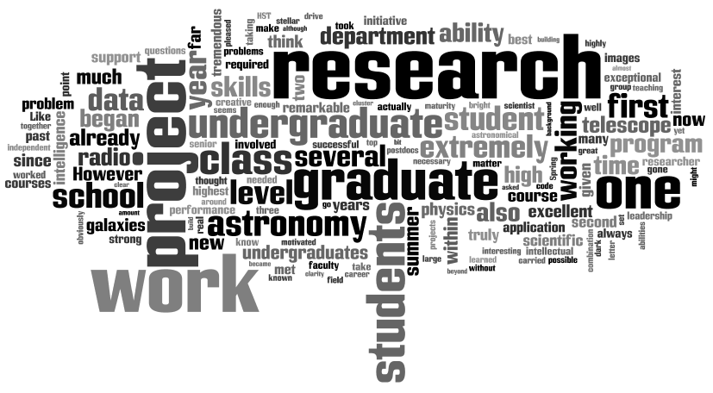

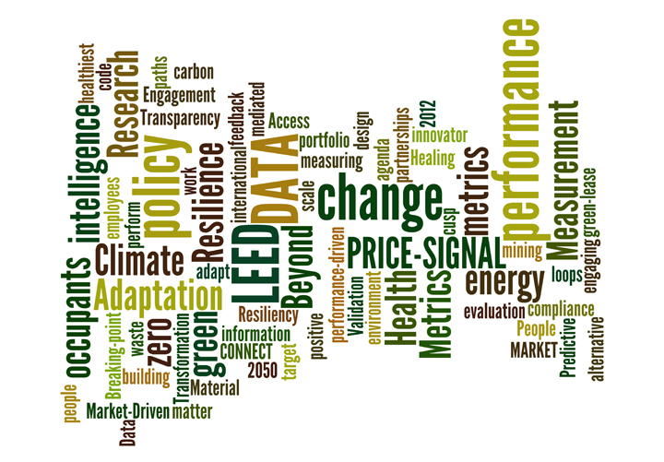
Showing have all the technologies opens a new chapter in our story!
Notes:
We do not intend this report to be seen as the ‘only way to save the planet’ - we actively seek modifications & improvements
Our aim is to open a new chapter in this story rooted in the physical realities which scientific consensus demands
To stimulate economic & political debate, engage the broader research community & get society thinking in a new way - & so help build a consensus to act

Slide 29



words
Notes:
29
We worked though our networks to develop an overview to share in paris

Slide 30
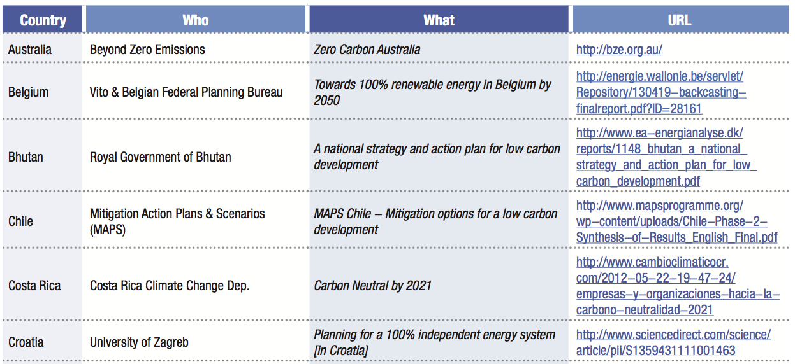
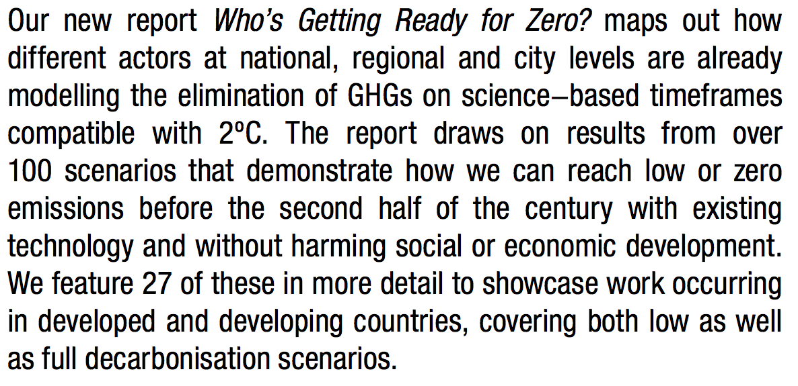
Notes:
30

Slide 31
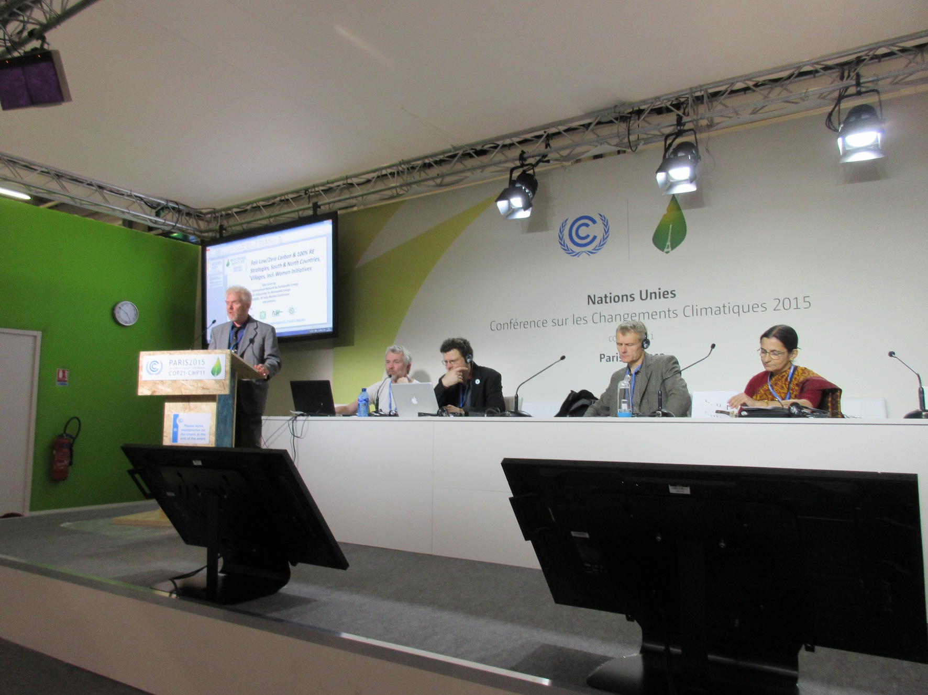
Notes:
31

Slide 32
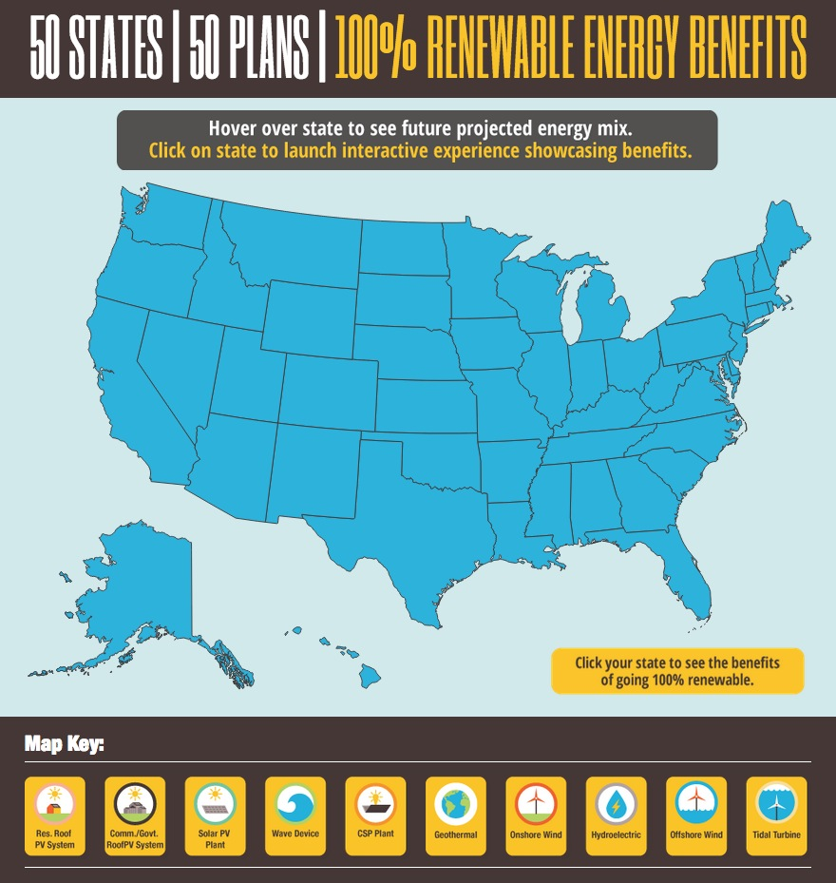

“The Solutions Project”
Notes:
32

Slide 33
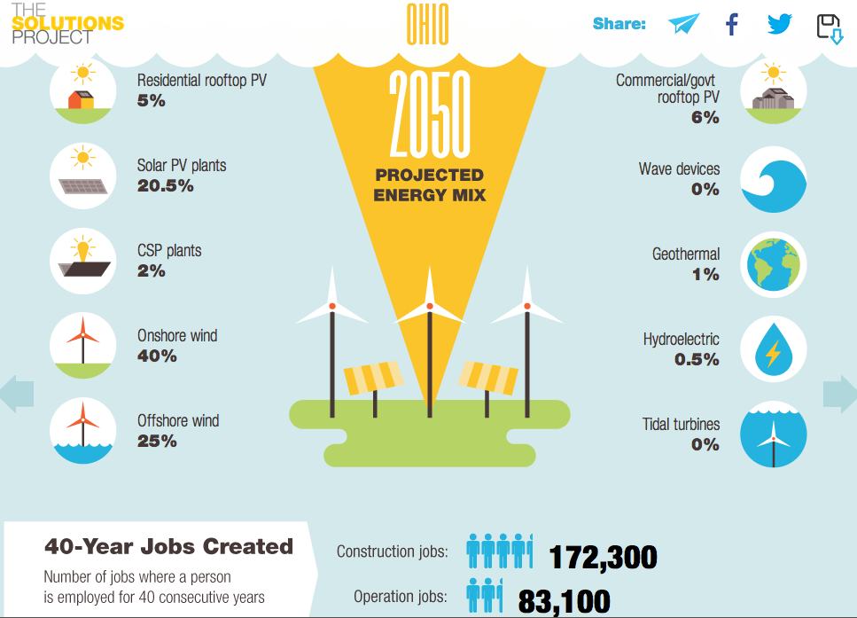
Notes:
33

Slide 34


Notes:
34

Slide 35
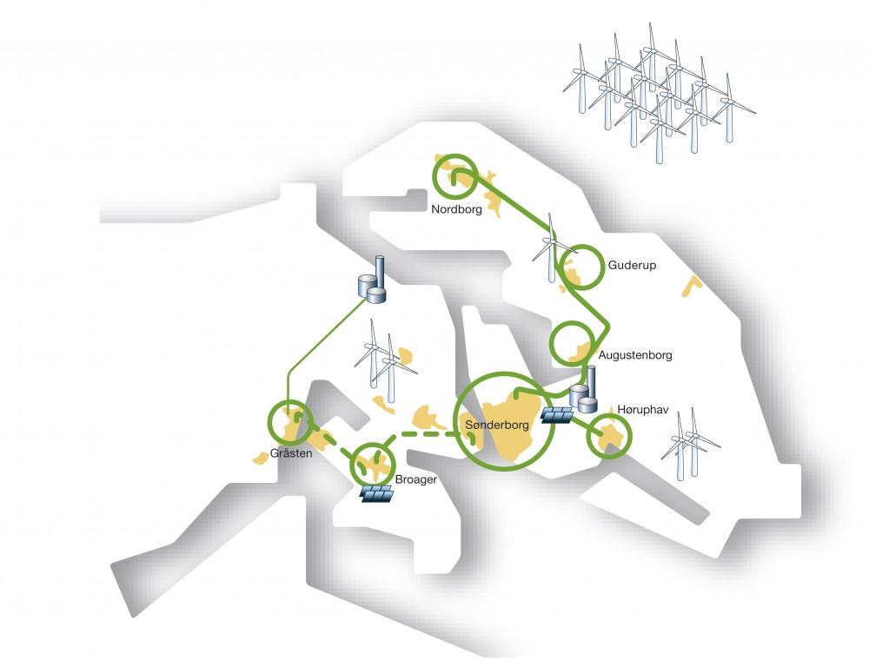

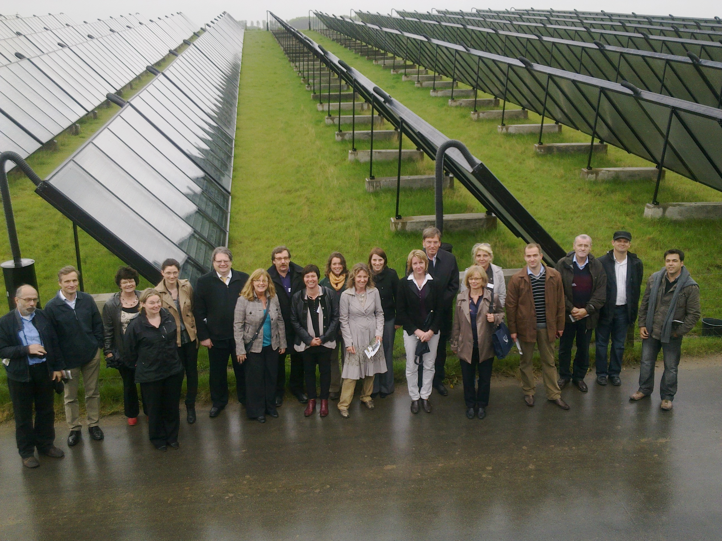

Notes:
35

Slide 36
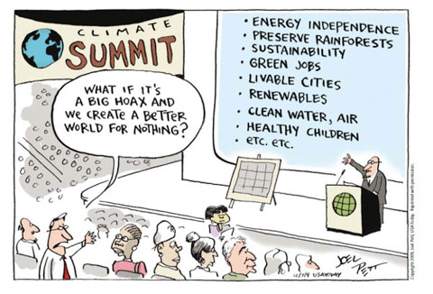
An exciting range of co-benefits
We have to re-think a lot of things to deal with the climate challenge
So this offers us a once in a generation opportunity to change other things too

Slide 37
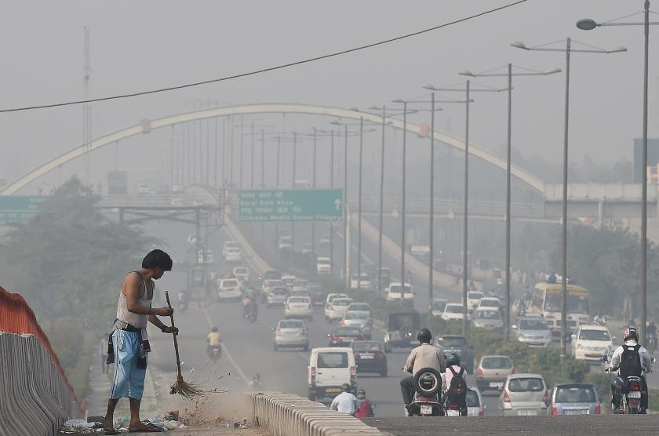
Notes:
37

Slide 38
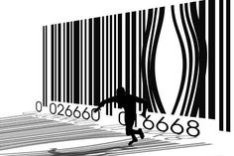
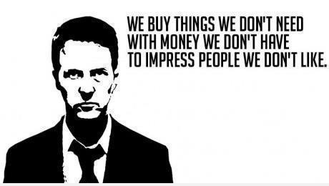
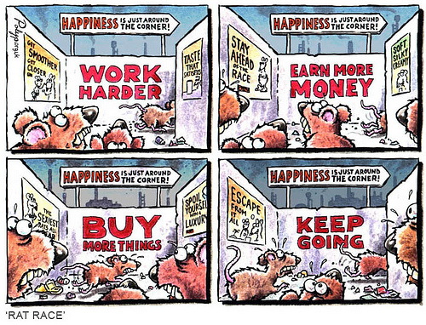
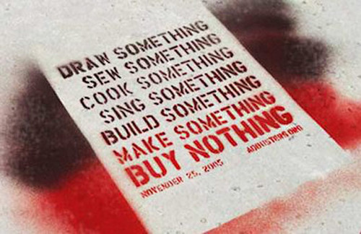
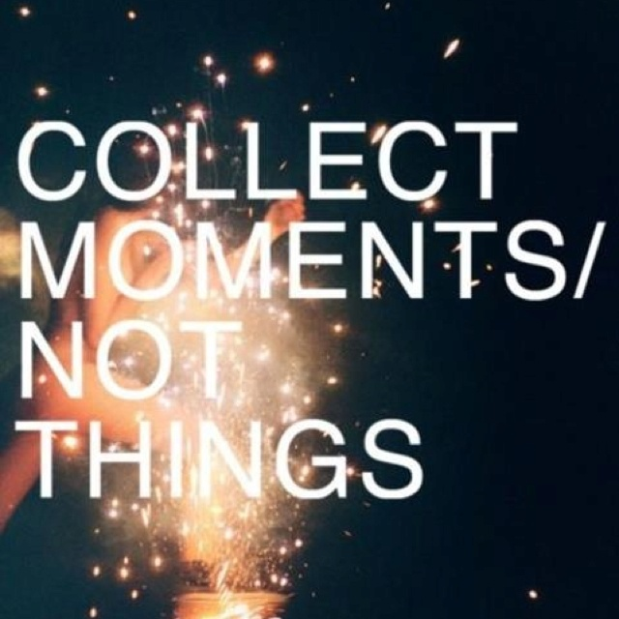
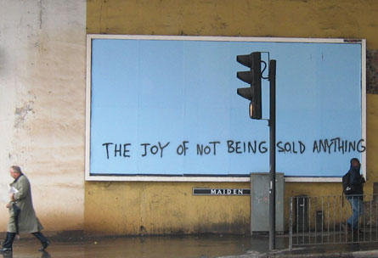

Notes:
38

Slide 39
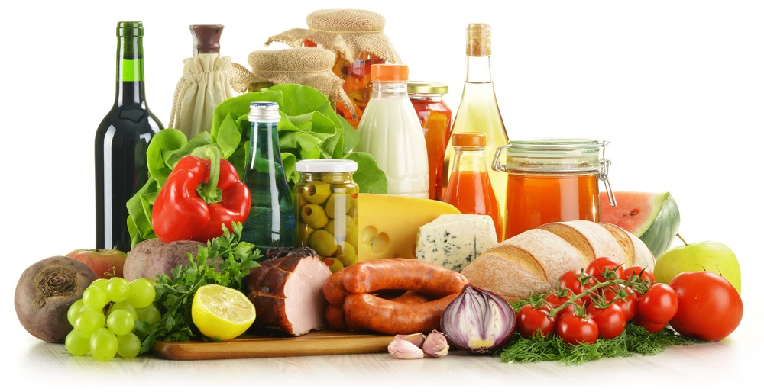

Notes:
39

Slide 40


£ 2,450,458
Notes:
40

Slide 41





Notes:
41

Slide 42






Notes:
42

Slide 43
Radical Technology 3.0 vision
What technology mix did we use?
What social, cultural and political shift enabled it to happen?
Potential co-benefits?
What is life like once completed?
Back-cast a timeline to 2016

