Slide 1

Innovation Architecture:
Windows and Clouds – Lets Blue Sky It !
RADICAL TECHNOLOGY:
NEXT STEPS
Bristol 3RD September 2016
Sue Roaf
Professor of Architectural Engineering,
Herito Watt University, Edinburgh
s.roaf@hw.ac.uk
?

Slide 2
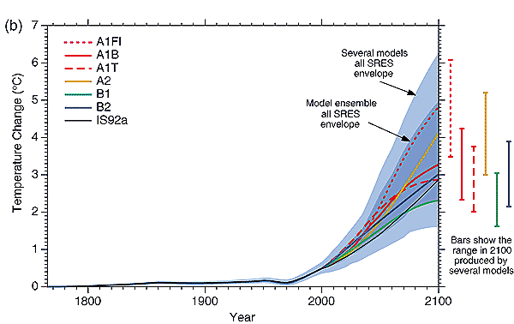





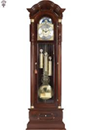
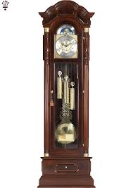


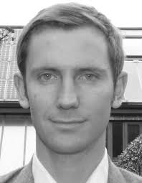
We all occupy passing Windows in History
New Media
Renewables
Space
Cities
WW2
Flight,Cars
2C
warmer
Slavery
Empire
1C
warmer
1860
1917
1952
1986
?

Slide 3
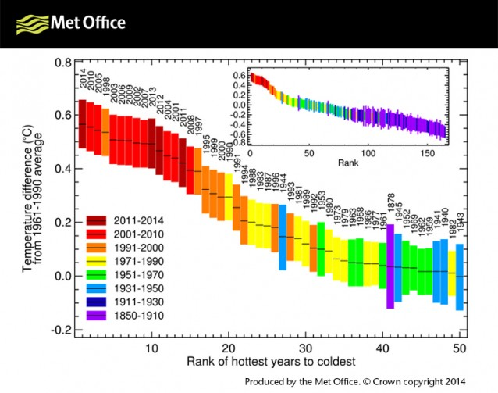

Slide 4
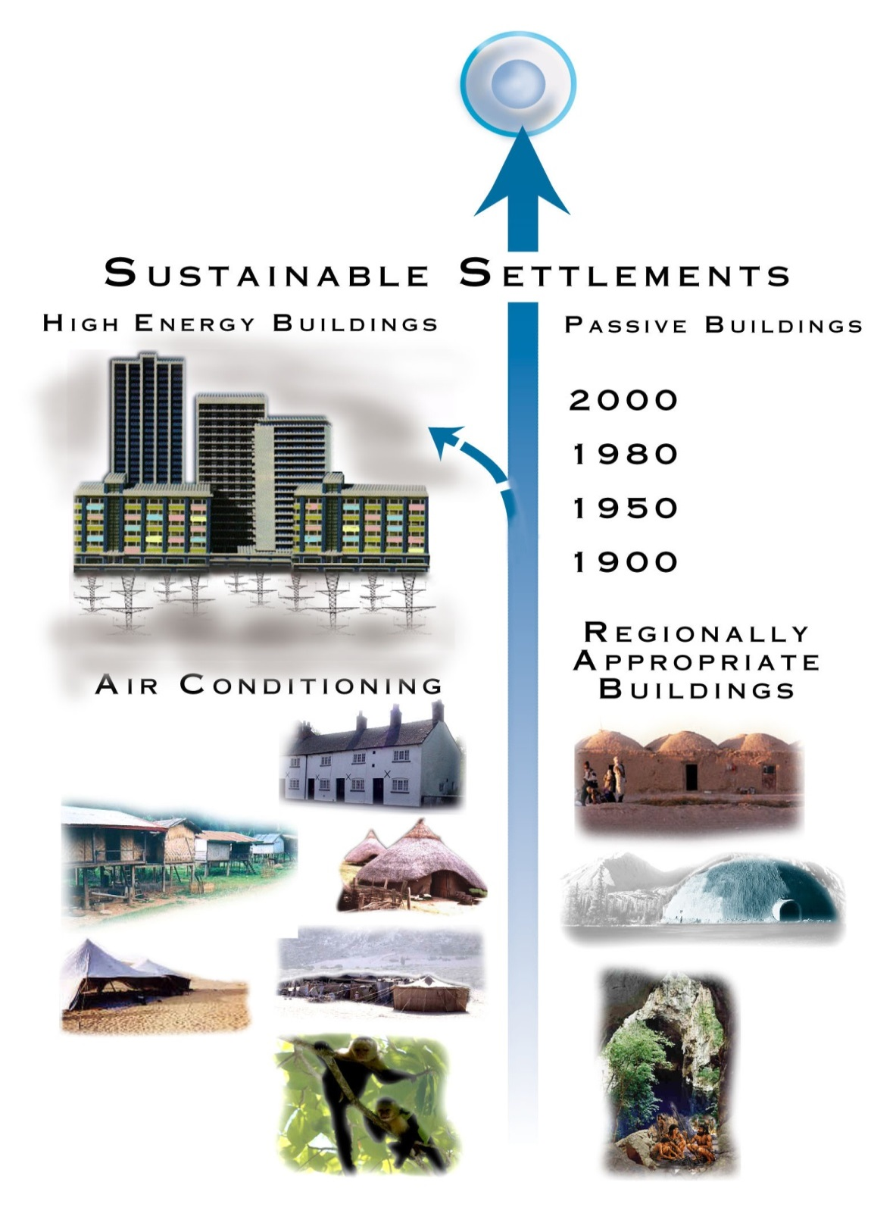
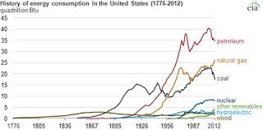
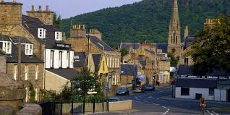
21ST Century Challenges:
PROBLEM 1: Humanity – More of Us
PROBLEM 2: Industrialisation
Vernacular Buildings: Archetypes

Slide 5

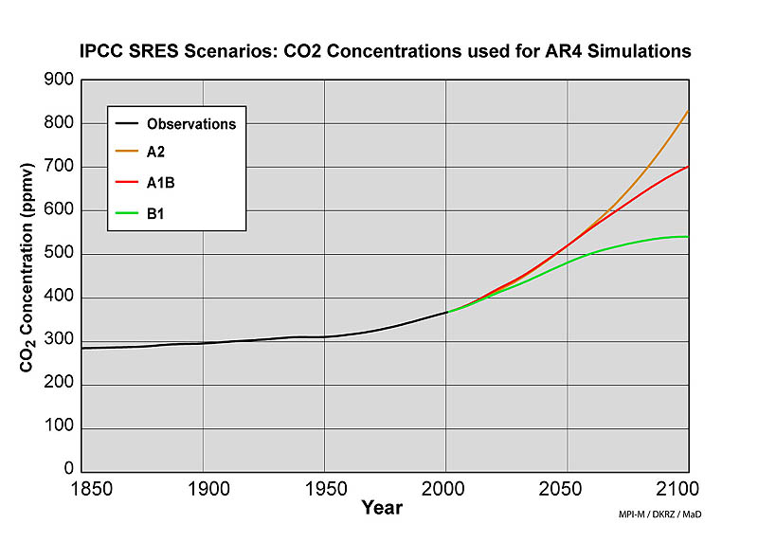
PROBLEM 3: CLIMATE CHAOS
PROBLEM 4: NOT ‘ GETTING IT’
6⁰C
4⁰C
3⁰C – Paris 2015 + Resilience
2⁰C – 2000s – Sustainability
2⁰C
1⁰C – 20th Century BAU
0⁰C
2045
2065
2010
www.berkeleyearth.org
www.ipcc.ch/SPM6avr07.pdf

Slide 6

1⁰C – INSOUCIANCE
20th Century Approaches
Business As Usual

Slide 7
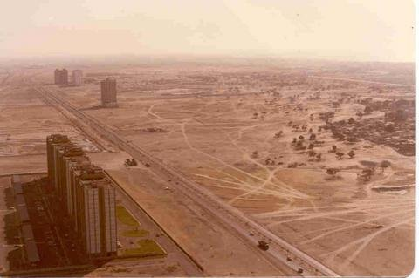
ACCELERATING RATES OF CHANGE
..\y My Pictures\untitled.bmp
Dubai 1990
Source: Jeremy Leggett

Slide 8
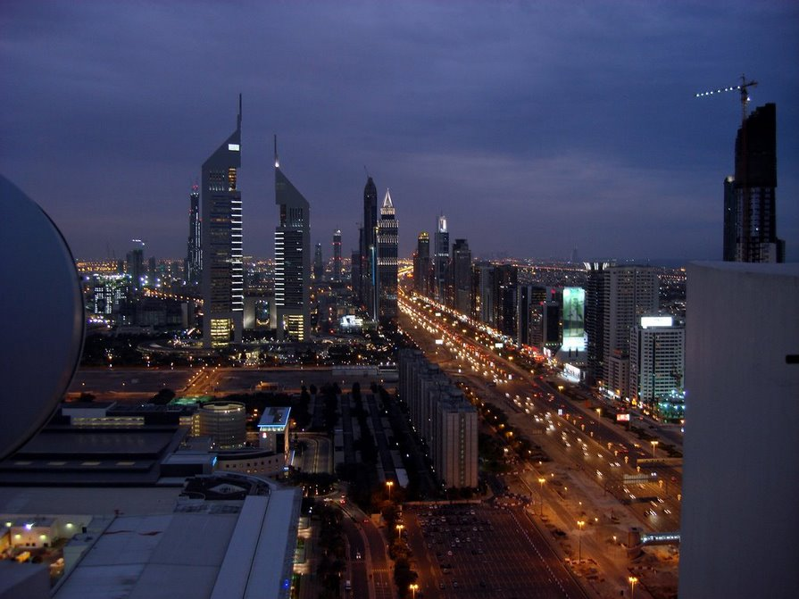
Dubai: 17 years later
..\y My Pictures\untitled.bmp
Dubai 2007
Source: Jeremy Leggett

Slide 9
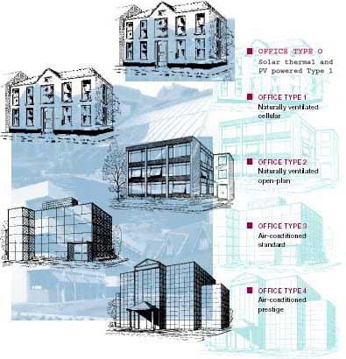
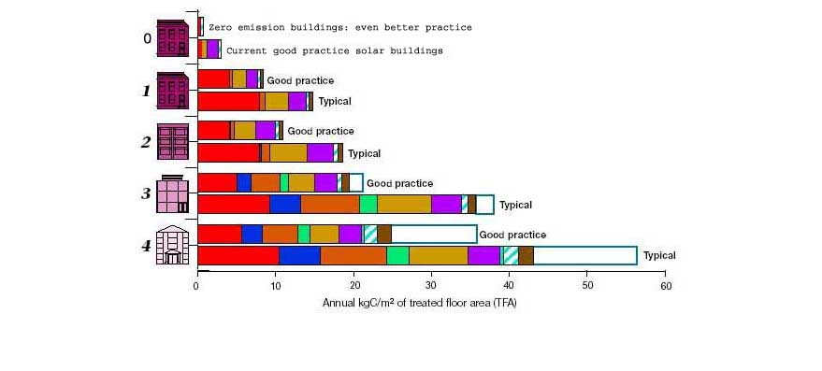
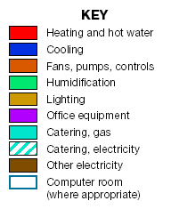
PROBLEM 5: POOR BUILDING DESIGN
20th C –Buildings just become Higher Tech / Higher Carbon each year
www.energybenchmarking.co.uk/Offices/ECON19reprintMarch03.pdf
0 = 2020
Low Carbon Building
Best of the Old -Run on
solar energy)
1900
Increasing Energy use over time
1960
1980
2000

Slide 10


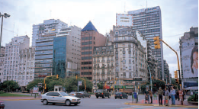
Seen in every City in the World
THIS TREND IS MADNESS
1950
1970
1990
1980
1900
1960
Buenos Aires

Slide 11
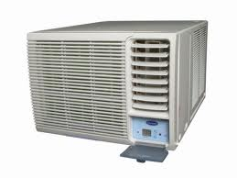
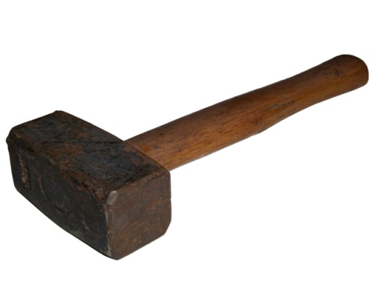

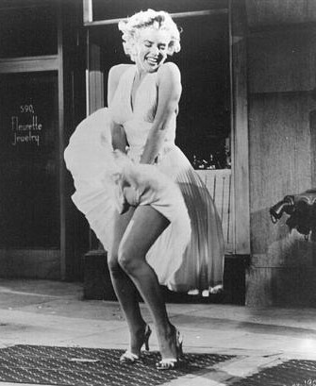


20th CENTURY DESIGN – SIMPLISTIC – INFLEXIBLE INCREASINGLY OBSOLETE
The solution is a machine
Nature is
excluded
The building
is a box
throwing energy away

Slide 12
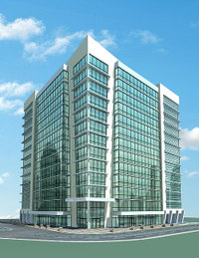
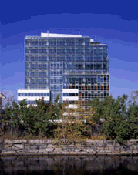
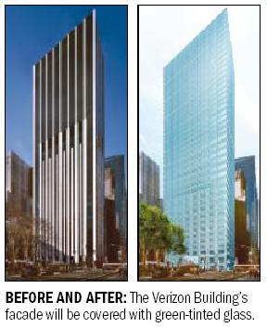
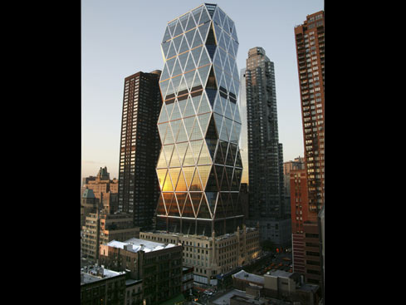
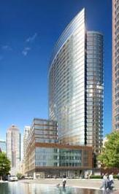
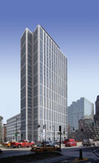

THE CONSTRUCTION INDUSTRY TELLS US THESE ARE THE
MOST SUSTAINABLE BUILDINGS IN THE WORLD!

Slide 13
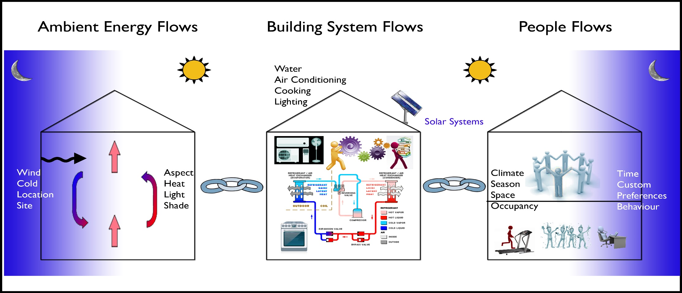
LEGISLATION – HIGHLY INFLUENCED BY
LOBBYING FROM VESTED INTERESTS - SEES
THE SOLUTION ONLY AS A MACHINE
.
Notes:
THE NATURE OF THE PROBLEM:
The primary function of a home is to provide shelter in a safe and healthy environment. In a world where fossil fuels are becoming scarcer and more expensive and the climate more extreme, the challenge of designing comfortable home requires a new approach. It is profoundly important that human beings learn how to adapt to changing weather and different climates with our bodies, behaviours, buildings and machines. A growing international consensus now calls for not only low energy buildings to mitigate against climate change but also more robust, passive structures that provide their occupants with multiple opportunities to adapt their own environments to protect themselves from more climate extremes with no cost or low cost solutions.
This lecture outlines how homes can be provided with just such adaptive opportunities, building on an enhanced understanding of ambient energy, building system and human behaviours in and around buildings.

Slide 14
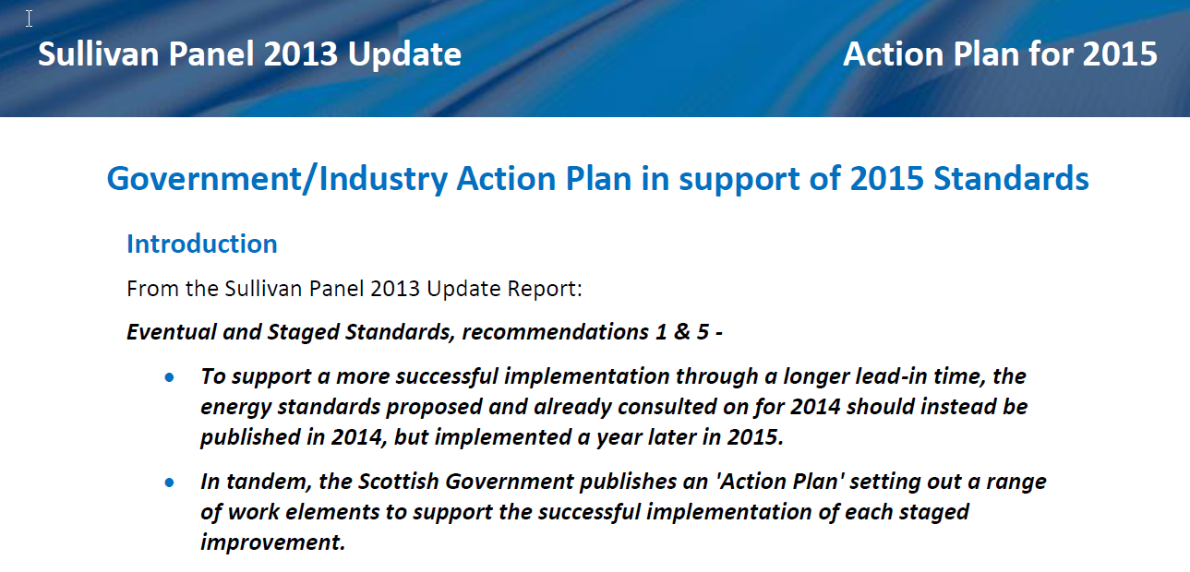
Scotland has an ACTION PLAN to reduce emissions from Buildings http://www.gov.scot/Resource/0046/00460375.pdf

Slide 15
Influenced by powerful lobby groups to create: A Joint Approach
Initial discussions in 2014 held between the following organisations:
Construction Scotland is the voice of industry to government
Homes for Scotland represent the organisations delivering over 90% of Scotland’s new homes
Scottish Property Federation represents organisations involved in the property industry in Scotland- property developers and owners, institutions, fund managers, investment banks and other lenders, corporate occupiers and professional organisations that support the industry
Building Standards Division of the Scottish Government are responsible for setting regulations and publishing guidance required to enable the building standards system to operate
Who is not represented: The ordinary citizens of Scotland

Slide 16
Scottish Policy Framework: 2008
National Performance Framework
Scottish Government Purpose: ’To focus the Government and public services on creating a more successful country, with opportunities for all of Scotland to flourish, through increasing sustainable economic growth’.
Purpose Targets: ‘To reduce emissions over the period to 2011. To reduce emissions by 80% by 2050’
National Outcomes: ‘We reduce the local and global environmental impact of our consumption and production’

Slide 17
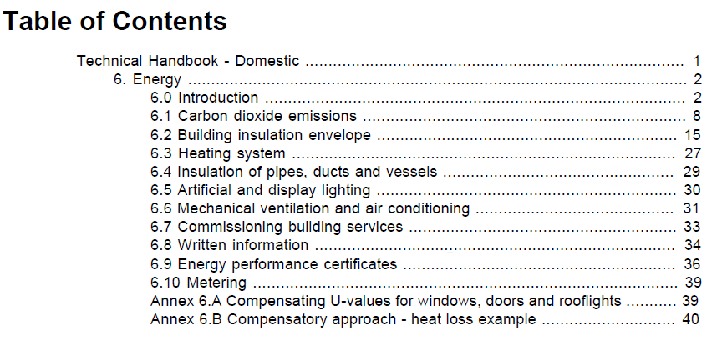
Scottish Domestic Regulations http://www.gov.scot/Resource/0047/00478110.pdf
LARGELY ABOUT PRODUCTS

Slide 18
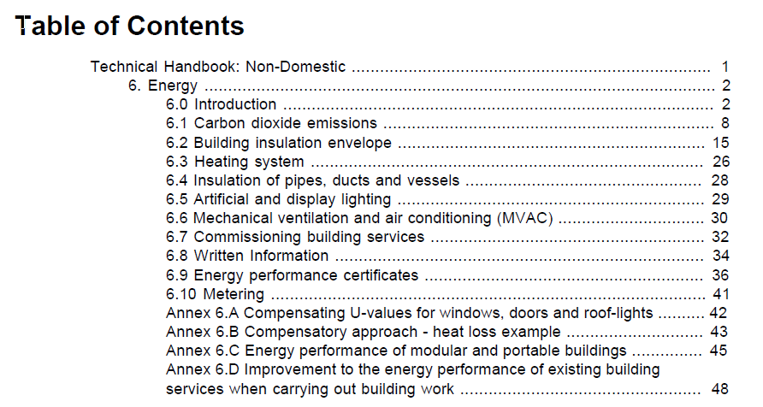
Scottish Non-Domestic Regulations http://www.gov.scot/Resource/0048/00486497.pdf
LARGELY ABOUT PRODUCTS

Slide 19
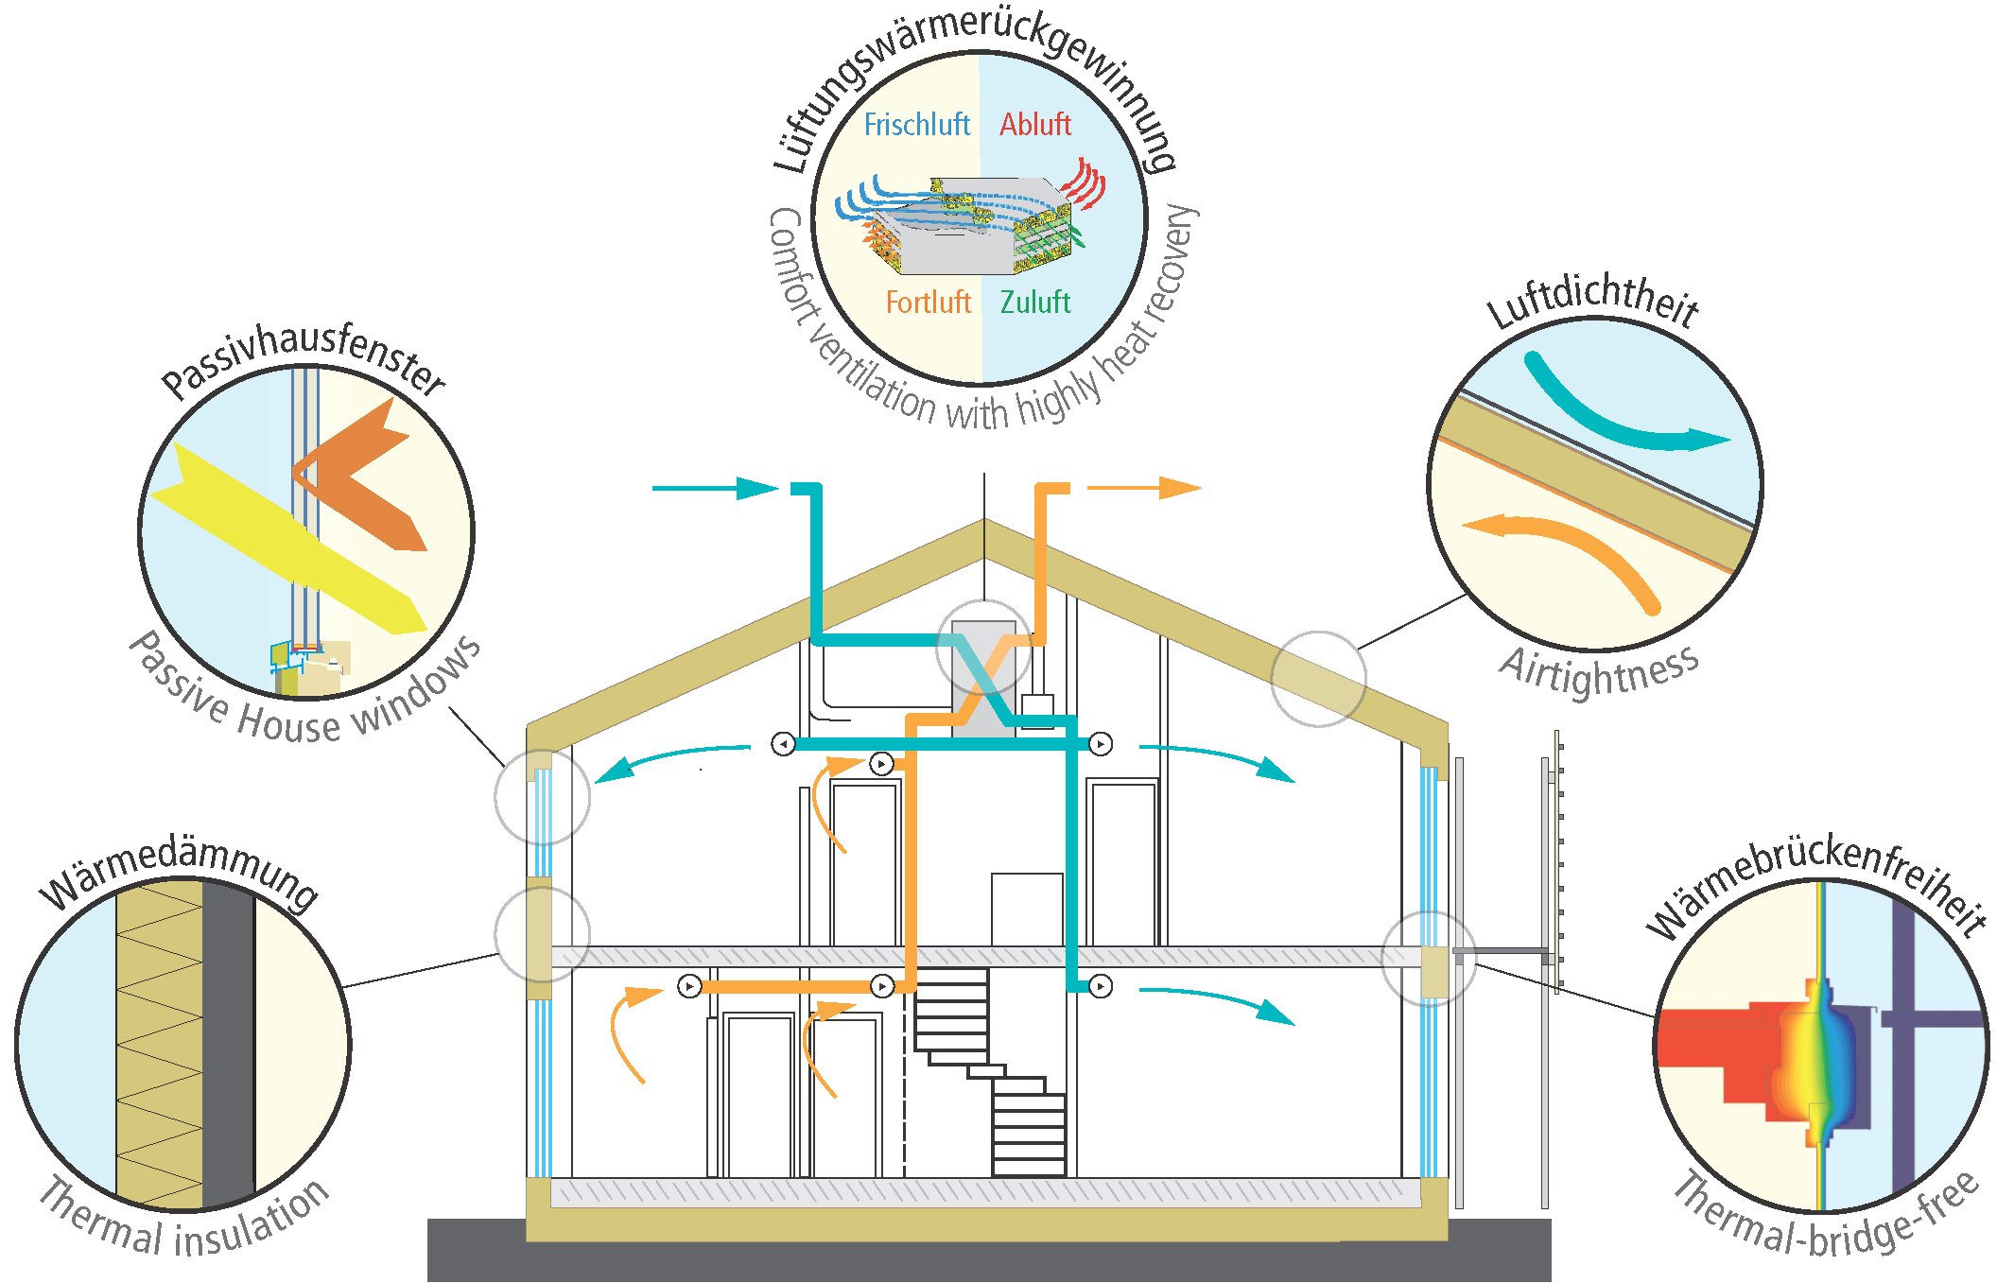
1990s – ENERGY EFFICIENCY - PASSIVE HOUSES
X

Slide 20

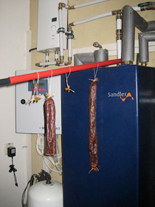
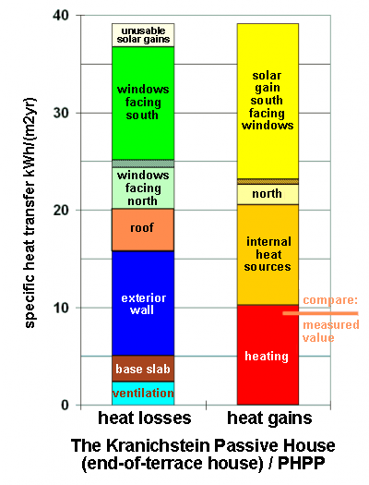
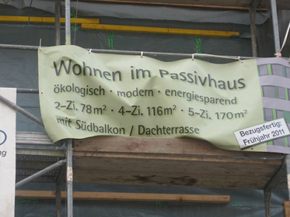
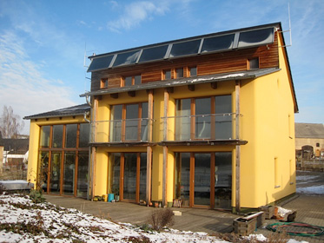
http://www.passivhaus.org.uk/
Inherent Flaw is that solar gain is in Summer
And Heat loss (need for heat) is in Winter

Slide 21
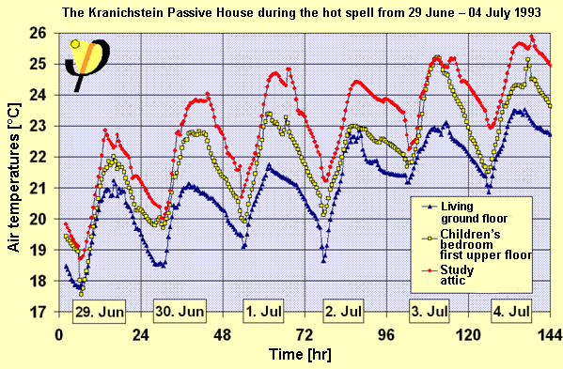
http://passipedia.passiv.de/passipedia_en/_detail/picopen/gemessene_sommertemperaturen.png?id=basics%3Asummer
Passive Houses Ignoring Overheating

Slide 22
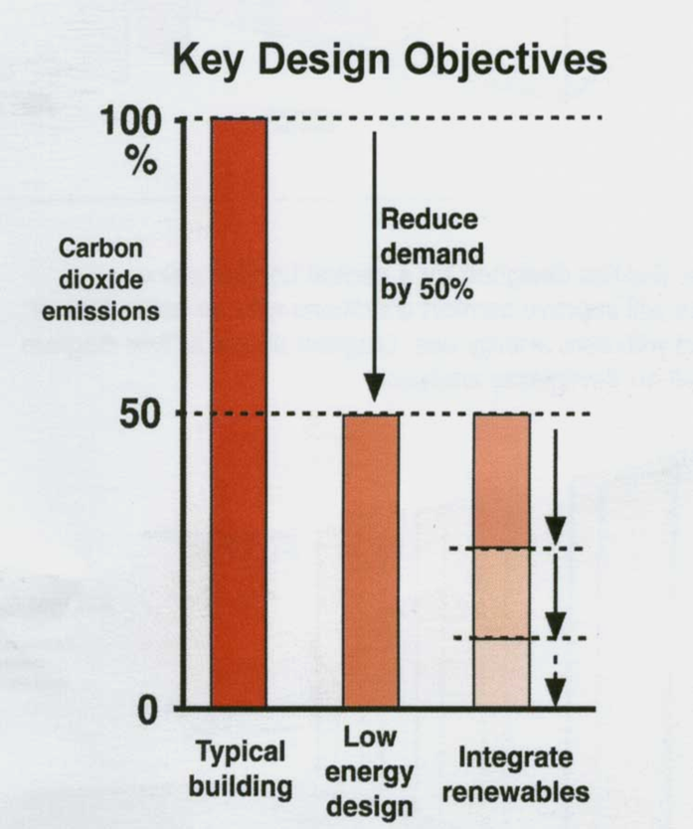
PASSIVE HOUSE: 1990s Energy Efficiency
Insulation
Good Windows
Air Tight
No thermal bridging
Heat Recovery
Over-simplistic
PRODUCT
‘Passive House Standard’
Compliance expensive ?
Performance predicted with a simplistic building model

Slide 23

2⁰C – 2000s
Sustainability

Slide 24
Sustainability becomes the Mantra

Slide 25
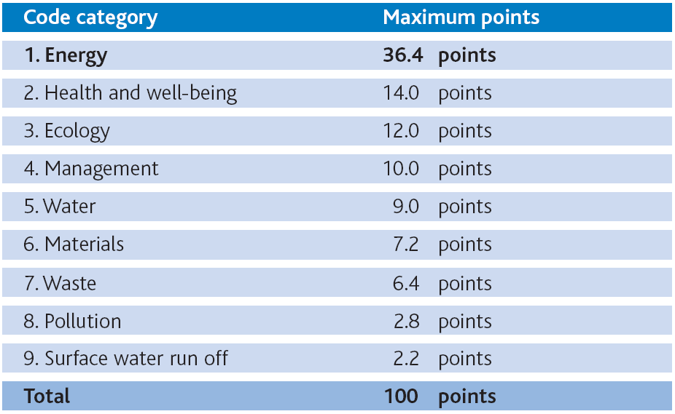
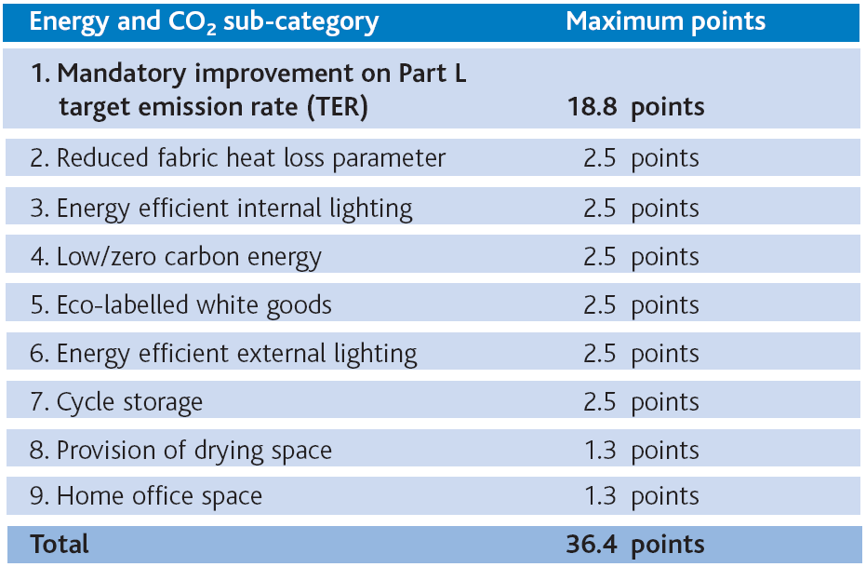


Green / Sustainable Rating Tools - Apples and Pears
Point Scoring system
Whose agenda ?
9 design categories
ONLY 2 OUT OF THESE 3 ARE NECESSARY
Notes:
9 categories
Energy is by far the most significant
Materials comes 6th
3 of 5 are A only gets an extra 1.5 points

Slide 26
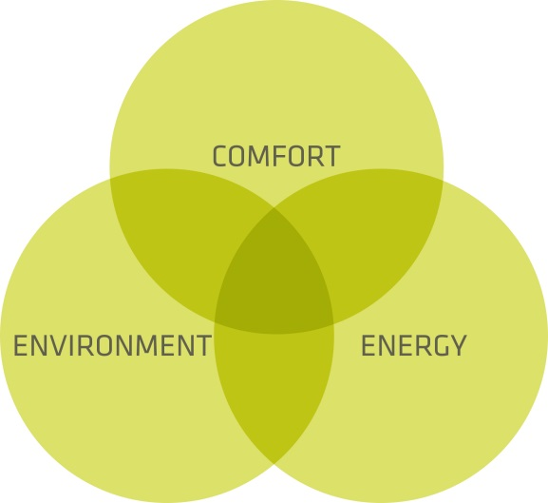
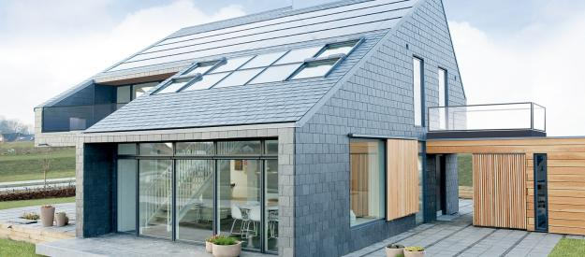
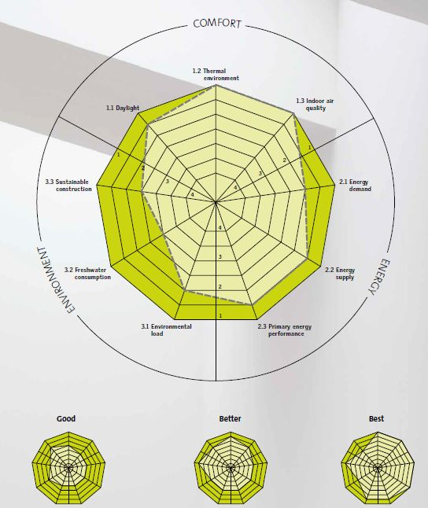
Design with ENERGY, INDOOR CLIMATE, and ENVIRONMENT in MIND http://activehouse.info/
The 2000s brought us ‘SUSTAINBILITY’ The ACTIVE HOUSE from Denmark had its Principles Enshrined:

Slide 27

ACTIVE HOUSE :
Insulation
Good Windows
Air Tight
No thermal bridging
Heat Recovery
Thermal Storage
Natural Ventilation
Adaptive Envelope
Active solar systems
But Still the Over-Heating Problem
Measured by an AH ‘Green Rating tool’

Slide 28

3⁰C Designed for:
Radical New
City Approaches

Slide 29
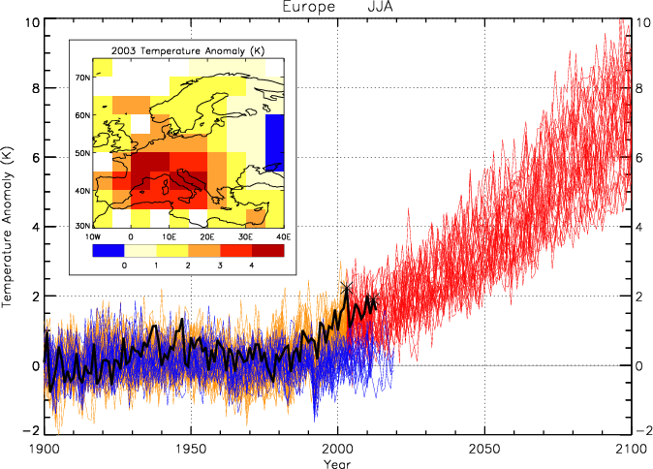
EXTREME WEATHER EVENTS INCREASE RAPIDLY
72,000 die in one heatwave
Across Europe

Slide 30
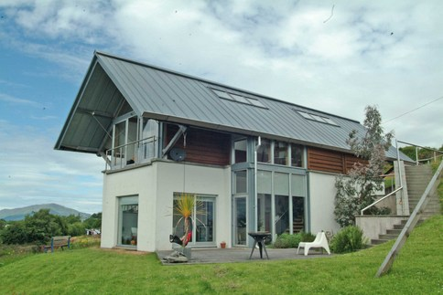
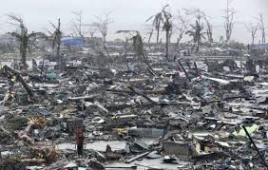
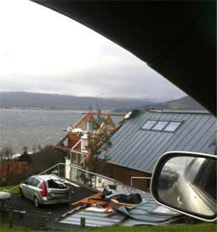

BUILDINGS / LIFESTYLES NOW ARE NOT CLIMATE-PROOF
Climate – Safe Buildings ?

Slide 31
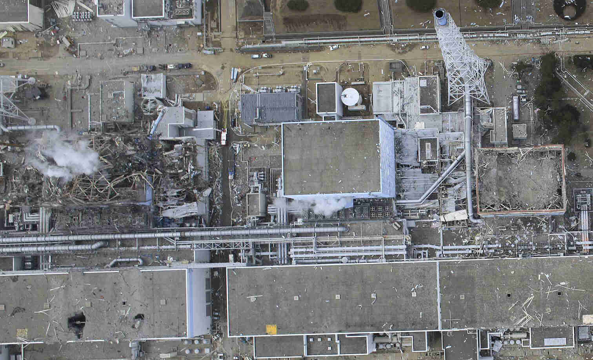
BRITTLE ENERGY SUPPLY SYSTEMS

Slide 32
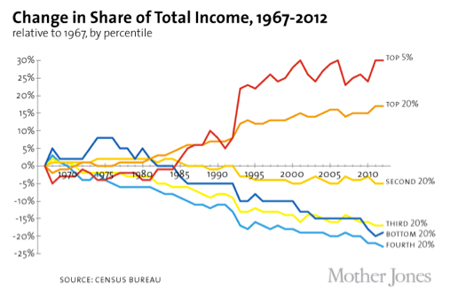
THE DISSAPPEARING MIDDLE CLASSES
The US Census in 2012 evidence of the widening income gap between
the rich and poor, prolonging the trend of the last 40 years http://www.eia.gov/ers

Slide 33
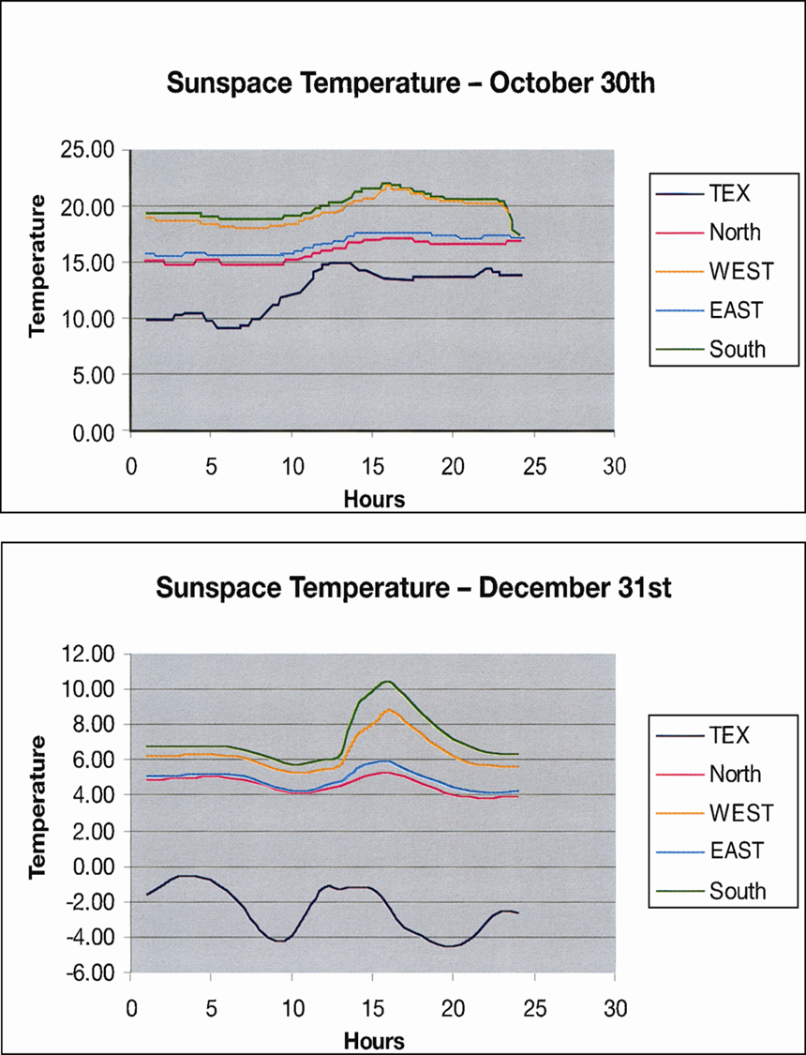
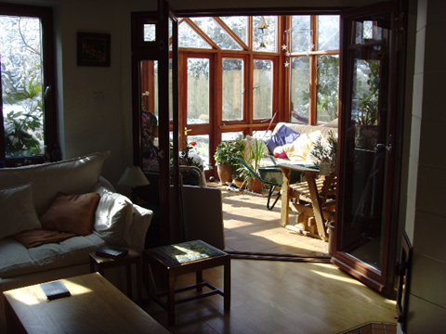
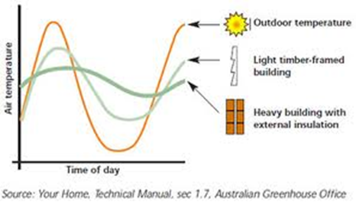
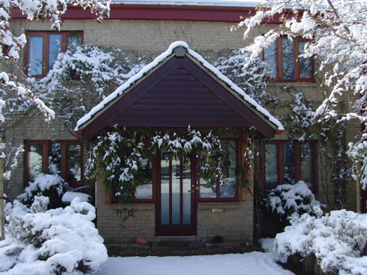

THE RESILIENT HOUSE
Energy store
Energy to Store

Slide 34

The Time has come to Prioritise RESILIENT DESIGN
Insulation
Good Windows
Air Tight
No thermal bridging
Heat Recovery
Thermal Storage
Natural Ventilation
Adaptive Envelope
Active solar systems
Buildings as Climate Refuges
Climate Ready & Future-Proofed
Run on Solar Energy with Storage
Adaptive Opportunities & Controls
Behaviours as part of the solution

Slide 35

FUTURE CITIES David Jenkins HWU
Business As Usual (BAU)/Medium Tech
Good times for... | Less good for....
Wind, gas, large-scale CHP and nuclear generation | Marine/hydro generation
Countries that export gas | Shale and North Sea gas
Cavity-wall and loft insulation | Solid-wall insulation (and more expensive demand-reduction measures)
Solar PV (with limitations) | Heat pumps and micro-CHP
Energy efficient appliances | Low carbon commercial and industrial sectors
Zero carbon new homes | Electric vehicles
Low-carbon public transport
INNOVATION ARCHITECTURE
A Mixed Tech Revolution
The Rational Approach – Who Decides ?

Slide 36



Next Generation Thinking:
3 Big 21st Century Innovations
Buildings:
Complex Spatial
Landscaping
Design With
Climate
People + Comfort

Slide 37
INNOVATION 1:
THE COMFORT REVOLUTION
1) There is no one comfort temperature
People live in Local Comfort Clouds
2) People Adapt themselves or their buildings
to ttemperatures they normally occupy

Slide 38

3⁰C Designed for:
Radical New
COMFORT Approaches

Slide 39
ADAPTIVE THERMAL COMFORT BECOMES THE STANDARD
Allowing temperatures indoors to tracks seasons
ASHRAE 55
prEN 15251
ISO7730 summer
21st C Temp
20th C Temp
Palermo-Punta Raisa
Brazil

Slide 40
SAVING BILLIONS £ IN RUNNING COSTS
(71F to 75F)
  Hoyt, T., H.L. Kwang, H. Zhang, E. Arens, T. Webster, 2009, “Energy savings from extended air temperature setpoints and reductions in room air mixing.” International Conference on Environmental Ergonomics 2009. Source: Arens

Slide 41
Occupied Temperatures in English dwellings
People live in a wide range of temperatures
Measurements Aug 07 – Jan 08
(Source: Fergus Nicol)

Slide 42

Comparison of UK domestic temperatures overlaid on Japanese measurements for winter and summer
UK

Slide 43
Comparison with International temperatures
UK Summer (FR)
UK winter
Dammam summer
(Source: Fergus Nicol)

Slide 44





Japan: KOTATSU + HOT BATHS – Traditional Solutions

Slide 45




Japanese Changing Fast their Clothing Culture
2005 Cool Biz introduced
Japanese Government Offices
AC only goes on above 28 C

Slide 46

PERSONAL ENVIRONMENTAL TECHNOLOGIES - PETS
In Future we will heat / cool people not buildings
Source: Edward Arens, UC Berkeley, Windsor Conference 9-11 April 2010.

Slide 47



PETS / Air - Take you PET with you
1 m/s corresponds to 3K temperature increase
3 W!
occupancy sensor
remote control
Source: Edward Arens, UC Berkeley, Windsor Conference 9-11 April 2010.

Slide 48




PETS
RE-THINK HOW PEOPLE HEAT AND COOL THEM SELVES

Slide 49





BUILDINGS / LIFESTYLES WITH CLIMATE REFUGES - Cool and Cosy Corners
Protect the Vulnerable
WARM GRAN PLAN
Building
Resilience
Matters
KOOL GRAN PLAN
Make a Climate
Safe Room for
The old and the
Young in homes

Slide 50




CLIMATICALLY APPROPRIATE VERNACULAR ARCHETYPES

Slide 51



COMPLEX MICRO-CLIMATES IN BUILDINGS
Increasing Time lag
N
S
Increasing Time lag
Hot Zone
º
Shade
Cool Zone
5º-10ºC temperature differences found in different rooms in the same house
Source: Jane Matthews

Slide 52


But the Secret of a Successful
Solar House lies in
the Building Itself
And its Ability to Harvest, Manage and Store Energy
(Passive Design)
Double
Efficiency
Machines
Generate
Solar + Use
Generate Solar + Store + Use

Slide 53





21C DESIGN LEVEL 1: WELL-BEHAVED BASIC BUILDINGS
The Elements of the Building you cannot change:
Form – Orientation - Openings – Height in Sky – Depth in Ground – Floor to Ceiling Heights - Structural / Roof Overhangs - Materials / Mass - Emissivity / Absorbance
Plan – Footprint
Section - Connections
UK Level 1 - Good
UK Level 1 –So/So ?
UK Level 1 - Bad

Slide 54


Building Form and Orientation
Minimum Surface To Volume Area
Calorific
Cascade
Cold
Air Lock
Hot
Air Lock
Warm Core
Coupled to the
Stove
Radiator
Notes:
17

Slide 55


ORIENTATION
Extra Solar Gain in Winter
Avoiding Overheating in Summer

Slide 56
Envelope Choices
Raincoat
All non-airlock windows – reasonable size
No cold bridges – even in floors
Overcoat
SHADING
Large glass windows into hot airlock only
No West Facing Windows – reduced heat gain
Notes:
17

Slide 57

COOLED
AIR
FROM GARDEN
Ventilation Strategies
COOLED
AIR
FROM GARDEN
Summer
Hot Spell
Radiator
Warm Flue
Winter
Stack Ventilation
In Hot Spells
Good Cross ventilation flow
Radiator
Hot Spell
Notes:
18

Slide 58
Energy Loads, Costs and Impacts Vary in
3 Different Level 1 Buildings
Much Extra Energy Needed
Upper Limit
In Local Climate
Some Extra Energy Needed
No Extra
Energy Needed
Acceptable Amplitude for a Good Building
Lower Limit
In Local Climate
Bad Building
So/So Building
Good Building

Slide 59








DESIGN LEVEL 2: ADAPTIVE OPPORTUNTIES
Elements you can Change for Climate Control
U-values / Occupancy / Internal Loads / Opening Windows / Infiltration / Furnishings / Local-Central Heating /Cooling systems / Shades / Curtains / Blinds / Conservatories / Porches / Landscape.. Machines are only level 2 / replaceable elements

Slide 60

Spaces with lots of Adaptive Comfort Opportunities

Slide 61





21C IMPERATIVE: NATURAL VENTILATION FOR AS LONG AS POSSIBLE

Slide 62
Same LEVEL 1: SO/SO Building can be a Good or Bad Energy Building
Depending on the LEVEL 2 Adaptive Opportunities it offers occupants
Mechanical Cooling
Passive Solar Heating with good summer shading and orientation so no over-heating - thermal mass
Natural Ventilation – opening windows – with shutters / shade / curtains to Pre-heat / cool air
Mechanical Heating
Mechanical Cooling
Mechanical Heating
Too Many HVAC Engineers
High Energy Building
Low Energy Building

Slide 63


This is it
MACHINES ARE VULNERABLE

Slide 64


SELF REPAIRING SYSTEMS

Slide 65






DESIGN LEVEL 3: THE MIND
SENSATION: Involving Feelings, Perception, First Impressions
View – Art - Sounds - Scents –Style - Colour – Light - Formal Composition of Shapes - Decoration - Furnishings - people / events associated with the building etc.
WELL BEING
Deeper sensation
WOW
Immediate Impact
Too Many Architects

Slide 66
INNOVATION 3:
POWERING OUR BUILDINGS

Slide 67




INNOVATION 3: POWERING BUILDINGS
Design with Nature
And Climate Change
In Mind
Buildings with many
Micro-climates run on
Renewable energy
Solar Energy
Renewable Energy
Architecture Matters

Slide 68


POWER FOR BUILDINGS TODAY
Energy Consumption in Scotland and Scottish Homes 2012

Slide 69

12 Gw Installed UK Solar– 9.2 Gw of Nuclear power
7th July 2015

Slide 70




http://www.sma.de/en/products/solarinverters/sunny-boy-3600-5000-smart-energy.html

Slide 71


First Day
Daily Production 12.284 kWh
Reading from the 21 year old 4 kWp system on the Oxford Ecohouse
Most Recent Reading
Daily Production 11.391 kWh

Slide 72

Charging Electric Bike
Iron Shirt for Work

Slide 73

THE SOLAR HOME DREAM JUST
KEEPS GETTING BETTER
Inverter that continues to work
When the grid fails
(with some battery capacity)
Update Gas Condensing Boiler
SMA Battery Installed
Range of local heating
And cooling technologies
LED lighting throughout
Electric car charging point
DC equipment and lighting loops

Slide 74



Solar Suburbs

Slide 75

Technologies built in Solar Powered Factories

Slide 76





INNOVATE FOR
A DIFFERENT FUTURE

