Slide 1
Is Small still Beautiful?
Schumacher and the need to reboot our relationship with technology

Slide 2
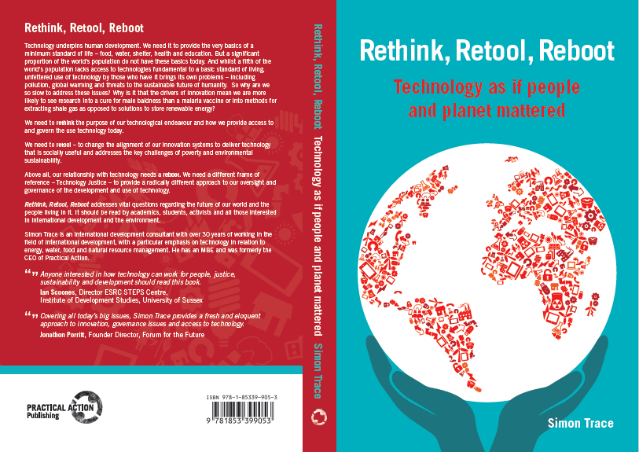

Slide 3


Slide 4

Limits to growth
Right Livelihoods
Technology with a
human face

Slide 5
45 years on…

Slide 6
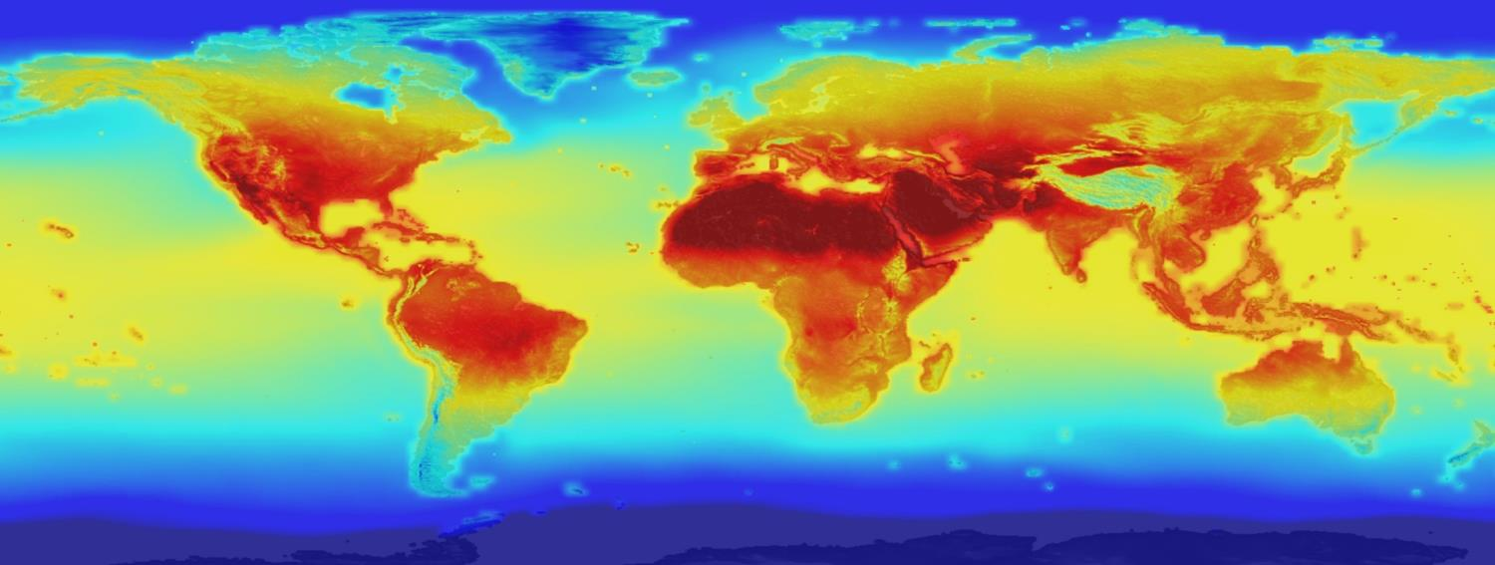
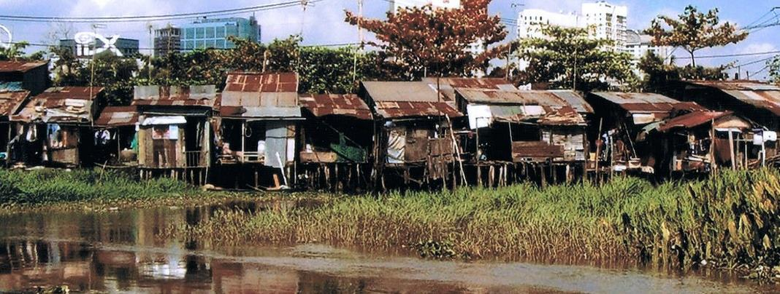

Slide 7
Technology Injustices
Access
Use
Innovation

Slide 8
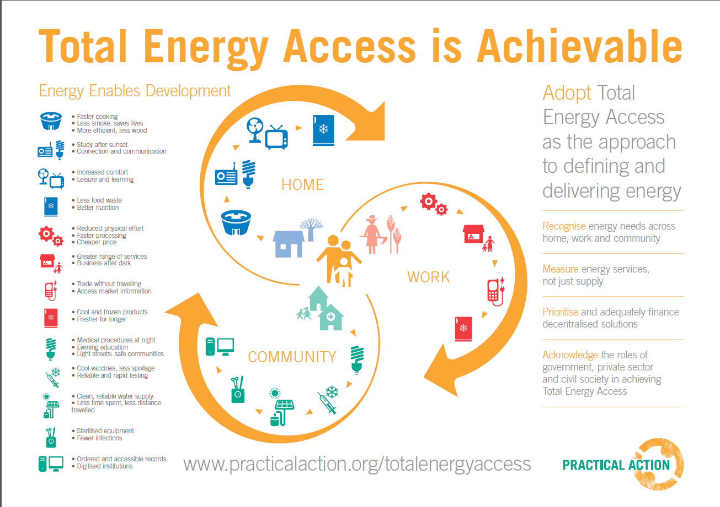


Slide 9
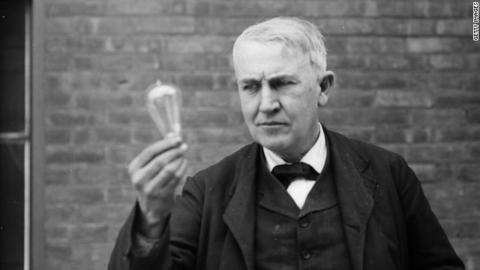
1879

Slide 10
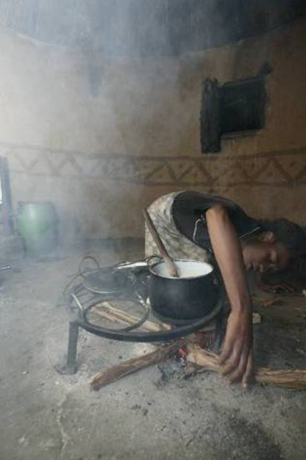

2015
1.1 billion 2.9 billion

Slide 11


Finance- requirement vs available
100
$ billions per annum
IEA 2011 Est.
50
$4.4 b/yr
$44.5 b/yr
IEA 2013
$0.4 b/yr
$12.7 b/yr
Annual cost to achieve universal access by 2030
Current annual investment in access
Notes:
IEA 2011 IEA estimate most commonly used to predict costs per annum to achieve universal access (elec and cooking) by 2030 – NOW SDG!
Latest (2015) IEA figures for actual spend are for the year 2013 – This is up 40% on 2009 figure ($9b) – so some good news. But still less than 25% of annual spend needed
Big question is how to fill that gap? Conventional wisdom is that public subsidy is not the answer…. There will never be enough to meet these massive investment requirements. Prob. right to say shouldn’t rely on pub. Subsidy alone. But just for the sake of argument lest see how big that investment requirement is to existing pub. Subsidies…. Say for example on FOSSIL FUELS!!

Slide 12

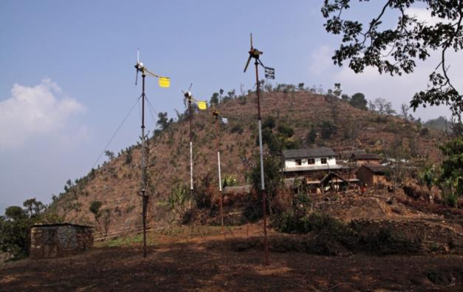
To achieve universal access to electricity by 2030 we need to invest $890 billion in new generating capacity as follows (i):
Grid electricity 35%
Off Grid electricity 65%
Current investment is:
? %
? %
(i) Based on UNSE4ALL Global Tracking framework report 2013

Slide 13
Funding going to the wrong technology
Development Bank Energy portfolios 2011-2013.
Grid Off-Grid

Slide 14
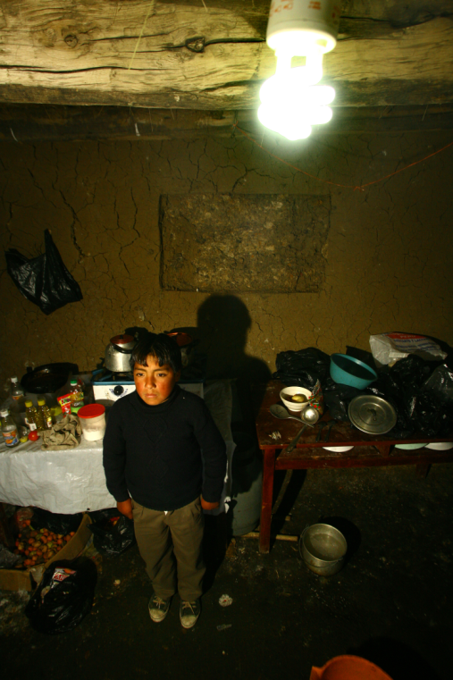
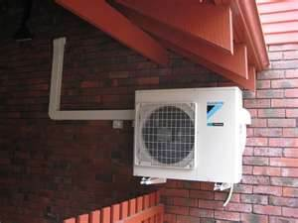
A choice is being made:
VS

Slide 15
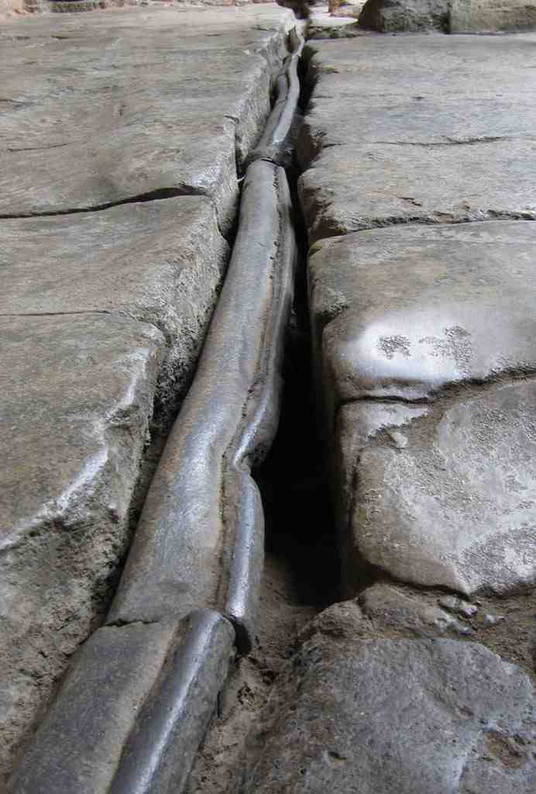


Slide 16
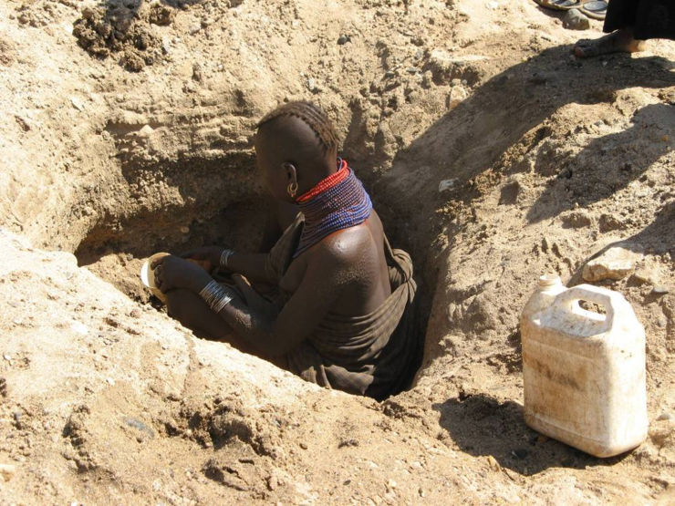
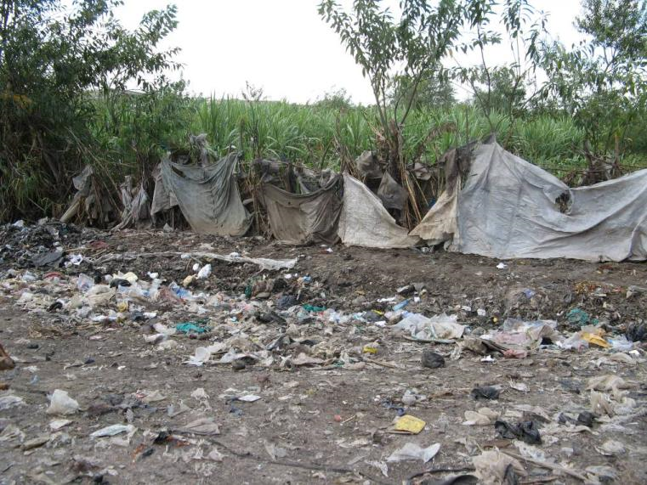
750 million
2.5 billion

Slide 17

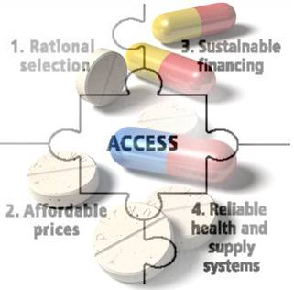
30% of the world’s population lacks access to WHO’s list of essential medicines

Slide 18
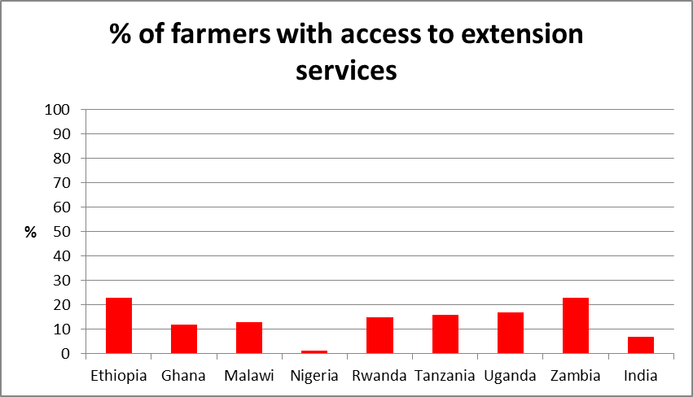
Most developing country farmers have no access to technical advice
ActionAid. (2013). Walking the Talk: Why and how African governments should transform their agriculture spending. London: ActionAid.
GFRAS. (2012). Fact Sheet on Extension Services Position Paper. Lindau: Global Forum for Rural Advisory Services.

Slide 19
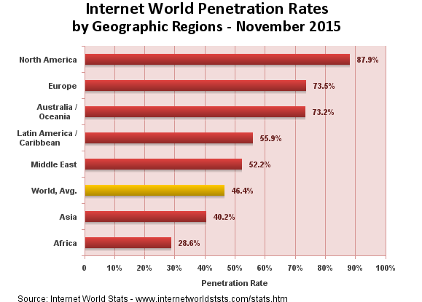
3.2 billion people in Africa and Asia lack internet access

Slide 20
Technology Injustices
Access
Use

Slide 21


An addiction to fossil fuels

Slide 22

Misuse of antibiotics
Inappropriate prescription
Affordability and under-dosage
Use as prophylactic and growth stimulator in animal feed

Slide 23
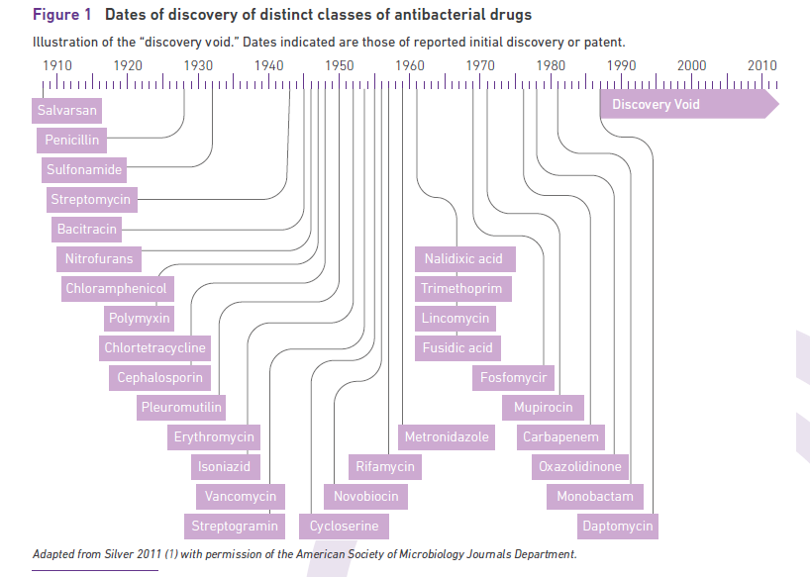

Slide 24
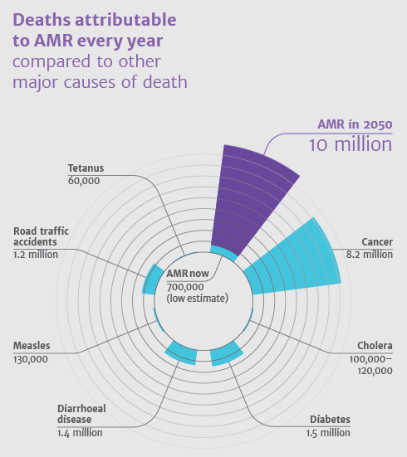

Slide 25
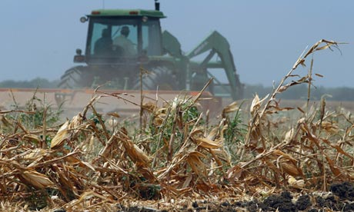
Destabilising the global food supply
Notes:
We have another ‘technical’ problem that will potentially not just affect the livelihood of peasant famers in the developing world, but also future global food supplies. The loss of genetic diversity within the species of livestock and crops we rely on for food.
Understandably, prior to the recognition of climate change government conservation efforts focussed on the most important plant and livestock species (through gene banks for orthodox seed, in situ collections for vegetatively propagated plants, cryogenically preserved eggs and sperm etc.). Collection efforts also concentrated on yield and uniformity characteristics to maximise profit and meet industrial processing requirements. But climate change and the food crisis demand a rethink of approach. We now need to think about genetic diversity in our livestock and crops as a way of mitigating future risk.

Slide 26
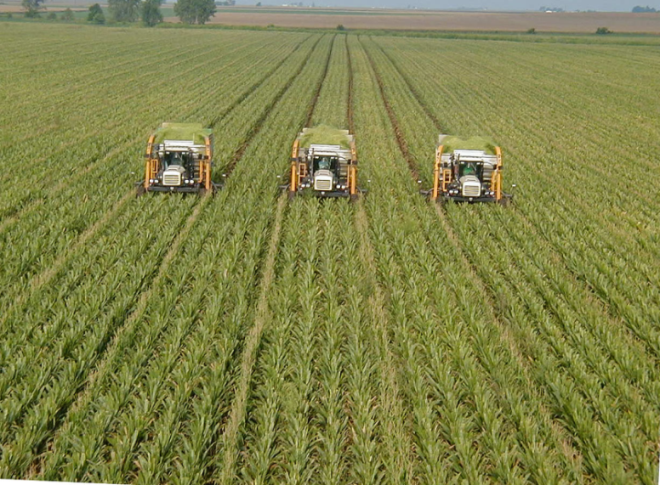

Since the 1900s, 75 % of plant genetic diversity has been lost as farmers worldwide have left their multiple local varieties for genetically uniform, high-yielding varieties.
Notes:
The Green revolution’s focus on wheat, rice and maize and commercial breeders’ focus on soybeans, alfalfa, cotton and oilseed rape has pushed other traditional food crops into the margins since the 1960s. But the focus on yield has also meant that even within the world’s leading crops its estimated that genetic diversity has been decreasing by 2% per annum since the 1990s and that perhaps three quarters of the germplasm pool for these crops is already extinct.
This severely limits the genetic pool we can draw on to develop crops that can cope with new climatic conditions and new pests and diseases in the future.

Slide 27
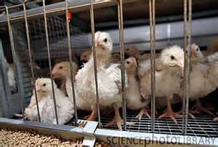
.
30 percent of livestock breeds are at risk of extinction; six breeds are lost each month
Notes:
The same issue faces us in the livestock sector where the search for uniformity and productivity have led to a focus on a very narrow range of breeds globally – On average just 5 breeds dominate commercial production in each of the 5 main species of livestock around the world. Holstein –Friesian dairy cows are found in 128 countries for example, whilst the Large White pig is farmed in 117 countries and the White Leghorn Chicken is found almost everywhere. Although the result has been an increase in productivity the narrowing of the gene pool carries with it real risk. Avian influenza and Mexican swine flu (H1N1) are just two recent examples of global pandemics largely provoked by extreme genetic uniformity in commercial breeds raised in confined spaces.

Slide 28
Technology Injustices
Access
Use
Innovation

Slide 29
10/90 Gap today
Røttingen, J; Regmi, S; et-al, The Lancet, May 2013

Slide 30
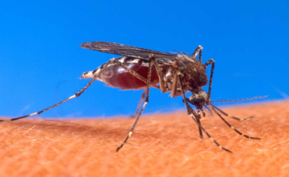

Weak market signals for R&D on diseases of poverty
‘Our priorities are tilted by marketplace imperatives. The malaria vaccine in humanist terms is the biggest need. But it gets virtually no funding. But if you are working on male baldness…you get an order of magnitude more research funding’
Bill Gates 2013
VS

Slide 31
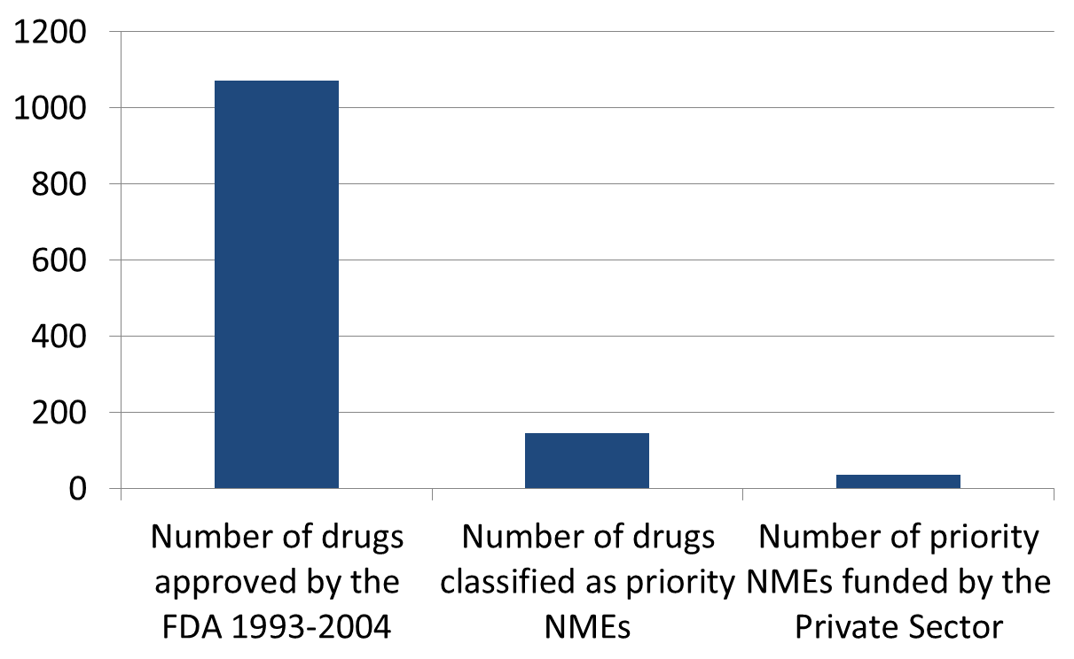
But weak market signals for new medicines in the US too!
Prof Marianna Mazzucato, The Entrepreneurial State (2014)

Slide 32
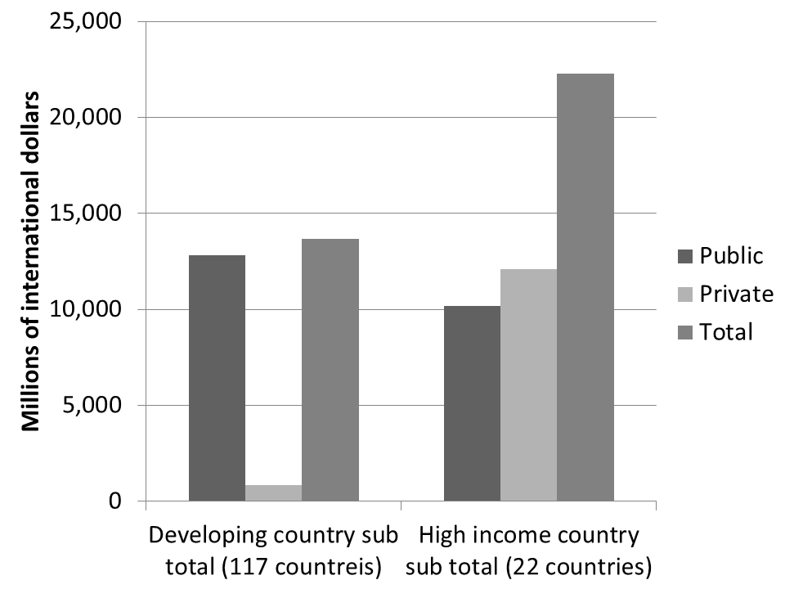
Agriculture R&D – different sector, same story
Global expenditure on agricultural R&D, 2000, based on figures from (Pardey & et_al, 2006)

Slide 33
Renewable vs fossil fuel subsidy
5000
IMF 2013 Est.
$4900 billion
$ billions per annum
IEA 2013 Est.
IEA 2013 Est.
$121 billion
$550 billion
Annual global renewables public subsidy
Annual global fossil fuel public subsidy
Notes:
IRENA – the intergovernmental renewable energy body – estimated that if you included these pollution costs or subsidies then the total annual subsidy to the fossil fuel industry is closer to $1900 billion per annum – 39 times the required annual investment and 145 times the current actual investment in energy access.
So next time someone tells you there is no way we could ever find sufficient public funding to make a bigger contribution to energy access take that with a pinch of salt!

Slide 34
Governing Technology

Slide 35

Biosphere integrity
Climate Change
Zone of Uncertainty
Zone of Uncertainty
safe planetary boundary
Novel entities
Land system change
Stratospheric ozone depletion
Freshwater use
Atmospheric aerosol loading
Biogeochemical flows
Ocean acidification

Slide 36
Biosphere integrity
Climate Change
safe planetary boundary
Novel entities
Safe, inclusive, sustainable space for development Safe, inclusive, sustainable space for development
Land system change
Social foundation
Water
Food
Income
Health
Education
Stratospheric ozone depletion
Gender equality
Social equity
Resilience
Freshwater use
Energy
Voice
Jobs
Atmospheric aerosol loading
Biogeochemical flows
Ocean acidification

Slide 37
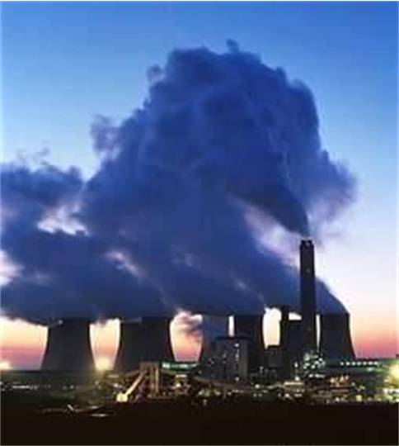
Biosphere integrity
Climate Change
safe planetary boundary
Novel entities
Safe, inclusive, sustainable space for development Safe, inclusive, sustainable space for development
Land system change
Social foundation
Water
Food
Income
Health
Education
Stratospheric ozone depletion
Gender equality
Social equity
Resilience
Freshwater use
Energy
Voice
Jobs
Atmospheric aerosol loading
Biogeochemical flows
Ocean acidification

Slide 38
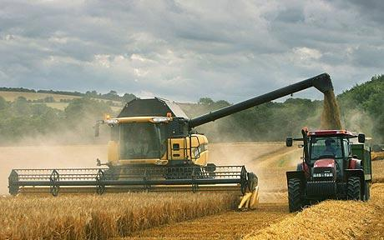
Biosphere integrity
Climate Change
safe planetary boundary
Novel entities
Safe, inclusive, sustainable space for development Safe, inclusive, sustainable space for development
Land system change
Social foundation
Water
Food
Income
Health
Education
Stratospheric ozone depletion
Gender equality
Social equity
Resilience
Freshwater use
Energy
Voice
Jobs
Atmospheric aerosol loading
Biogeochemical flows
Ocean acidification

Slide 39
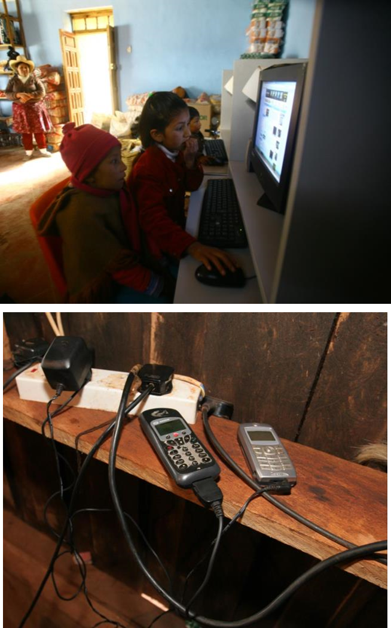
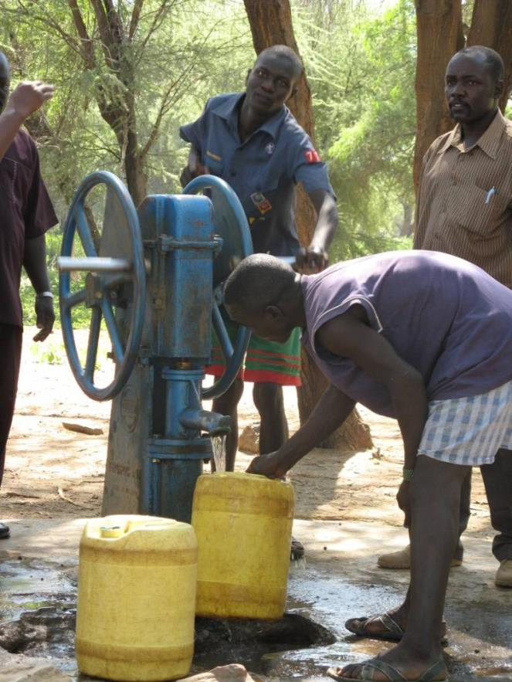

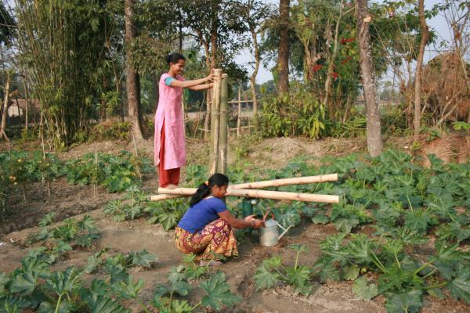
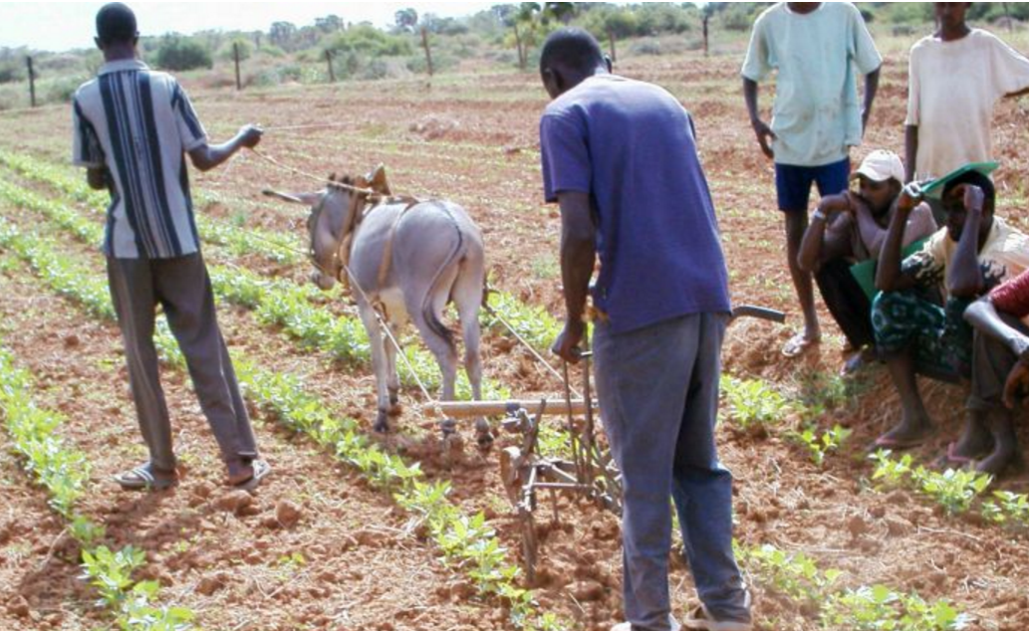

Biosphere integrity
Climate Change
safe planetary boundary
Novel entities
Safe, inclusive, sustainable space for development Safe, inclusive, sustainable space for development
Land system change
Social foundation
Water
Food
Income
Health
Education
Stratospheric ozone depletion
Gender equality
Social equity
Resilience
Freshwater use
Energy
Voice
Jobs
Atmospheric aerosol loading
Biogeochemical flows
Ocean acidification

Slide 40
Biosphere integrity
Climate Change
safe planetary boundary
Novel entities
Safe, inclusive, sustainable space for development Safe, inclusive, sustainable space for development
Land system change
Social foundation
Water
Food
Income
Health
Education
Stratospheric ozone depletion
Gender equality
Social equity
Resilience
Freshwater use
Energy
Voice
Jobs
Atmospheric aerosol loading
Biogeochemical flows
Ocean acidification

Slide 41
Biosphere integrity
Climate Change
Safe planetary boundary
Control of technologies for safe environmental ceiling
Novel entities
Safe, inclusive, sustainable space for development
Technology Justice
Land system change
Access to technologies for minimum social foundation
Water
Food
Income
Health
Education
Stratospheric ozone depletion
Gender equality
Social equity
Resilience
Freshwater use
Energy
Voice
Jobs
Atmospheric aerosol loading
Biogeochemical flows
Ocean acidification

Slide 42
Technology Justice
Where everyone has access to the technologies that are essential for a basic standard of life, in a sustainable way that doesn’t prevent others now, or in the future, from doing the same.

Slide 43
So is Small still Beautiful?
Notes:
Humanity has lost control of technology, or rather relinquished it to the vagaries of the market, assuming its ‘invisible hand’ will ensure the most efficient development and dissemination of technology that best meets people’s needs.
The result is failure. Failure to provide universal access to a set of basic technologies that are key to achieving a basic standard of living and a minimum social foundation. Failure to control the use of technologies to avoid the risk of breaching planetary boundaries. And failure to guide technology innovation in a direction which addresses the massive challenges of global poverty and environmental sustainability that the world now faces.
We have to reboot our relationship with technology. This is not incremental change but a radical shift in the way oversight and governance of innovation and access to and use of technology is provided. The lens of Technology Justice has to be used to recognise that some choices are more likely to lead to that safe and equitable space for human development, whilst other choices are more likely to lead in the opposite direction. Responsibility needs to be taken for those decisions rather than hoping market mechanisms can make them by default and without intervention.
This is a massive undertaking. Systemic change on a global scale. The point of this forum is to explore how the first steps on that journey might be taken, so I’m not even going to attempt to provide a roadmap. But I do want to finish by offering up some of the questions I think its going to be important to consider and debate in drawing that roadmap.

Slide 44
Schumacher wasn’t all about ‘Small’
Things have changed
Bigger problem; smaller time to resolve
‘What I wish to emphasise is the duality of the human requirement when it comes to the question of size: there is no single answer. For his different purposes man needs many different structures , both small ones and large ones, some exclusive and some comprehensive….’

Slide 45
Access
Define the social foundation and identify the technologies needed to support it

Slide 46


Slide 47
Access
Define the social foundation and identify the technologies needed to support it
Improve our understanding of what influences the success of innovation and technology transfer in developing economies

Slide 48
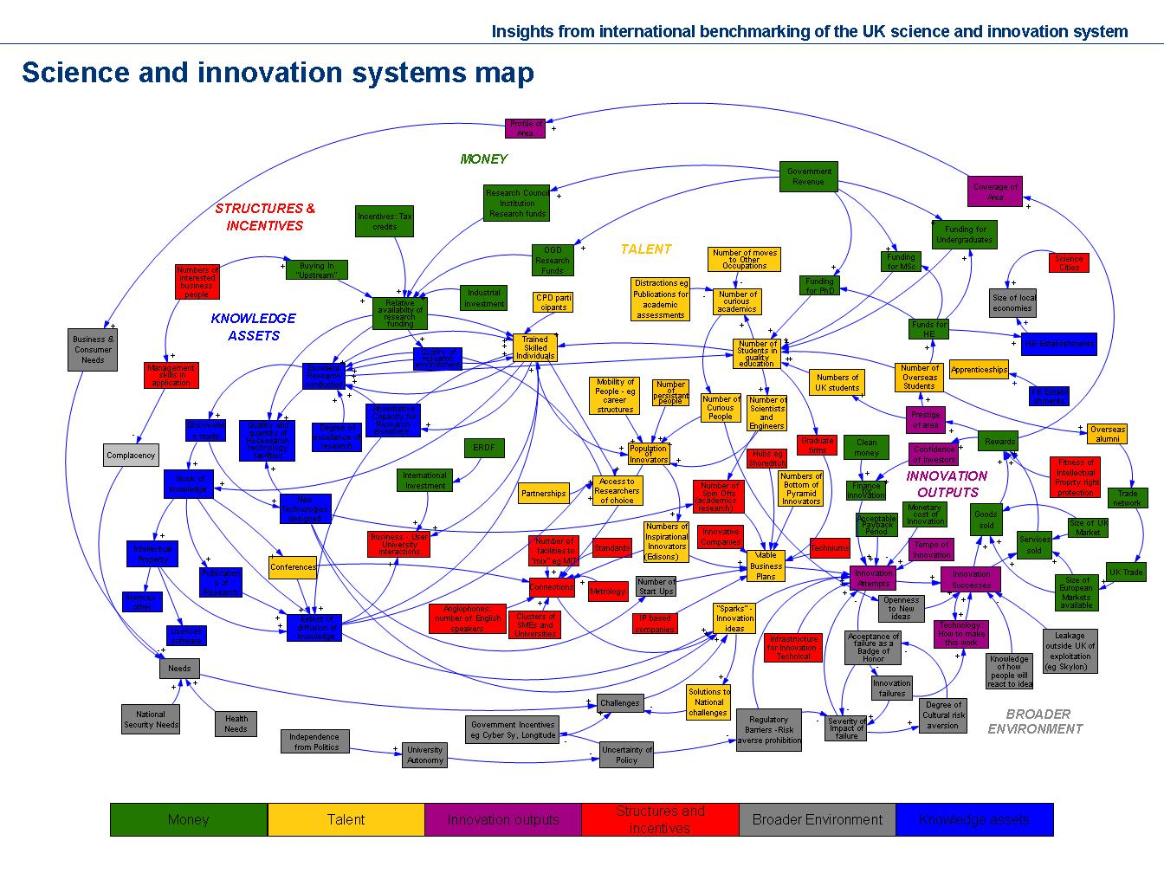

Slide 49
Access
Can we agree the social foundation and the technologies needed to support it?
Improve our understanding of what influences the success of innovation and technology transfer in developing economies.
Change the finance debate

Slide 50
Finance- requirement vs available
100
$ billions per annum
IEA 2011 Est.
50
$4.4 b/yr
$44.5 b/yr
IEA 2013
$0.4 b/yr
$12.7 b/yr
Annual cost to achieve universal access by 2030
Current annual investment in access
Notes:
IEA 2011 IEA estimate most commonly used to predict costs per annum to achieve universal access (elec and cooking) by 2030 – NOW SDG!
Latest (2015) IEA figures for actual spend are for the year 2013 – This is up 40% on 2009 figure ($9b) – so some good news. But still less than 25% of annual spend needed
Big question is how to fill that gap? Conventional wisdom is that public subsidy is not the answer…. There will never be enough to meet these massive investment requirements. Prob. right to say shouldn’t rely on pub. Subsidy alone. But just for the sake of argument lest see how big that investment requirement is to existing pub. Subsidies…. Say for example on FOSSIL FUELS!!

Slide 51
Subsidy?
5000
IMF 2013 Est.
$4900 billion
$ billions per annum
IEA 2013 Est.
IEA 2011 Est.
IEA 2013
$550 billion
Annual cost to achieve universal access by 2030
Current annual investment in access
Annual global fossil fuel public subsidy
Notes:
IRENA – the intergovernmental renewable energy body – estimated that if you included these pollution costs or subsidies then the total annual subsidy to the fossil fuel industry is closer to $1900 billion per annum – 39 times the required annual investment and 145 times the current actual investment in energy access.
So next time someone tells you there is no way we could ever find sufficient public funding to make a bigger contribution to energy access take that with a pinch of salt!

Slide 52
Use
Foster public debate and consensus on managing risks associated with technology development and use

Slide 53
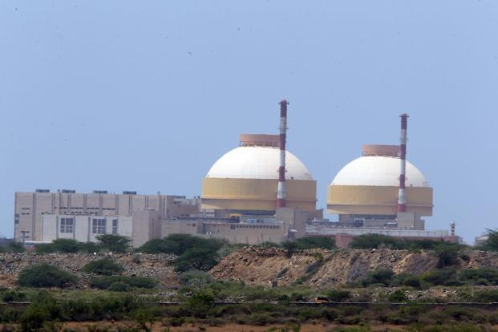


Choices
Notes:
IRENA – the intergovernmental renewable energy body – estimated that if you included these pollution costs or subsidies then the total annual subsidy to the fossil fuel industry is closer to $1900 billion per annum – 39 times the required annual investment and 145 times the current actual investment in energy access.
So next time someone tells you there is no way we could ever find sufficient public funding to make a bigger contribution to energy access take that with a pinch of salt!

Slide 54
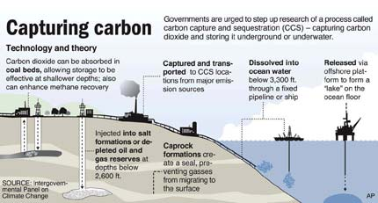

Choices

Slide 55


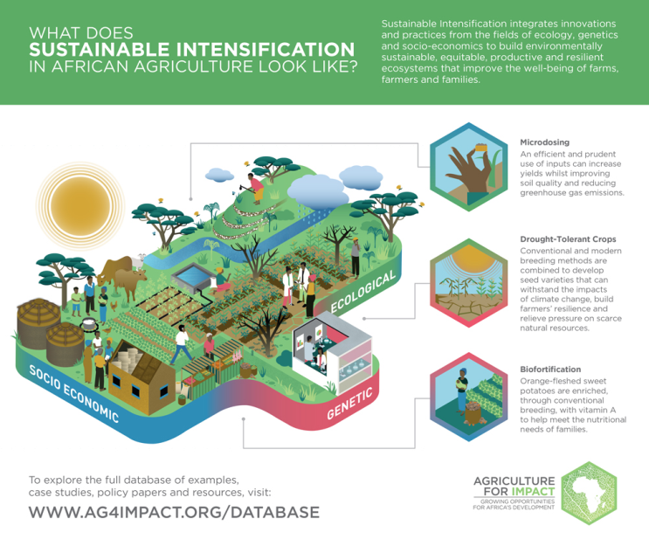
Choices

Slide 56
Use
Foster public debate and consensus on managing risks associated with technology development and use?
Consider alternative economic models

Slide 57
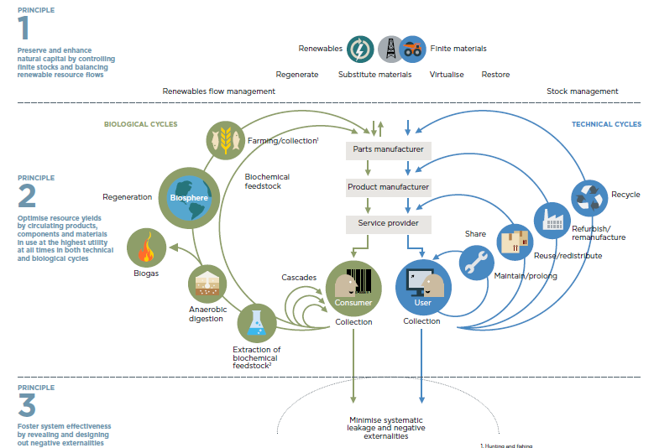

Slide 58
Innovation
Agree the most urgent technology innovation needs and co-ordinate research agendas and funding
Notes:
Humanity has lost control of technology, or rather relinquished it to the vagaries of the market, assuming its ‘invisible hand’ will ensure the most efficient development and dissemination of technology that best meets people’s needs.
The result is failure. Failure to provide universal access to a set of basic technologies that are key to achieving a basic standard of living and a minimum social foundation. Failure to control the use of technologies to avoid the risk of breaching planetary boundaries. And failure to guide technology innovation in a direction which addresses the massive challenges of global poverty and environmental sustainability that the world now faces.
We have to reboot our relationship with technology. This is not incremental change but a radical shift in the way oversight and governance of innovation and access to and use of technology is provided. The lens of Technology Justice has to be used to recognise that some choices are more likely to lead to that safe and equitable space for human development, whilst other choices are more likely to lead in the opposite direction. Responsibility needs to be taken for those decisions rather than hoping market mechanisms can make them by default and without intervention.
This is a massive undertaking. Systemic change on a global scale. The point of this forum is to explore how the first steps on that journey might be taken, so I’m not even going to attempt to provide a roadmap. But I do want to finish by offering up some of the questions I think its going to be important to consider and debate in drawing that roadmap.

Slide 59


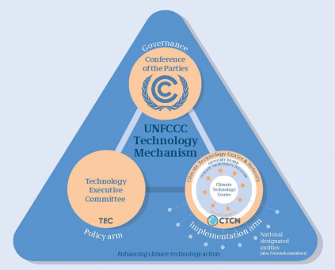

Global Health
Observatory

Slide 60
Innovation
How do we agree the most urgent technology innovation needs and co-ordinate research agendas and funding?
More emphasis on collaboration as an alternative to competition
Notes:
Humanity has lost control of technology, or rather relinquished it to the vagaries of the market, assuming its ‘invisible hand’ will ensure the most efficient development and dissemination of technology that best meets people’s needs.
The result is failure. Failure to provide universal access to a set of basic technologies that are key to achieving a basic standard of living and a minimum social foundation. Failure to control the use of technologies to avoid the risk of breaching planetary boundaries. And failure to guide technology innovation in a direction which addresses the massive challenges of global poverty and environmental sustainability that the world now faces.
We have to reboot our relationship with technology. This is not incremental change but a radical shift in the way oversight and governance of innovation and access to and use of technology is provided. The lens of Technology Justice has to be used to recognise that some choices are more likely to lead to that safe and equitable space for human development, whilst other choices are more likely to lead in the opposite direction. Responsibility needs to be taken for those decisions rather than hoping market mechanisms can make them by default and without intervention.
This is a massive undertaking. Systemic change on a global scale. The point of this forum is to explore how the first steps on that journey might be taken, so I’m not even going to attempt to provide a roadmap. But I do want to finish by offering up some of the questions I think its going to be important to consider and debate in drawing that roadmap.

Slide 61








Slide 62
Innovation
How do we agree the most urgent technology innovation needs and co-ordinate research agendas and funding?
More emphasis on collaboration as an alternative to competition
Accept and support a more entrepreneurial role for governments
Notes:
Humanity has lost control of technology, or rather relinquished it to the vagaries of the market, assuming its ‘invisible hand’ will ensure the most efficient development and dissemination of technology that best meets people’s needs.
The result is failure. Failure to provide universal access to a set of basic technologies that are key to achieving a basic standard of living and a minimum social foundation. Failure to control the use of technologies to avoid the risk of breaching planetary boundaries. And failure to guide technology innovation in a direction which addresses the massive challenges of global poverty and environmental sustainability that the world now faces.
We have to reboot our relationship with technology. This is not incremental change but a radical shift in the way oversight and governance of innovation and access to and use of technology is provided. The lens of Technology Justice has to be used to recognise that some choices are more likely to lead to that safe and equitable space for human development, whilst other choices are more likely to lead in the opposite direction. Responsibility needs to be taken for those decisions rather than hoping market mechanisms can make them by default and without intervention.
This is a massive undertaking. Systemic change on a global scale. The point of this forum is to explore how the first steps on that journey might be taken, so I’m not even going to attempt to provide a roadmap. But I do want to finish by offering up some of the questions I think its going to be important to consider and debate in drawing that roadmap.

Slide 63

Setting direction where market signals are too weak
Investing where risks, complexities, or costs are too high for the private sector to act alone.
Changing the rules to reward value addition and penalise parasitic and product-less behaviour by corporations.
Move from de-risking for private investors to the sharing of risk and reward

Slide 64
So is Small still Beautiful?
Notes:
Humanity has lost control of technology, or rather relinquished it to the vagaries of the market, assuming its ‘invisible hand’ will ensure the most efficient development and dissemination of technology that best meets people’s needs.
The result is failure. Failure to provide universal access to a set of basic technologies that are key to achieving a basic standard of living and a minimum social foundation. Failure to control the use of technologies to avoid the risk of breaching planetary boundaries. And failure to guide technology innovation in a direction which addresses the massive challenges of global poverty and environmental sustainability that the world now faces.
We have to reboot our relationship with technology. This is not incremental change but a radical shift in the way oversight and governance of innovation and access to and use of technology is provided. The lens of Technology Justice has to be used to recognise that some choices are more likely to lead to that safe and equitable space for human development, whilst other choices are more likely to lead in the opposite direction. Responsibility needs to be taken for those decisions rather than hoping market mechanisms can make them by default and without intervention.
This is a massive undertaking. Systemic change on a global scale. The point of this forum is to explore how the first steps on that journey might be taken, so I’m not even going to attempt to provide a roadmap. But I do want to finish by offering up some of the questions I think its going to be important to consider and debate in drawing that roadmap.

Slide 65
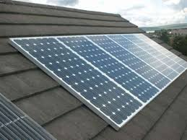



Slide 66
