Slide 1
We have the technology...
Robert Vale, Brenda Vale
Victoria University of Wellington
New Zealand
robert.vale@vuw.ac.nz
brenda.vale@vuw.ac.nz

Slide 2
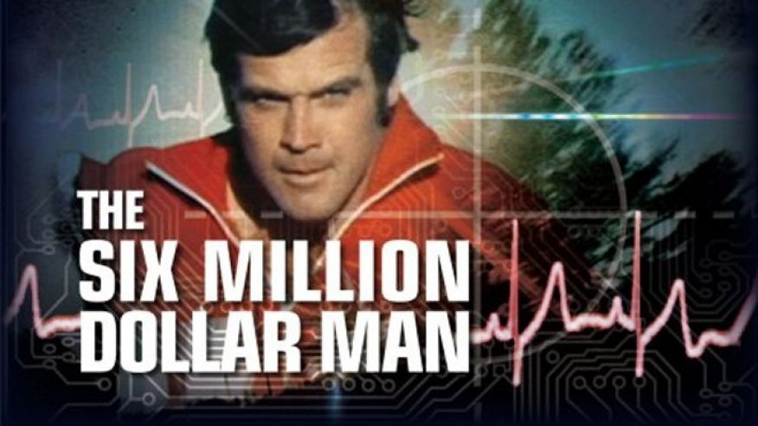
http://www.foxnews.com/science/2013/08/28/whats-6-million-dollar-man-worth-today.html
“We have the technology” was a slogan from this 1970s’ tv series

Slide 3
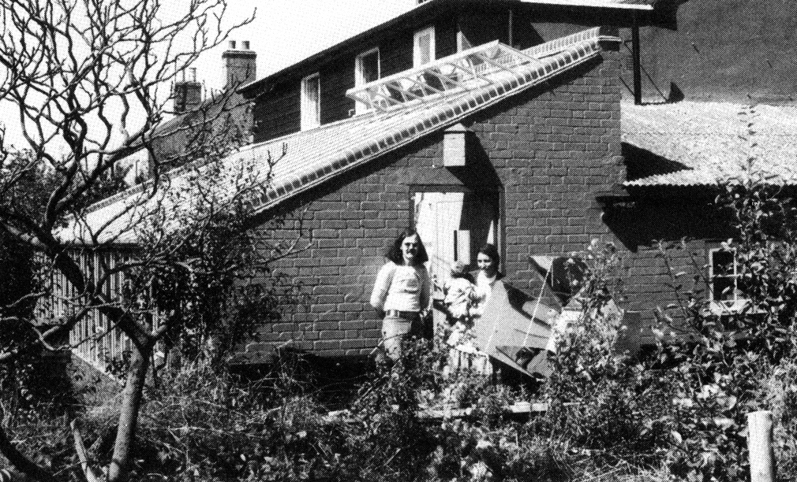
In 1972 we moved into The Horse and Gate. a former pub in Cambridgeshire, UK, to experiment with technology for sustainable living. To the right of Brenda you can see our home made solar cooker

Slide 4
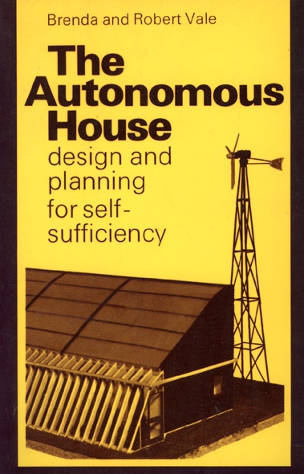
We wrote our first book on technology for sustainable design in 1975

Slide 5
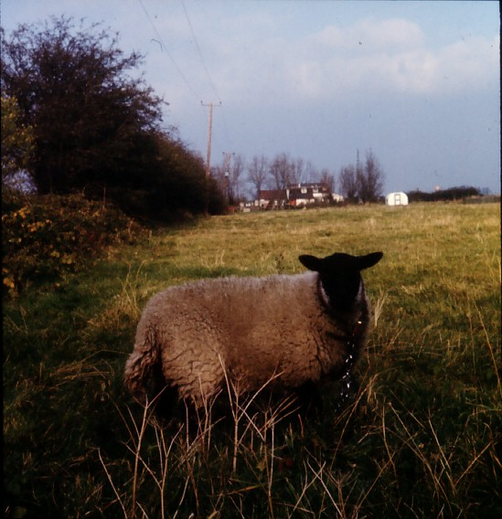
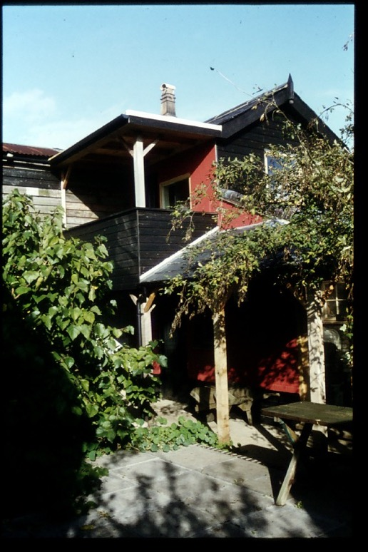
The Horse and Gate project in Cambridgeshire (1972-1982) was a low-energy conversion of an existing house, combined with a smallholding for food production
Beatrice the sheep was very tasty...

Slide 6
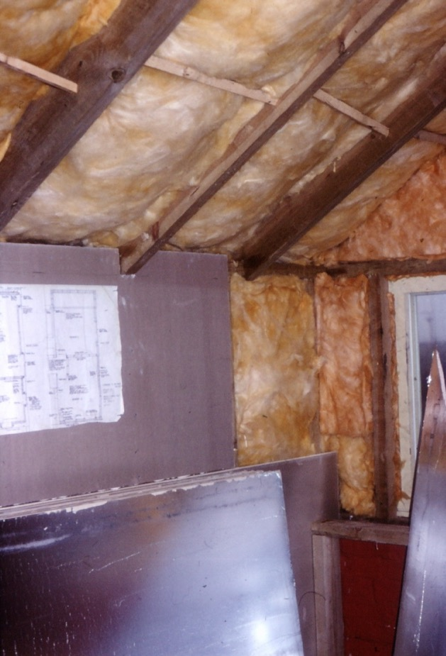
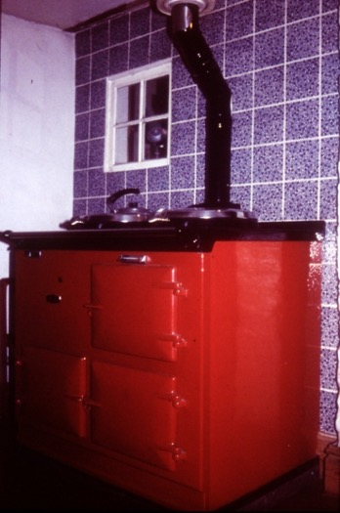
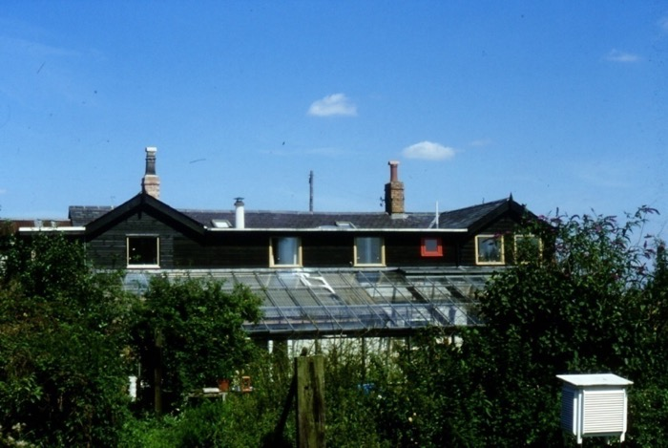
Superinsulated construction applied to the existing house and to the new extensions meant the whole building could be heated with a 1kW solid fuel stove, which also supplied cooking and hot water

Slide 7
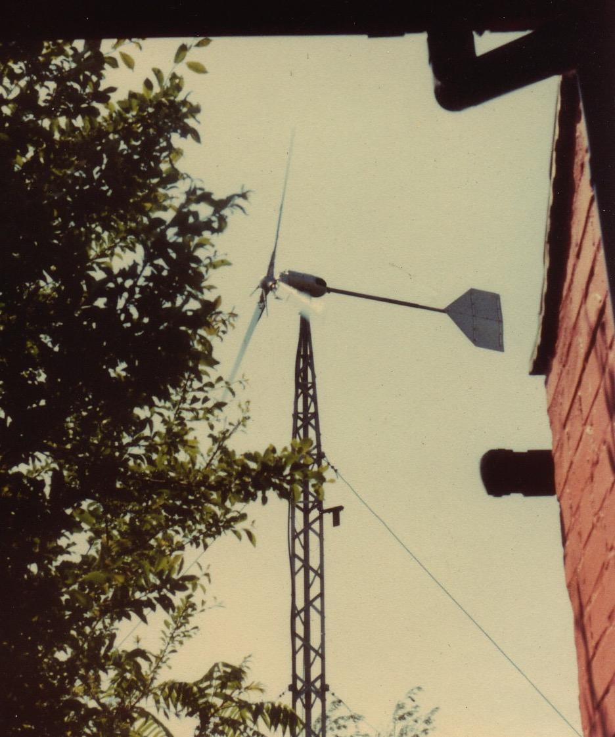
A 5kW wind turbine drove the electricity meter backwards, and lots of insulation reduced the energy demand by 80% compared to the original house

Slide 8
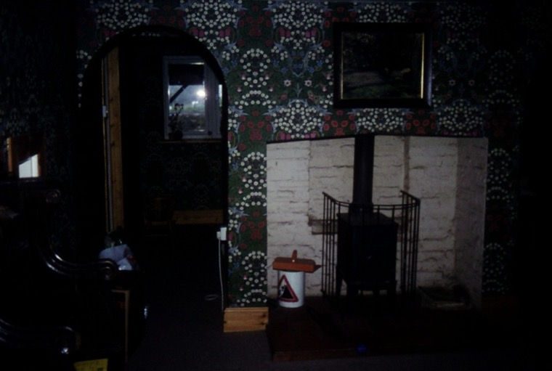
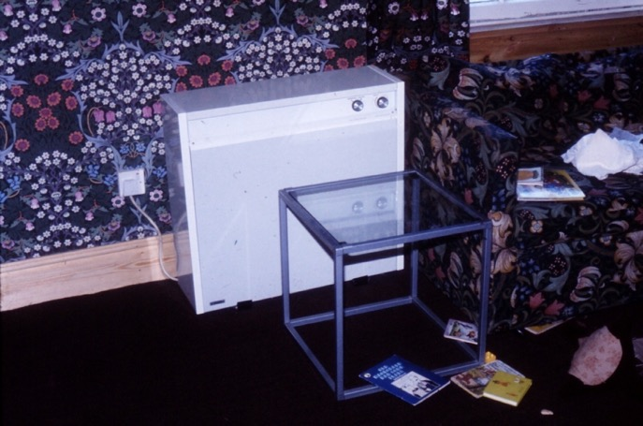
Back-up heating was with wood, plus electric storage heaters fed by the wind generator

Slide 9
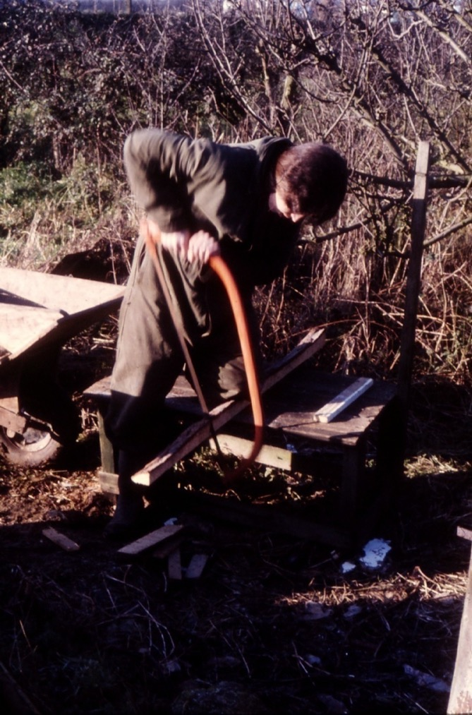
It took two hours to saw enough firewood, from sawmill waste, for a week of heating in the winter

Slide 10
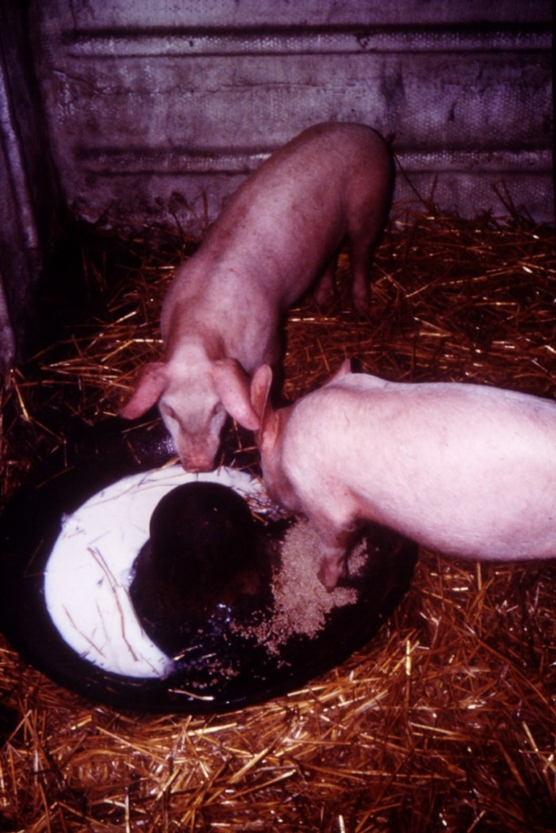
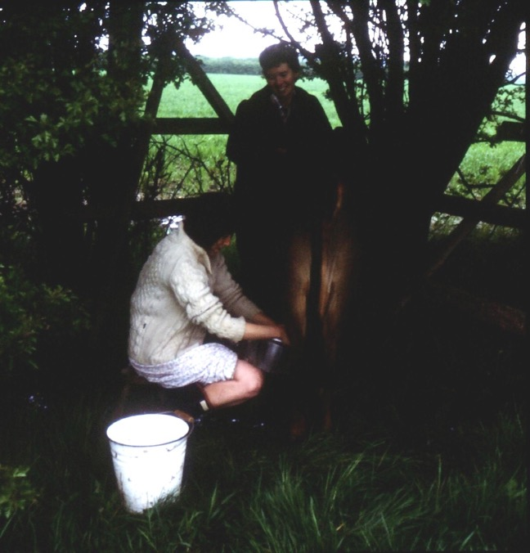
It was not only a technology project, we also grew most of our food including milk and meat

Slide 11
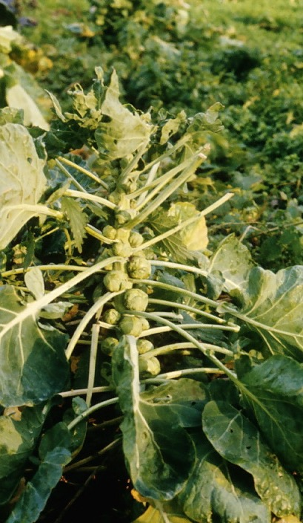
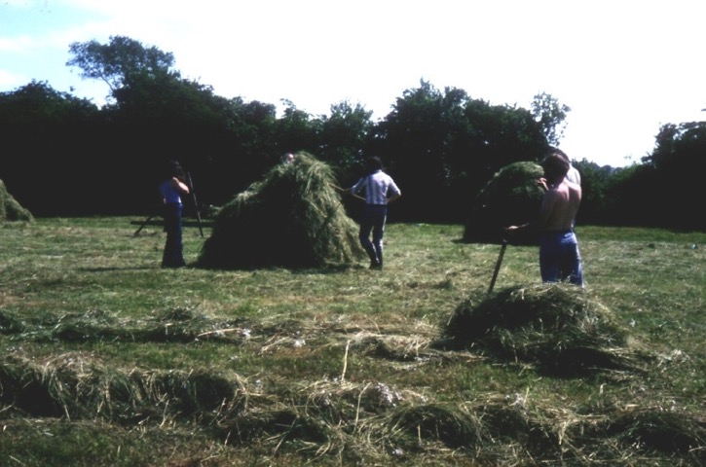
It took two hours of work a day to produce 75% of our food. On the left, members of the Technology Faculty of the Open University help with the hay harvest

Slide 12
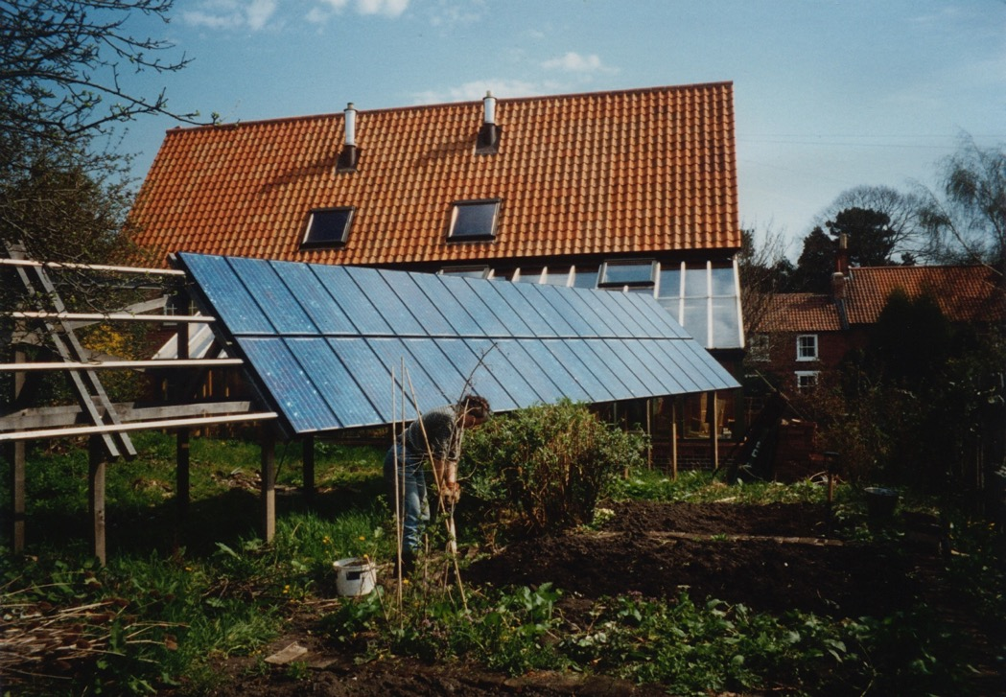
In 1993 we built the Autonomous House. It is in a designated heritage Conservation Area in Southwell, Nottinghamshire and obtains its services – heating, electricity, water and sewage treatment - from its environment

Slide 13
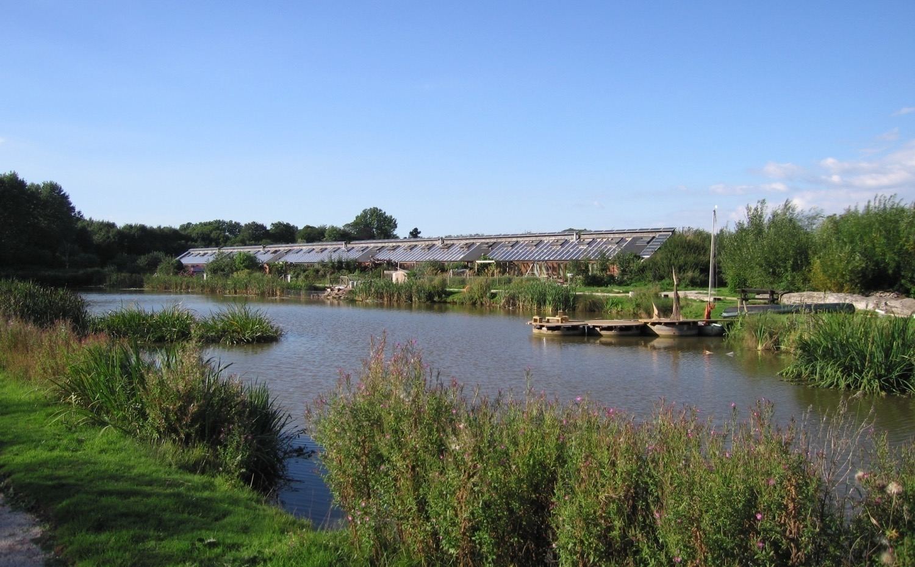
We went on to design the zero-emission, autonomous cooperative Hockerton Housing Project (1998) in Hockerton, a nearby village

Slide 14
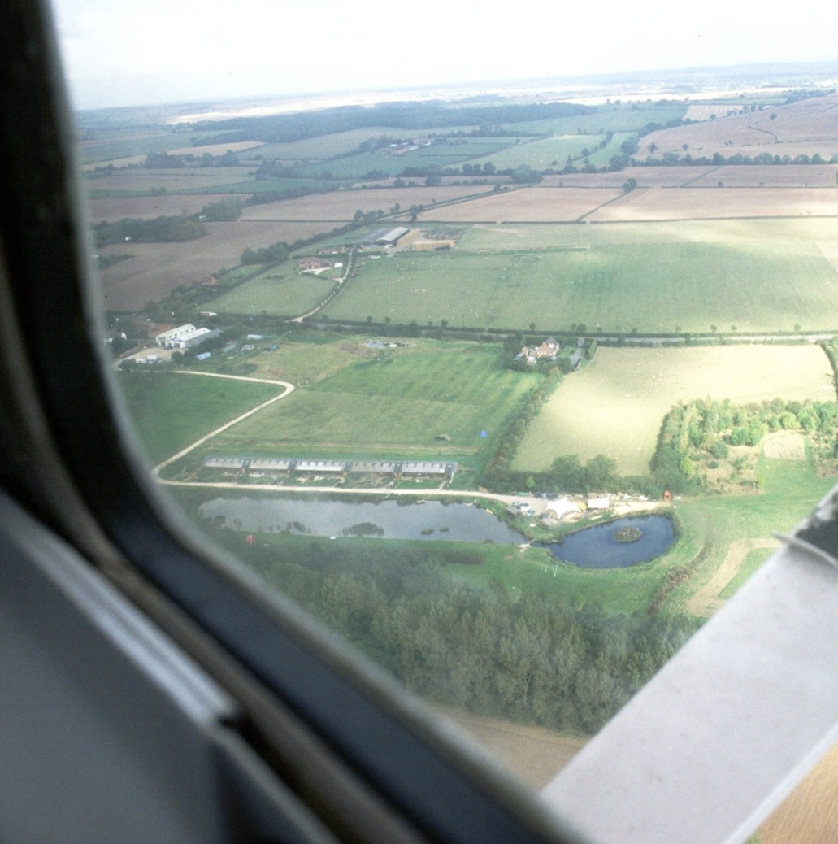
The project comprises five houses overlooking a large purpose built lake used for sewage treatment, fish farming, wildlife and swimming

Slide 15
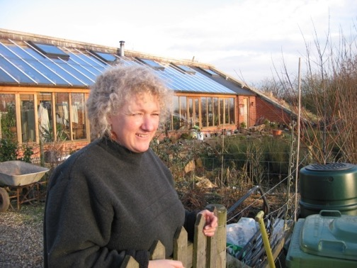
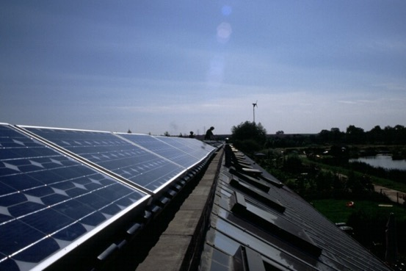
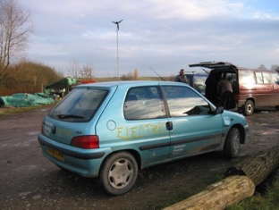
The Hockerton Housing Project “ticked all the boxes” 18 years ago
Organisation is as a cooperative
Construction is passive solar using low-impact healthy materials
Interiors use natural water-based finishes and allergy-free ceramic flooring
Energy is from wind turbines and PV panels, with export to the grid
Sewage is turned into compost
Transport is provided by a renewably-charged electric car and pedal power
Food is grown on the site and 5,000 native trees have been planted
Wildlife habitat has been created by the lake and surroundings
Cost was similar to conventional housing

Slide 16
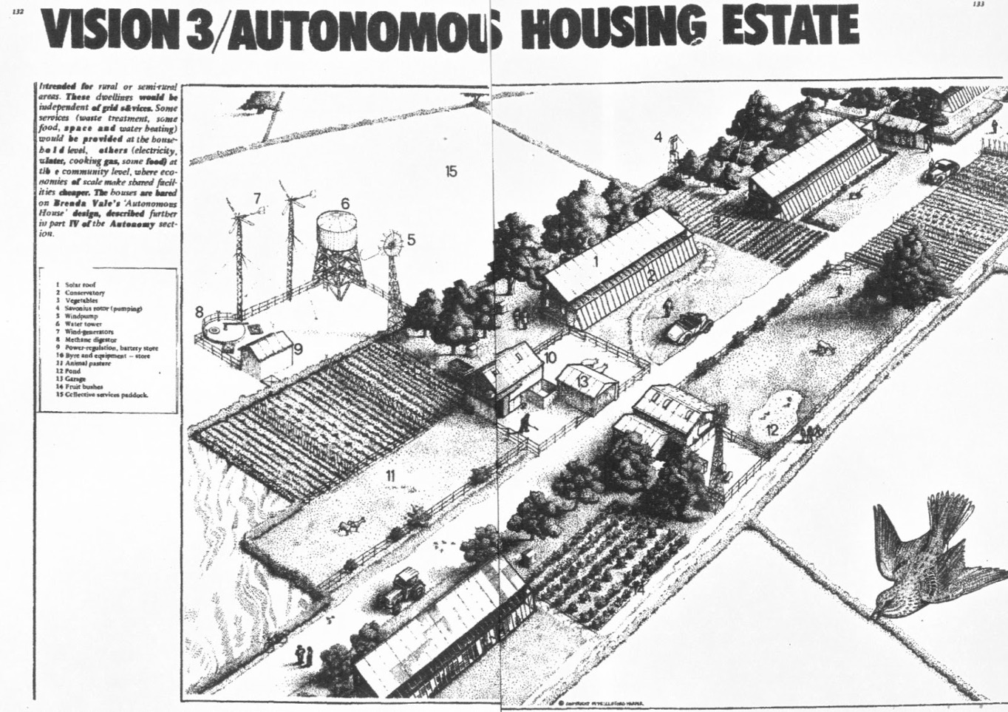
Not too far from Cliff Harper’s vision...?

Slide 17
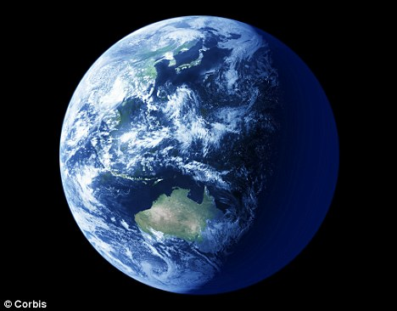
But where has this got us?
?
=
7,345,000,000 people
http://www.census.gov/popclock/
http://www.how-things-work-science-projects.com/images/planet_earth_500x499-56k.jpg

Slide 18
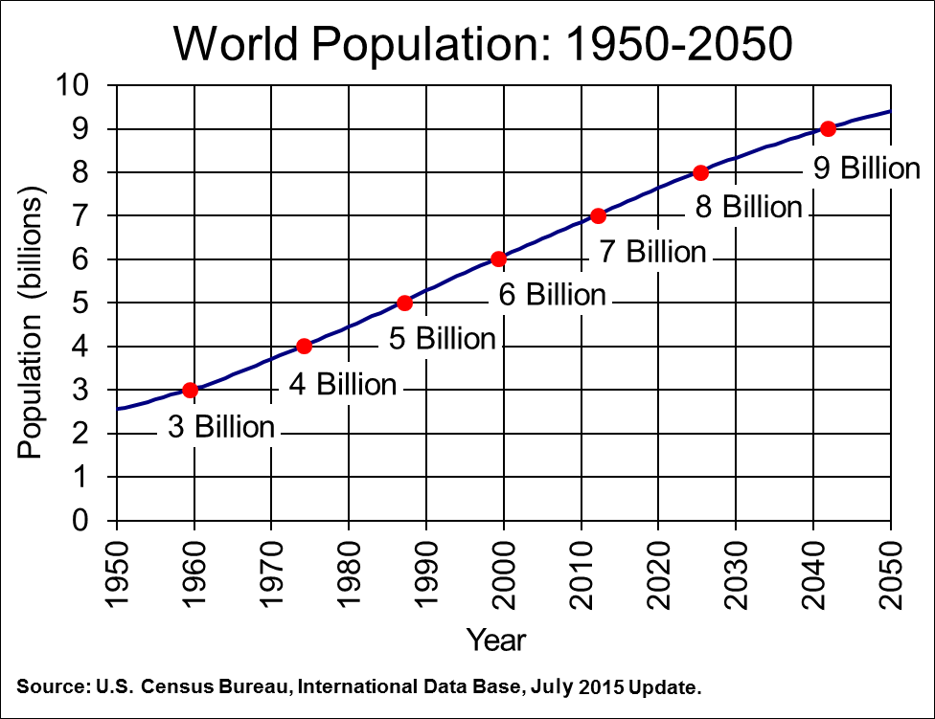
http://www.census.gov/population/international/data/idb/worldpopgraph.php
40 years
In the 40 years since Radical Technology was published, population has nearly doubled...

Slide 19
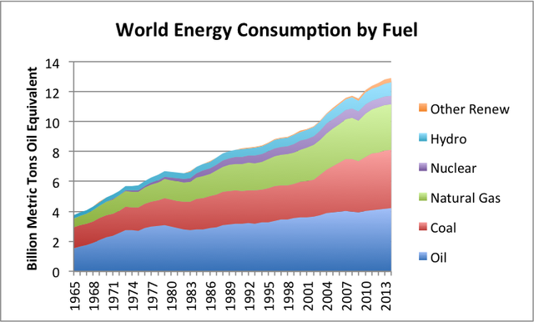
https://ourfiniteworld.com/2015/06/23/bp-data-suggests-we-are-reaching-peak-energy-demand/
40 years
...consumption of non-renewable energy sources has doubled....

Slide 20
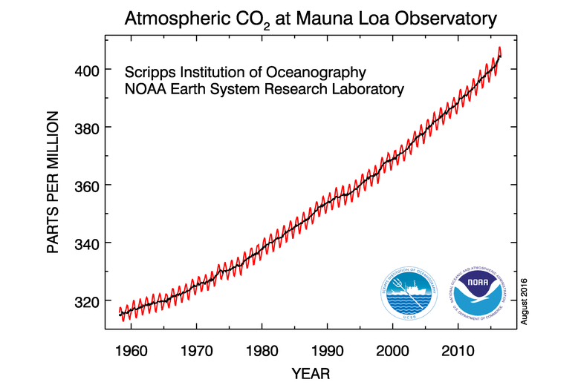
40 years
http://www.esrl.noaa.gov/gmd/ccgg/trends/
...CO₂ has gone from 330 ppm to over 400ppm

Slide 21
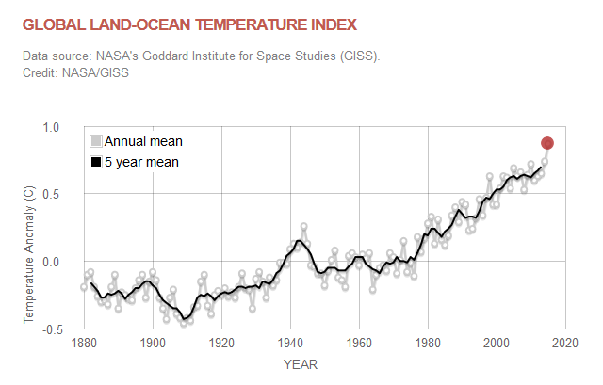
http://climate.nasa.gov/vital-signs/global-temperature/
40 years
In the forty year period global temperature has gone up by 0.87ºC over the 1951-1980 average

Slide 22
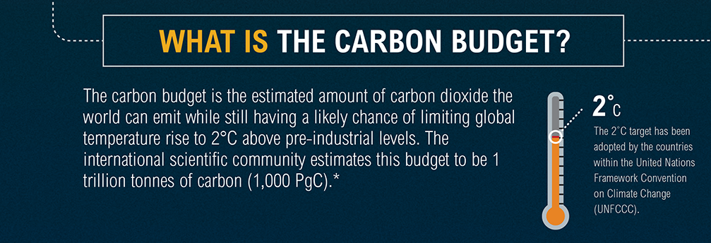
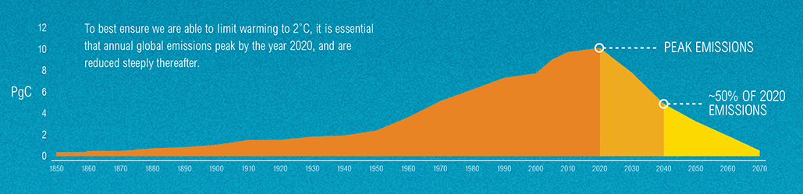
Some attempts are being made to take account of, and possibly to reduce, carbon emissions. We need to learn to live within a total “carbon budget” if we are to avoid severe consequences of unchecked climate change. The IPCC shows that emissions have to begin to fall in no more than four years’ time. There is no sign of this happening
http://www.wri.org/sites/default/files/WRI13-IPCCinfographic-FINAL_web.png

Slide 23
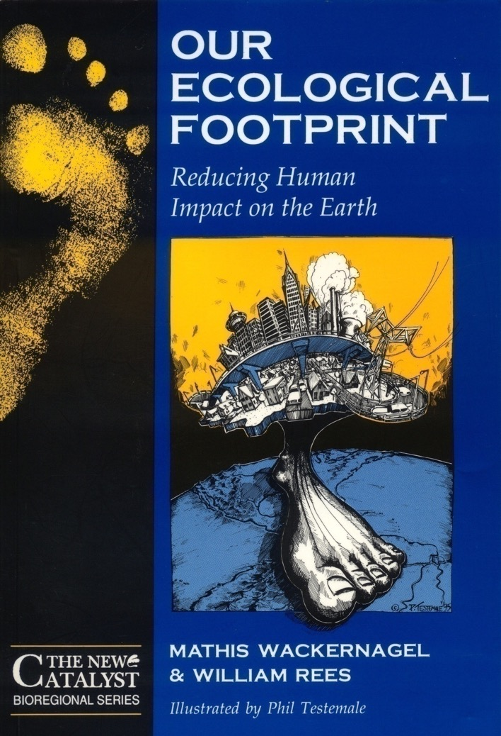
In an attempt to reveal the full impact of humanity on the planet our research for many years has used the Ecological Footprint, developed in Canada by Wackernagel and Rees (1996)

Slide 24
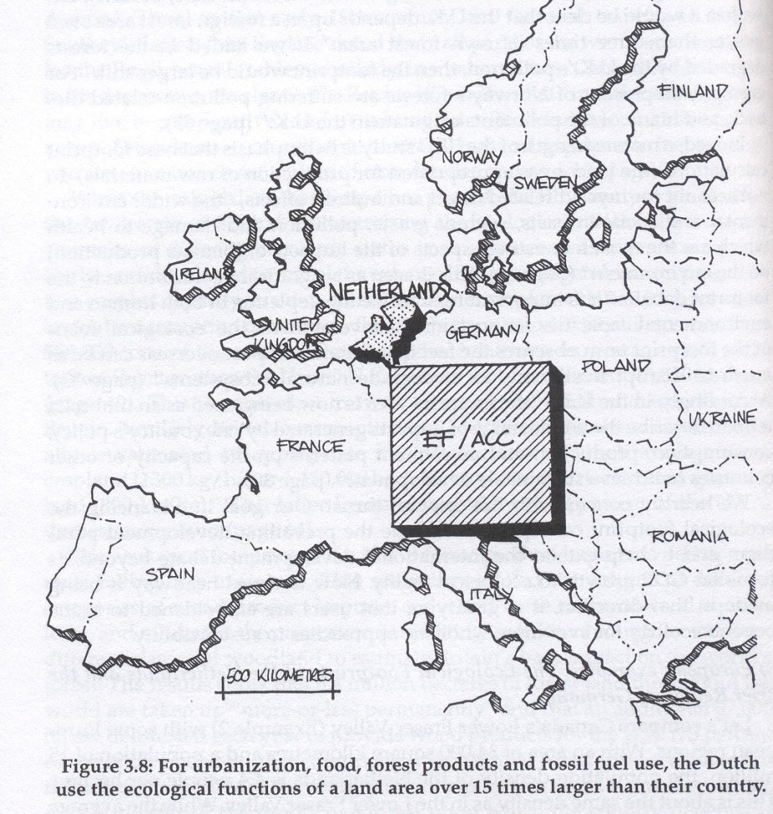
The Ecological Footprint is the area of land that would be required to provide sustainably all of a society’s goods and services. It can be measured from the scale of the individual to the scale of a whole country

Slide 25
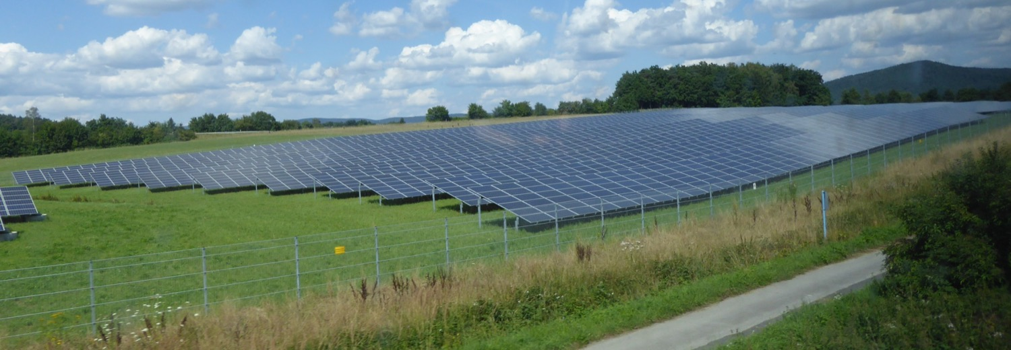
Ecological Footprint is measured in “global hectares” (gha). A global hectare is a hectare of land of average productivity
A hectare of land can be used to produce energy or food or fibre or materials, but it cannot produce all simultaneously
Land is a finite resource, there is a fixed quantity

Slide 26
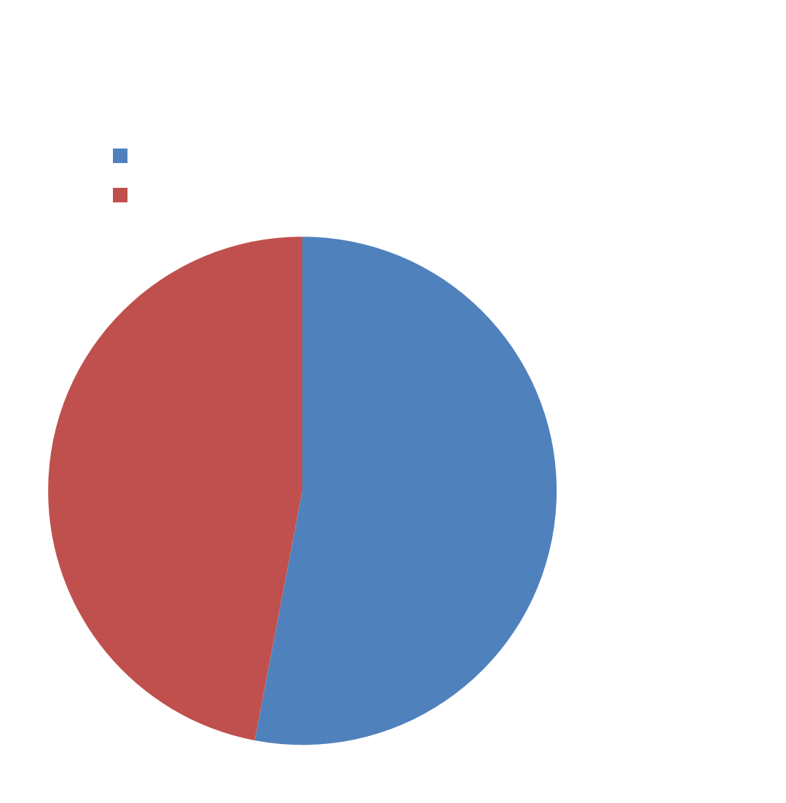
Ewing B., Moore D., Goldfinger S., Oursler A., Reed A. and Wackernagel M. (2010) The Ecological Footprint Atlas 2010 Oakland Ca, USA: Global Footprint Network
Ewing B., Moore D., Goldfinger S., Oursler A., Reed A. and Wackernagel M. (2010) The Ecological Footprint Atlas 2010 Oakland Ca, USA: Global Footprint Network
Ewing B., Moore D., Goldfinger S., Oursler A., Reed A. and Wackernagel M. (2010) The Ecological Footprint Atlas 2010 Oakland Ca, USA: Global Footprint Network
According to data in Ewing et al
(Fig 3, p18) the carbon related part of the global Ecological Footprint in 2007 was only 53% of the total footprint
This makes clear that to count only carbon is missing much of the problem of human effects on the environment
Ewing B., Moore D., Goldfinger S., Oursler A., Reed A. and Wackernagel M. (2010) The Ecological Footprint Atlas 2010 Oakland Ca, USA: Global Footprint Network

Slide 27
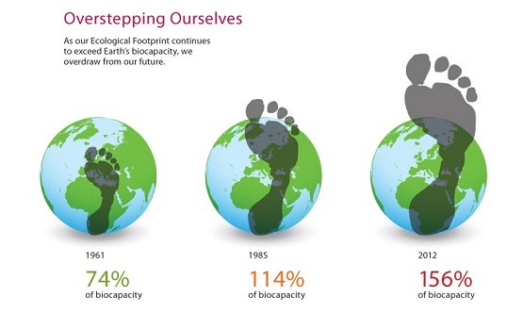
http://ecobnb.com/blog/2014/10/earth-overshoot-day/
We are already living beyond the resources that are available. In 2007 the world's average Ecological Footprint (EF) per person was 2.7 global hectares (gha) but the available bio-productive land and sea area, the “Fair Share EF", was only 1.8gha per person (Ewing et al op cit, p18)
This difference between the available area and the area actually used, known as the "overshoot", is made possible by using finite resources such as oil, coal, natural gas, uranium, limestone etc. that are mined from the earth's crust

Slide 28
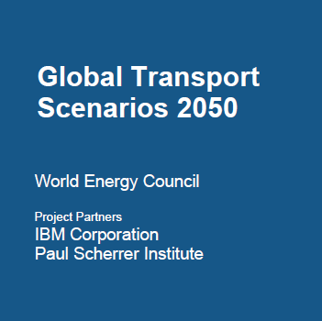
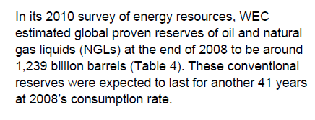
less than 40 years of oil...
We exceed the world's bio-capacity by using finite resources such as oil, gas and coal, BUT…
when they are gone all resources will have to come from the land

Slide 29
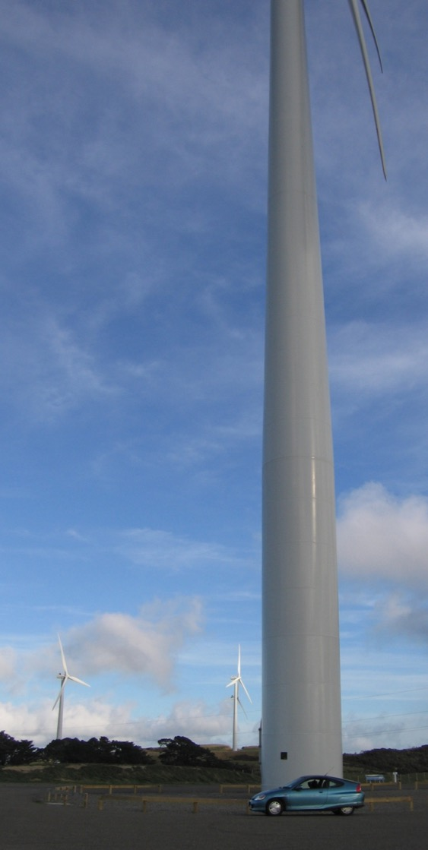
Why we use Ecological Footprint…
Bio-fuel vehicles | Land area for 10,000 km/year
Current diesel cars burning vegetable oil | 10,000m²
Horse eating grass and cereals | 8,500m²
Current petrol cars burning ethanol | 3,500m²
Efficient diesel cars burning veg. oil | 3,700m²
Efficient petrol cars burning ethanol | 1,900m²
Electric vehicles
Hydrogen cars using solar power | 75-90m²
Hydrogen cars using wind power | 18-22m²
Electric cars using solar power | 25m²
Electric cars using wind power | 6m²
All options here are zero-carbon, but the land needed for the same amount of transport varies from 6m² to 10,000m².

Slide 30
Me
You
Me
You
Ecological Footprint is based on the world’s fixed land area. If land is the measure, rather than money,
it is clear that
if I want to have more...
you will have to have less

Slide 31
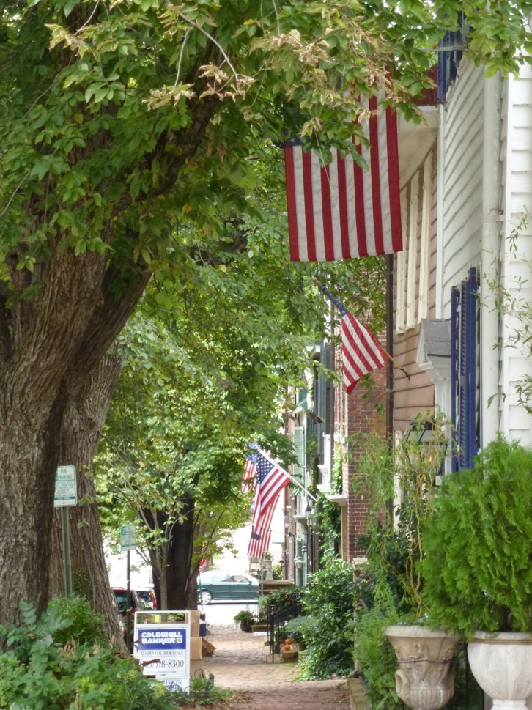
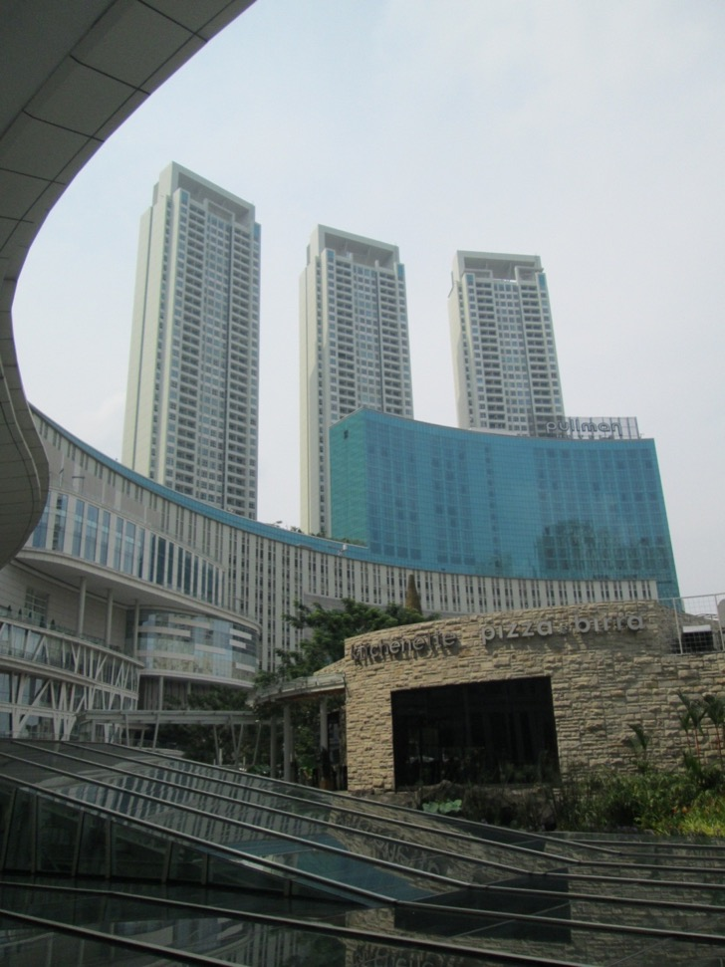
USA - Footprint 8.0gha Indonesia - Footprint 1.2gha
Nations which have footprints larger than the Fair Share are stealing from poorer nations the chance to improve their situation

Slide 32
Every year the population increases but the land area remains the same, so the Fair Share is smaller every year
Table 1: The change over time in global Fair Share Ecological Footprint
Date Population* Fair Share EF**
1961 3,084 million 3.2gha
1971 4,089 million 2.7gha (the year consumption exceeded biocapacity)
2007 6,631 million 1.8gha
7,176 million ?
* Population data from US Census Bureau (2013)
**Global Footprint data from Global Footprint Network, 2012)
Every year what we can all have becomes less
US Census Bureau (2013) International Programs: International Data Base available at http://www.census.gov/population/international/data/idb/worldpoptotal.php Viewed 20th November 2014
Global Footprint Network (2012) "World" 5th August. Available at http://footprintnetwork.org/en/index.php/GFN/page/trends/world/ Viewed 20th November 2014

Slide 33



From an economic perspective the poor appear to be getting richer...
Data from Vale R. and Vale B. (2009) Time to eat the Dog? London, Thames and Hudson – Table 3, p22
Country US$ 1996 value
United States of America
1972 US disposable personal income $13,692
2002 US disposable personal income $24,479
Increase over thirty years 79%
India
1972 India per capita income $ 1,100 8% of US income in 1972
2002 India per capita income $ 2,700 11% of US income in 2002
Increase over thirty years 145%
China
1972 China per capita income $500 4% of US income in 1972
2002 China per capita income $4,000 16% of US income in 2002
Increase over thirty years 700%
Table 2: Per capita income growth in some rich and poor countries

Slide 34
…but in fact economic growth since 1972 means that the poor are getting poorer compared to the rich
Data from Vale R. and Vale B. (2009) Time to eat the Dog? London, Thames and Hudson – Table 3, p22
Country US$ 1996 value
India
1972 Income gap with United States $12,592
2002 Income gap with United States $21,779
China
1972 Income gap with United States $13,192
Income gap with United States $20,479
Table 3: Per capita income gap for India and China compared with the United States
Over the last 30 years economic growth has favoured the rich

Slide 35

Growth means the rich can take more of the world’s resources –
"To make sure the UK can succeed in the global economy, we are taking action to stimulate economic growth..." (HM Treasury, 2013).
HM Treasury (2013) Policy: Achieving strong and sustainable economic growth 31 July Available at https://www.gov.uk/government/policies/achieving-strong-and-sustainable-economic-growth Viewed 3 December 2014

Slide 36
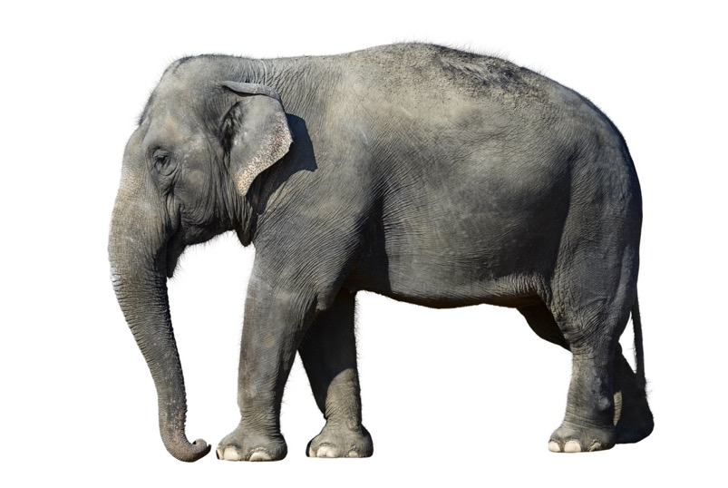

In nature, continuous growth is impossible – a mouse never grows into an elephant

Slide 37
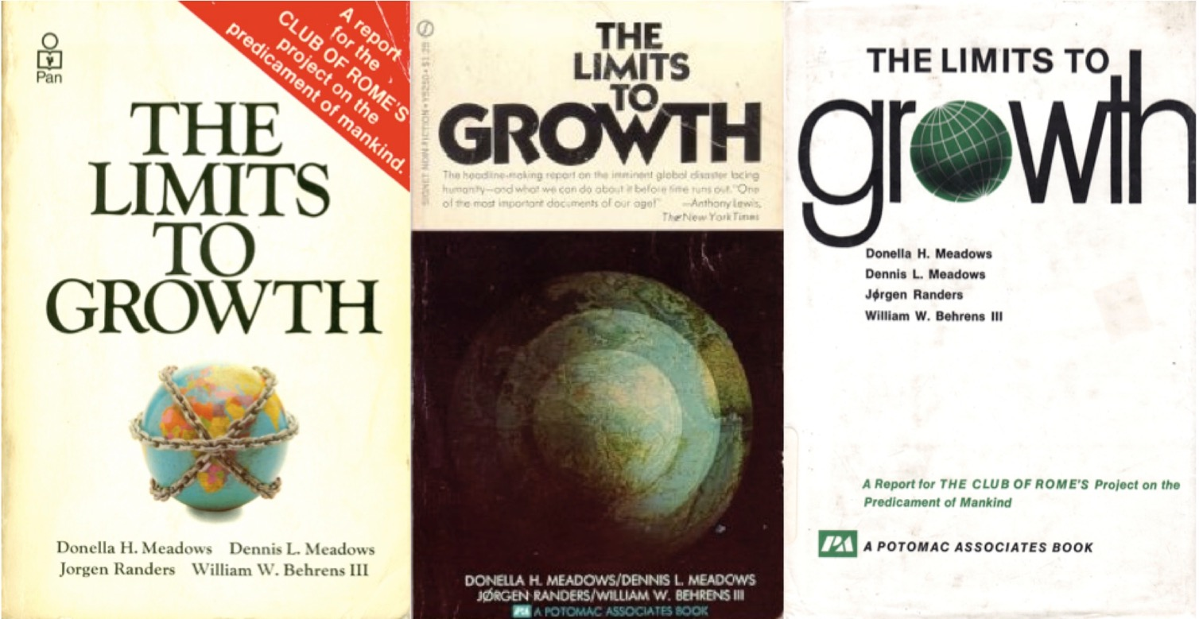
Because it is based on a fixed area of land the Ecological Footprint makes clear that there really are “limits to growth”, as proposed in this influential book by Meadows et al in 1972 ttps://limitstogrowthnet.wordpress.com/home/history/

Slide 38
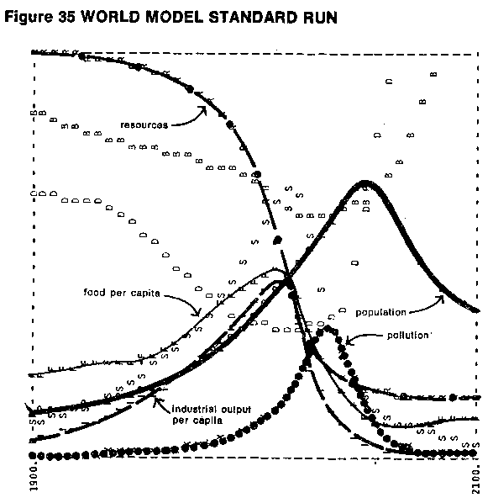
The Limits to Growth was published in 1972. It used early computer modelling to show that global society would collapse around 2050 because of lack of resources.
It was widely criticised by economists
The Limits to Growth A report for the Club of Rome's project on the predicament of mankind by D.H. Meadows, D.L. Meadows, J. Randers and W.W. Behrens III (1972)
page 124

Slide 39

...but a recent study of The Limits to Growth by Graham Turner of the Australian government CSIRO states
“…the observed historical data for 1970-2000 most closely matches the simulated results of The Limits to Growth “standard run” scenario…
…this scenario results in global collapse before the middle of this century”
Turner G. (2008) A comparison of The Limits to Growth with thirty years of reality Socio-Economics and the Environment in Discussion, CSIRO Working Paper Series
It looks like society will go down like the Titanic
http://www.encyclopedia-titanica.org/images/16-Titanic%20Sinking%20B.jpg

Slide 40
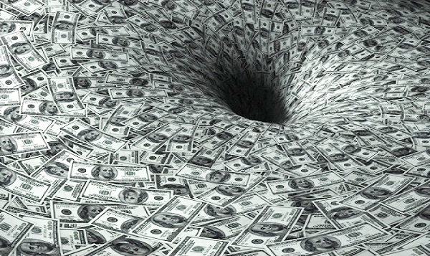
http://www.secretsofthefed.com/wp-content/uploads/2013/05/Global-Financial-Collapse.jpg
Continued economic growth makes it highly likely that carbon emissions will continue to increase. It may not be possible to reduce emissions unless the world changes its economic focus

Slide 41
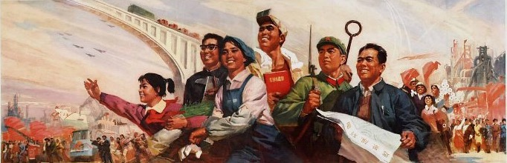
http://www.iisg.nl/landsberger/images/c05.jpg
We have the Technology… but what happened to the Radical?

