Slide 1
Is feeding people easy?
Tara Garnett
Food Climate Research Network – University of Oxford
www.fcrn.org.uk
3 September 2016

Slide 2
What do we talk about when we talk about food?
Trade
Education
Class
Economy
What we know
Biology
What’s affordable
Religion
Nurture
Sociability
What’s “normal”
Entertainment
Pleasure
Need
Guilt
Technology
What’s food?
Habit
Ritual
Values
Satisfaction
Media
Geography
Love
Comfort
Status
Power
Bribery
What’s marketed
What’s available
Institutions
Industry
Government
What’s legal
Notes:
Source: Garnett T (unpublished)
Our food consumption patterns are influenced by many factors. Key factors include price, availability, knowledge, social norms, industry marketing and regulation. Garnett T (2014). Changing consumption: How can we change the way we eat? A discussion paper. Food Climate Research Network, University of Oxford
Thus our choices are influenced by affordability, availability, social norms, marketing and other information sources.
Other influences on our eating patterns include the habitual and ritual nature of many consumption practices, religious beliefs and taboos, the pleasure we gain from food or particular types of food, or settings in which they are consumed, and many other factors.
As an overarching point, we live in a highly consumerist society – food is just one part of this.. Approaches to understanding and shaping our eating patterns need to take account of these wider societal influences, structures and norms. For example, rebound effects could occur when, for example, someone makes a sustainable food choice but feels they have “done their bit” and subsequently acts in an unsustainable way in other aspects of their life.
Leakages can occur whereby, for example, reduced consumption of meat within a country leads to increase exports of meat – in other words, consumption goes down, but production stays the same. The production-consumption relationship is complex and a full understanding of how they impact each other, beyond simple supply and demand, and across different consumption-production categories (food and non food) is lacking.

Slide 3
What’s the problem with food? And what does a solution look like?
Not enough food!
Too much greed!
Too much inequity!
Produce more food, more efficiently
Reduce consumption
Transform the system

Slide 4
Shaping ideas about…
HOW to produce food – and how MUCH
How to define FOOD SECURITY & NUTRITION
ANIMAL ethics and welfare
Our relationship with the ENVIRONMENT
CONSUMPTION & the ECONOMY
Personal vs collective FREEDOM
METRICS used to assess progress
The legitimacy and necessity of different TECHNOLOGIES

Slide 5
Examples
Food miles and local
Meat
Limits

Slide 6
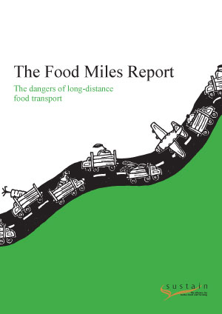
Example 1: food miles
What we’re really talking about..
Time
Space
Agency/moral responsibility
Nature-technology relationship

Slide 7
Some ways of thinking about food miles
The life cycle analysis (LCA) approach
The LCA+ approach
The operating systems perspective

Slide 8
The LCA approach
Main gases: methane, nitrous oxide, carbon dioxide

Slide 9
Whether local is better depends on:
Impacts of other life cycle stages
Mode & efficiency of transport
Scope of analysis ... What do we really mean by local (jam jar labels, tractors)?
“food miles … are stupid” (University of Cranfield)

Slide 10
LCA & time, space, agency
Time: atemporal, snapshot approach – future trends not considered. Present simple
Space: Map, not a picture; no geographical memory or sense of spatial identity. Ecological comparative advantage Agency: Silent on power structures, cultural identify/ownership; implicitly ‘invisible hand’ employment ‘efficiency’
Good question: why value local people’s employment more than foreigners?
Classical economics
Way forward: efficiency, clean tech

Slide 11
LCA +: A bit more critical..
Transport part of nexus of inter-influencing, energy using technologies (e.g. refrigeration, packaging, manufacturing, ICT, mining etc)

Slide 12
Time, space, agency
Time: What if? (eg. what if aviation becomes more ‘efficient’ and therefore cheaper..? Conditional tense
Space: Technology creates new spatial relationships: eg. Chill-chain makes possible livestock concentration; opportunity costs of land
Agency: Techno- ‘lock-in’: technological innovation creates new norms, expecations, dependencies
Behavioural economics
Way forward: dynamic & agent based modelling & clean tech

Slide 13
The operating system perspective: It’s the system, stupid.
Food miles: arteries of globalisation
Globalisation kills dramatic unities of time, place, action
Out of time (cold storage, a-seasonality)
Out of place (local distinctiveness; agri-cultures)
Out of action (loss of agency; moral autonomy, collectivity)

Slide 14
Time & space & agency
All come together – interact - in the word ‘nostalgia’ (lit: longing for home)
Home – in the past (which time? pre-industrial revolution? Real time? Future?) Past perfect? Future perfect
Home as place geographically specific (this land is your land, bioregional)
Home as agency: : Land and rights, identity ownership of means of production/consumption, culture

Slide 15
Ways forward: self sufficiency, food sovereignty movements, human scale development
Who’s in, who’s out?
A new economics
What are alt technologies now?
https://farmbot.io/?

Slide 16
Nature – technology – where are our starting points?
‘Natural living’ safe but dull? Eg. town mouse vs country mouse – “environmentalism is dull” (eco is conservative)
Or: green movement seeks a socially disruptive eco-future? (road protests, CAT – eco is radical)
Technological innovation is a valiant force in the fight against the dead hand of oppression: eg. Galileo vs the Church (technology radical, pro-individual)
Technology itself the oppressor? “when the sun rises, do you not see a round disc of fire somewhat like a guinea?” Oh! no, no! I see an innumerable company of the heavenly host crying “Holy, holy, holy is the Lord God Almighty!” (Technology conservative, anti individual?)

Slide 17
The nature-technology issue
Something to do with how we see ourselves as passive agents (content to ‘be’) or active changers of things (do-ers) – cuts both ways
Technology for individuality against conformity – or for collectivism against individualism?

Slide 18
Example 2: meat

Slide 20
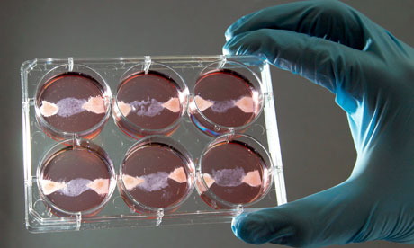
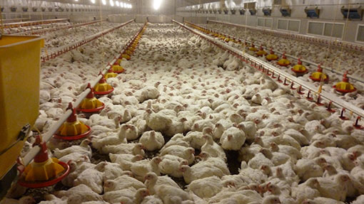
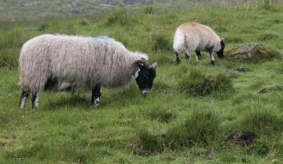
Balanced offering or puritanical, meagre & unrealistic?
Techno-answer or on-going alienation from nature?
Possible livestock futures – what does ‘good’ look like?
Bag of wind or miraculous ‘something from nothing’?
Ultra efficient – or a waste of grain?
Notes:
Art meat – 3D printing, synthetic biology, insects, artisanal, open source design – or corporate vats - transhumanism
Intensive poultry – breeding for no pain, food processing technologies, taste reformulations – big pharma, big agri-food,
Uplands – back to the land, anti science
Veg – hydroponics, GM? Fortification, open source design

Slide 21
Example 3: Limits & boundaries

Slide 22
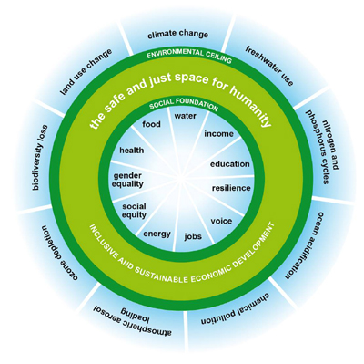
The question of limits & boundaries
Rockström et al 2009
Raworth 2012
What are they? Do they exist?

Slide 23
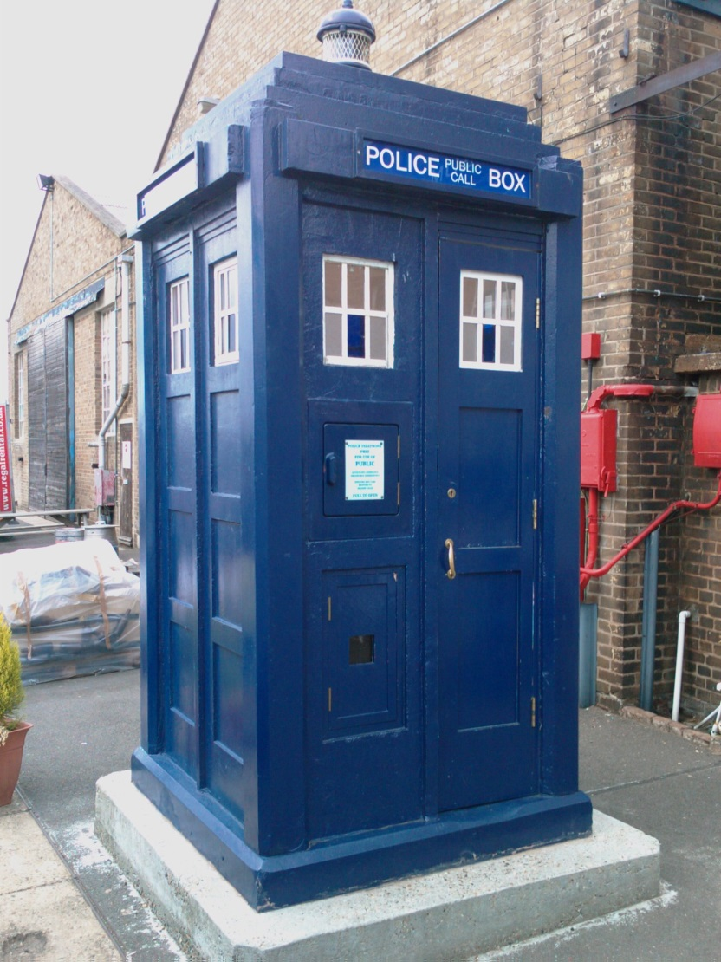
Can we do a Tardis?

Slide 24
Should we?

Slide 25
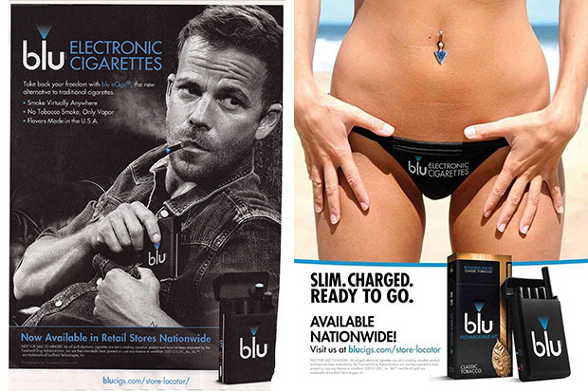
Should we?

Slide 26
Thank you Join the Food Climate Research Network www.fcrn.org.uk
Visit our new learning resource
www.foodbytes.org.uk
taragarnett@fcrn.org.uk

