Slide 1
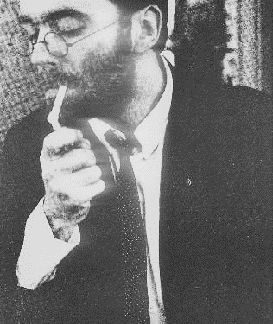
Radical Technology Revisited: Exhibition
THE EARLY WORK
OF THE
ANARCHIST ARTIST AND ILLUSTRATOR
CLIFF HARPER
Annotations by Peter Harper (who is no relation, but a fan who worked with Cliff in the 70s)

Slide 2
Preliminary remarks
Cliff Harper is a working artist with a long history. More information can be found in the Wikipedia entry https://en.wikipedia.org/wiki/Clifford_Harper and in the relatively early biographical work The Education of Desire (Anarres, 1984).
The images shown here are chosen for their connection with Radical Technology (RT 1.0), to which Cliff made an important contribution. See also the full reproduction of Class War Comix No 1, in this section of the web site.
‘Presentation’ format is used because it allows images to be shown in sequence. Annotations are presented in the foregoing slide to each image.

Slide 3
Pictures 1-7
THE ‘VISIONS’ FROM RADICAL TECHNOLOGY
This famous series was created for Radical Technology (RT 1.0) using a style based on fine dots. Each image was associated with one of the sections in RT 1.0. The editors sent Cliff sketches for what they wanted, and references for technical items, calling them ‘Visions’. These are Cliff’s realisations.
Although the Visions were much reprinted, no definitive collection seems to exist. Here the original six are presented in various incarnations, plus a seventh that Cliff added later, a much more overtly political comment on his fears, with continuing resonance today.
It will be noticed that a large proportion of the figures are female. This was a deliberate response to criticism of early drafts of Class War Comix (q.v), that there were too many male figures. There are signs throughout this period of sex-change operations deftly performed with only Tippex paste and a fine-nibbed Rotring. Perhaps Cliff took this too far. The Health and Safety issues raised by a lathe operator with bare breasts have been widely remarked on.

Slide 4
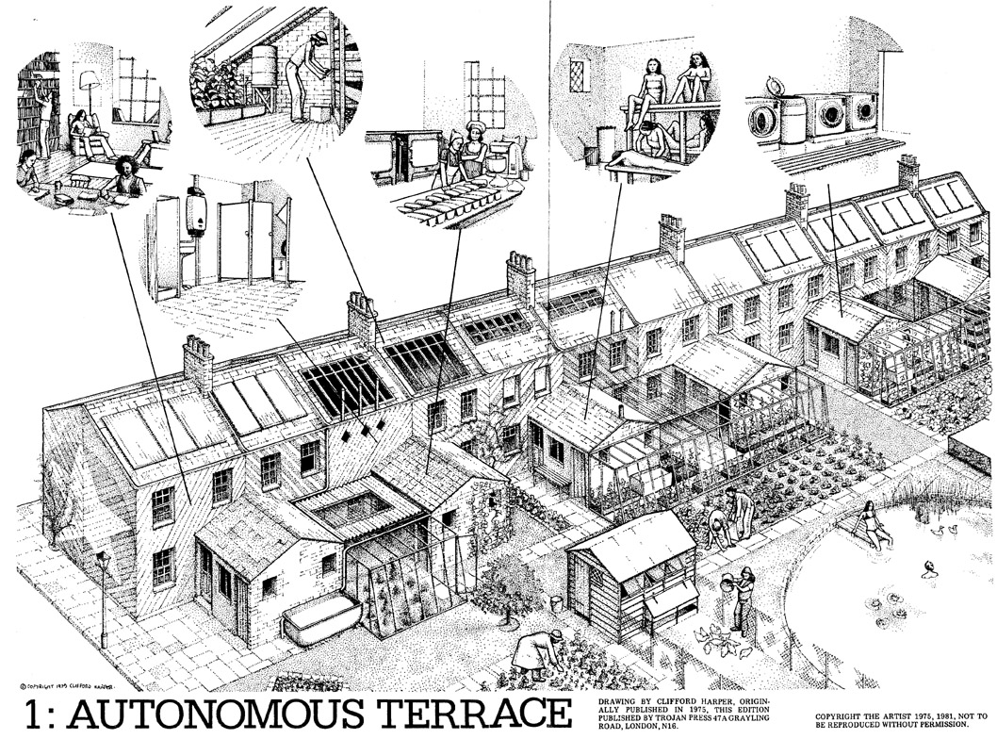

Slide 5
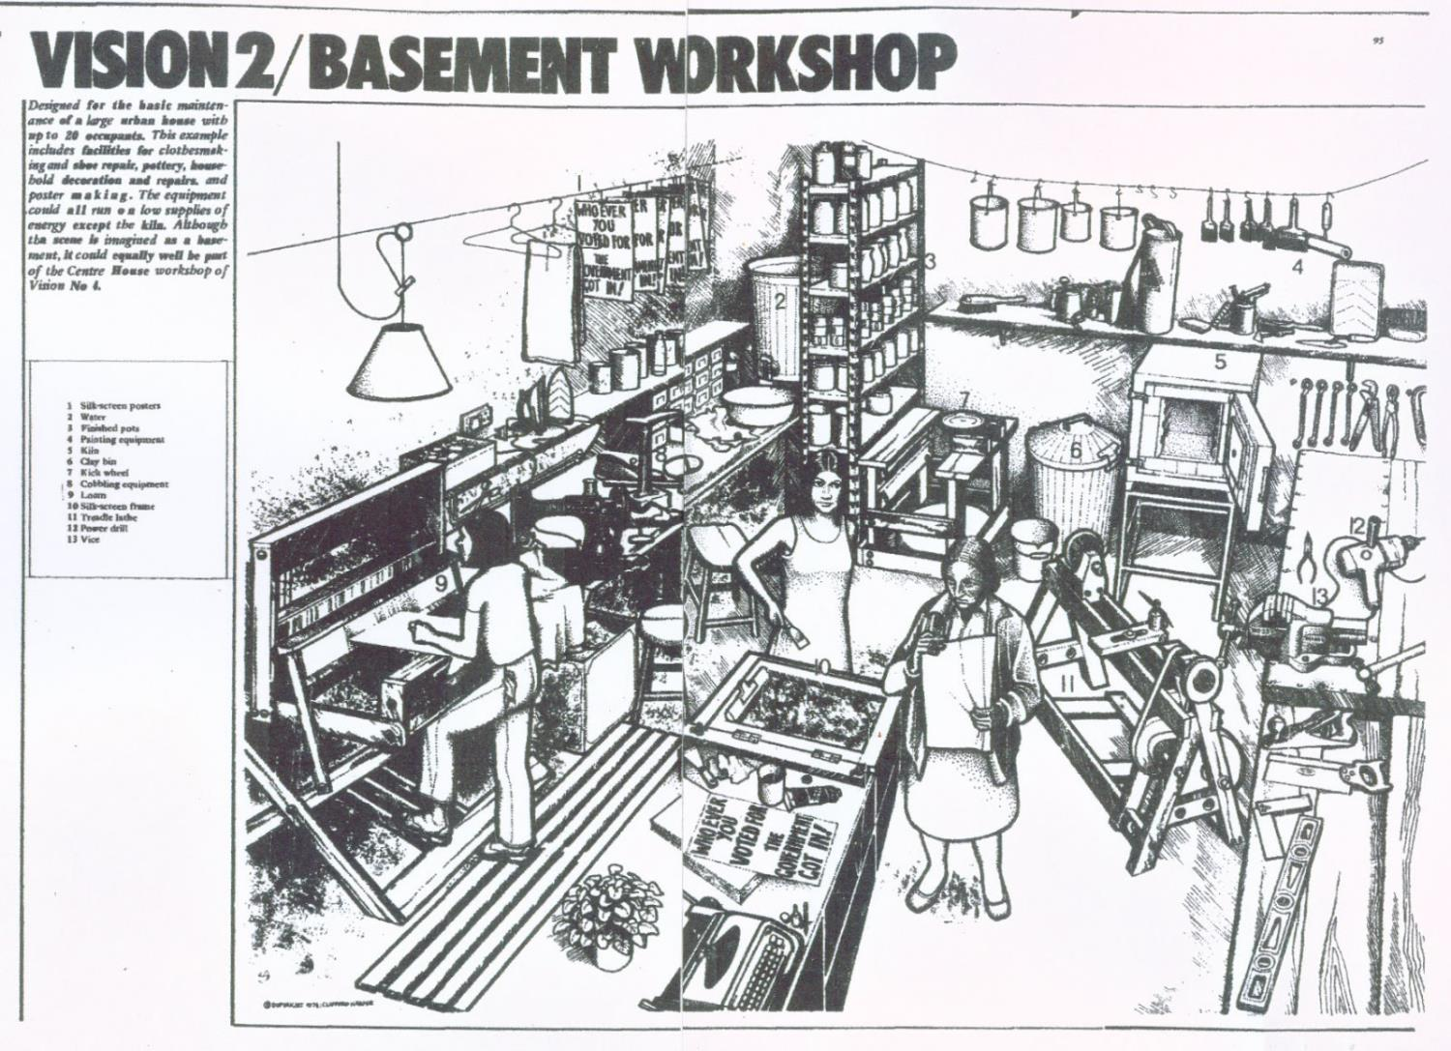

Slide 6
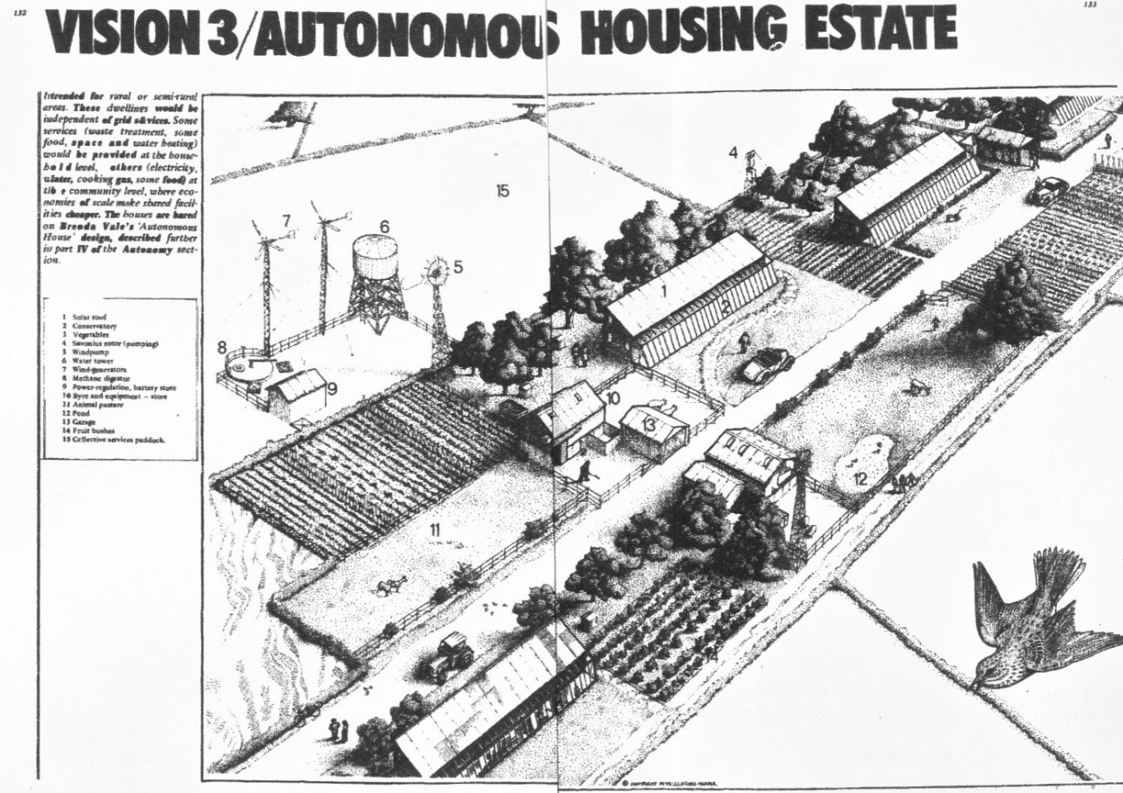

Slide 7
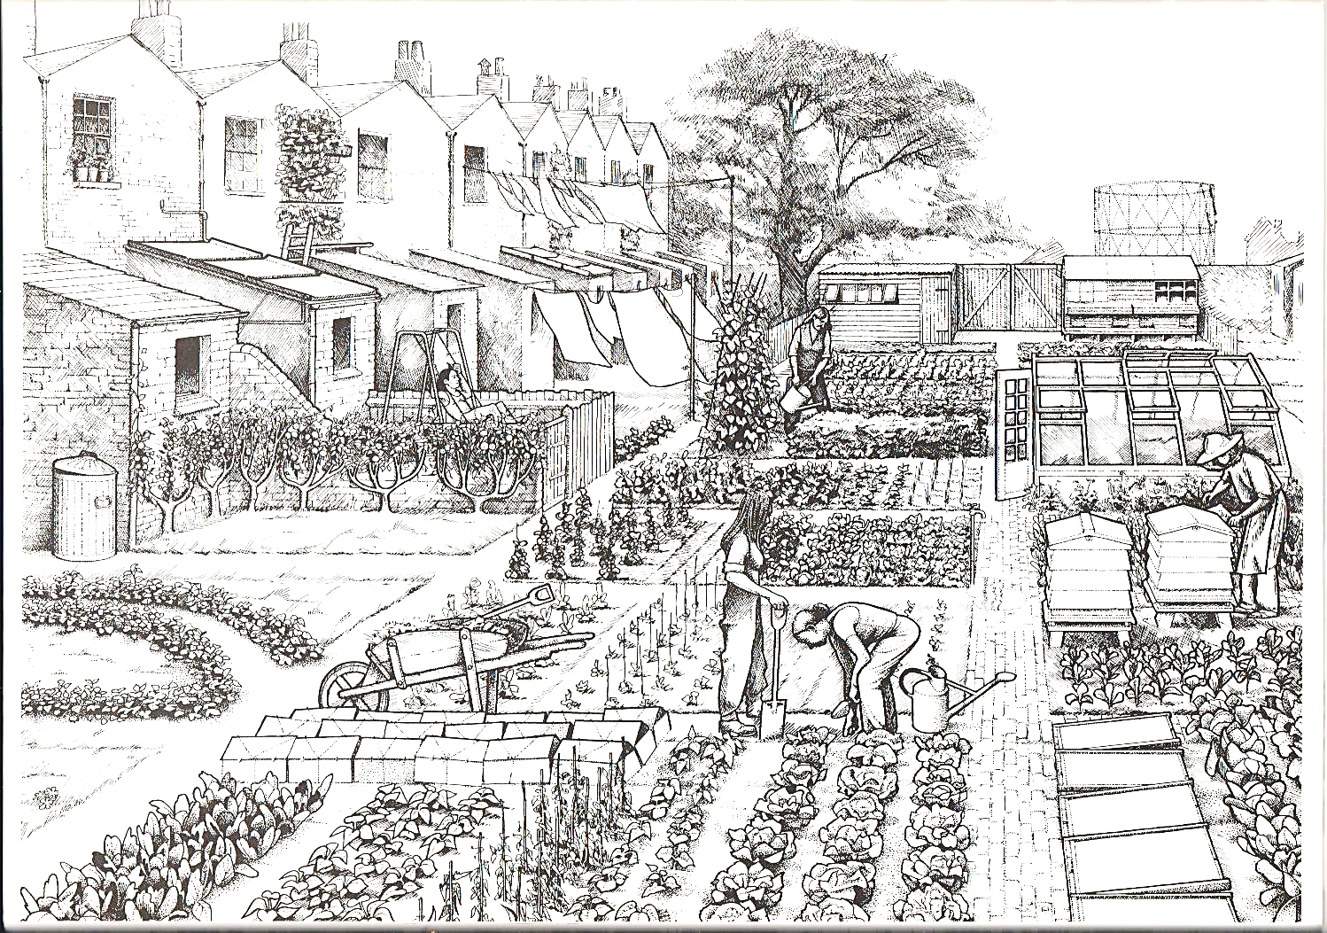

Slide 8
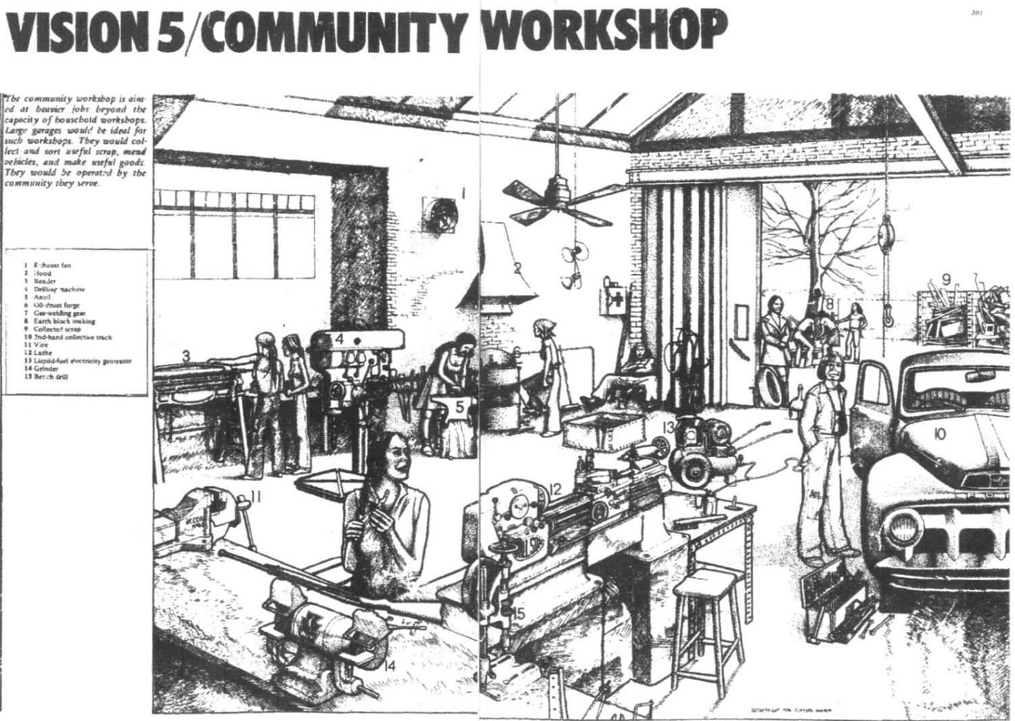

Slide 9
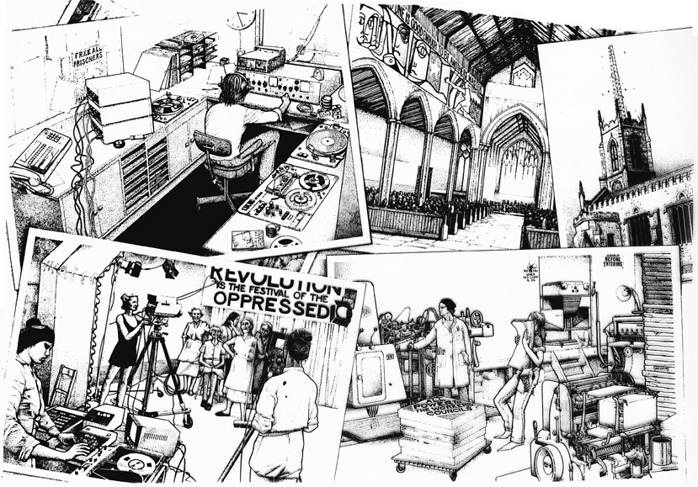

Slide 10
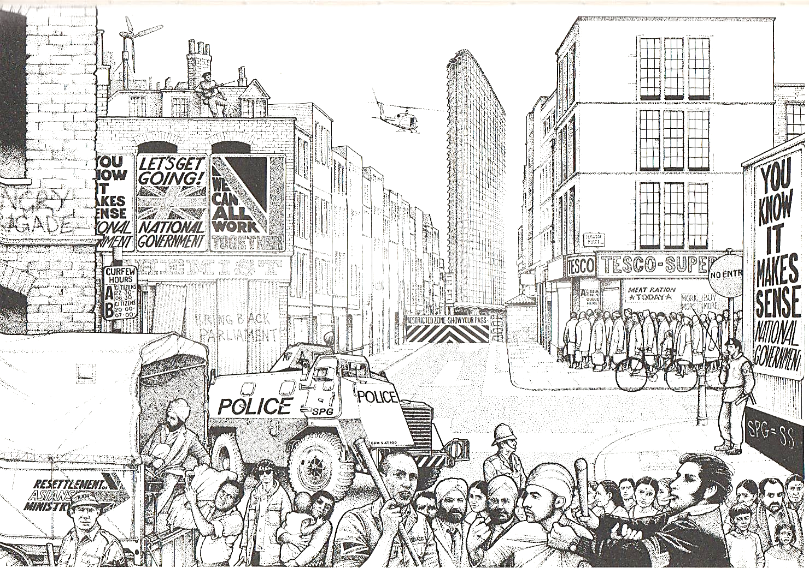

Slide 11
Pictures 8 and 9
Other drawings in similar vein did not make it into RT 1.0 but evoked the same utopian aspirations. The annotations in Picture 9 are by Peter Harper and cover many of the tropes of the early alternative technology movement.

Slide 12
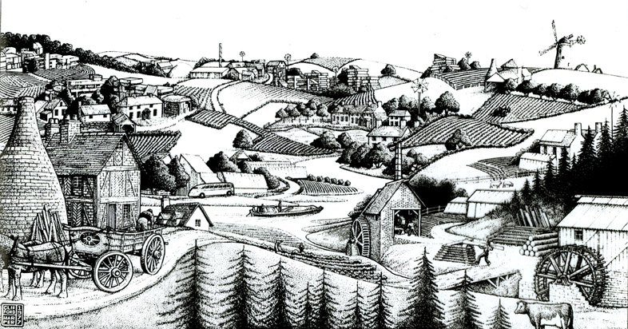
Notes:
Reproduce at 120% original size

Slide 13
Notes:
Reproduce at existing size.

Slide 14
OTHER EARLY WORKS
Picture 10
Cliff created several other images satirising naïve alternative values. A favourite trick was to present a superficially attractive scene that pressed ‘alternative’ buttons, with a hidden hinterland of repression. He used this approach on a cover of Architectural Design magazine, presenting a special issue featuring material from RT 1.0. Cliff has drawn a notionally ‘autonomous’ rural property but above, in black and white we see the urban back streets and ‘Dark Satanic Mills’ suggesting potential hypocrisy in the search for household autonomy.

Slide 15
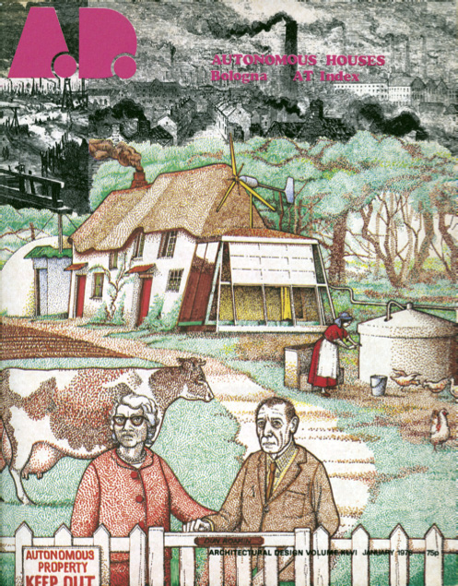
Notes:
Reproduce at a4 size.

Slide 16
Picture 11 and 12
A similar effect is delivered in two strokes. The cover of Undercurrents seen in Picture 11 suggests a charming alternative arcadia. Inside the magazine however the centre spread showed the full picture, with all the menace of what was later called ‘the surveillance state’.
Note that here Cliff is moving from the ‘dotty’ style to one of short lines, perhaps a precursor of his later ‘woodcut’ style.

Slide 17
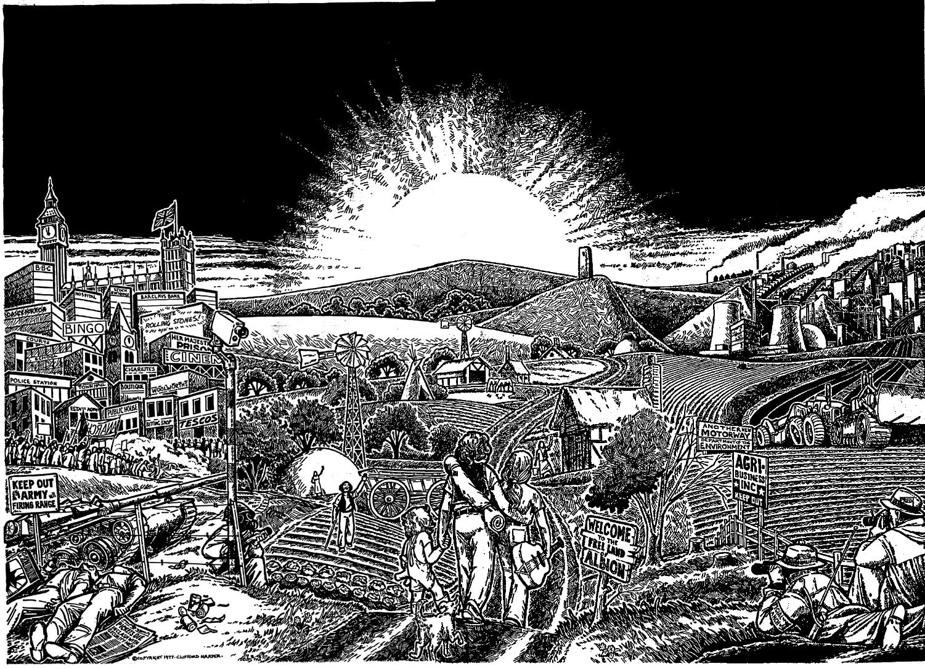

Slide 19
Picture 12
Possibly Cliff’s most savage image in this period was drawn for the cover of the magazine of the British Society for Social Responsibility in Science, Science for People. It shows a soldier in full riot gear wielding a petrol filler nozzle that is actually a machine gun. Chris Ryan, one of the organisers of this conference, was editor of the magazine at the time.

Slide 20
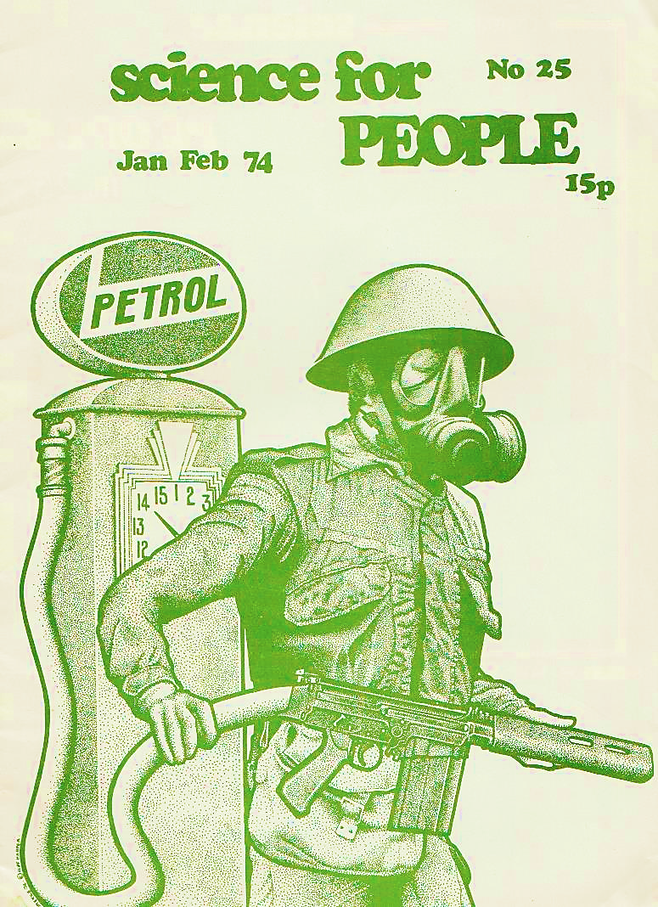

Slide 21
CLASS WAR COMIX
The early ‘monochrome-pointilliste’ style was also used for comic strips. In fact his earliest work was the first in a projected series called Class War Comix (sic). He wrote a kind of prospectus for the series, and in an early example of crowd funding, his friends raised enough money to print No 1. See details here. There is also a slide show of the complete work.
Remarkably, Cliff approached the task by doing the comic strip drawings first, complete with empty speech bubbles, creating a mysterious and open-ended effect, which was how his friends first encountered them. The utopian romanticism was irresistible.
Later Cliff filled in the bubbles, which reveal his stark political philosophy. A review in Undercurrents is also included in the exhibits nearby.

Slide 22
Picture 13
This is a frame from Class War Comix used in RT 1.0, where the words have been deliberately altered, a procedure that can be used for almost any of the speech bubbles to change the mood or storyline.
‘Borage fritters’ was a contemporary in-joke referring to the craze for wild foods sparked off by Richard Mabey’s classic Food for Free.

Slide 23
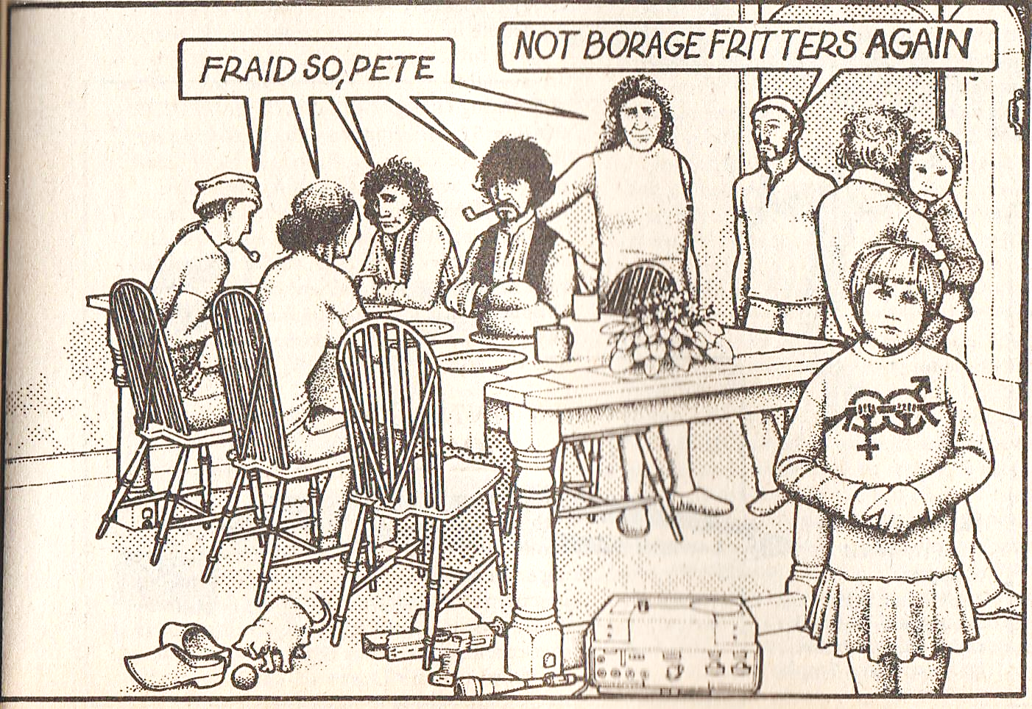

Slide 24
Picture 14
This image is possibly the only frame from Class War Comix that Cliff ever coloured, apart from the cover. The colouring is done by pencil crayons, and is simply the reverse side of a short letter, signed ‘Boris’ and ending with a characteristic slogan:
RED RUST IS EATING INTO THE CHASSIS OF THE MODEL T
The original of this image was framed, and hung for many years in the community-house toilet at the Centre for Alternative Technology in Wales. Sitting on the toilet seat, it was directly opposite, just a few feet away. CAT staff sometimes took it as deliberate propaganda and it generated heated debates over the years, with occasional demands for its removal – which eventually occurred.

Slide 25
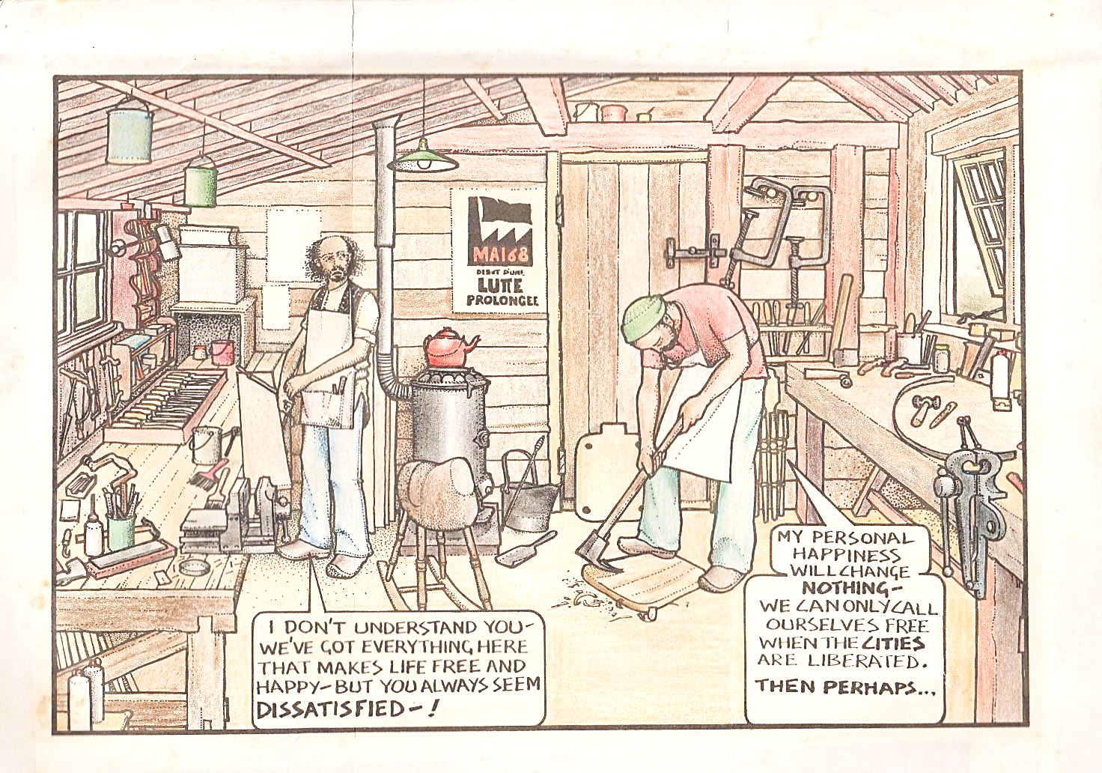

Slide 26
Picture 15
Some of Cliff’s drawings for Class War Comix did not make it into the Comic itself, but existed as a kind of pool from which several were used in Radical Technology. Here is an example, dripping with retro funk, showing medievally-clad characters drilling a post-hole with a classic ‘Fergie’ tractor.

Slide 27
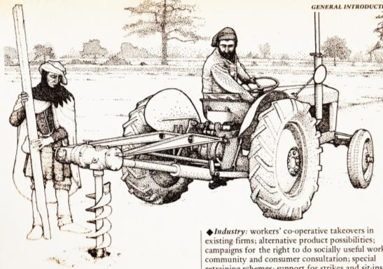
Notes:
Reproduce at twice original size

Slide 28
Picture 17
PURE ART?
Most of Cliff’s work was applied propaganda, but he just liked drawing, and occasionally produced ‘still lifes’. This one includes a typewriter of the kind that much of Radical Technology was written on, plus several political texts, an ash-tray (he was an enthusiastic smoker) and in the drawer, a pistol. Unlike many anarchists of his generation he was comfortable with the idea of revolutionary violence.

Slide 29
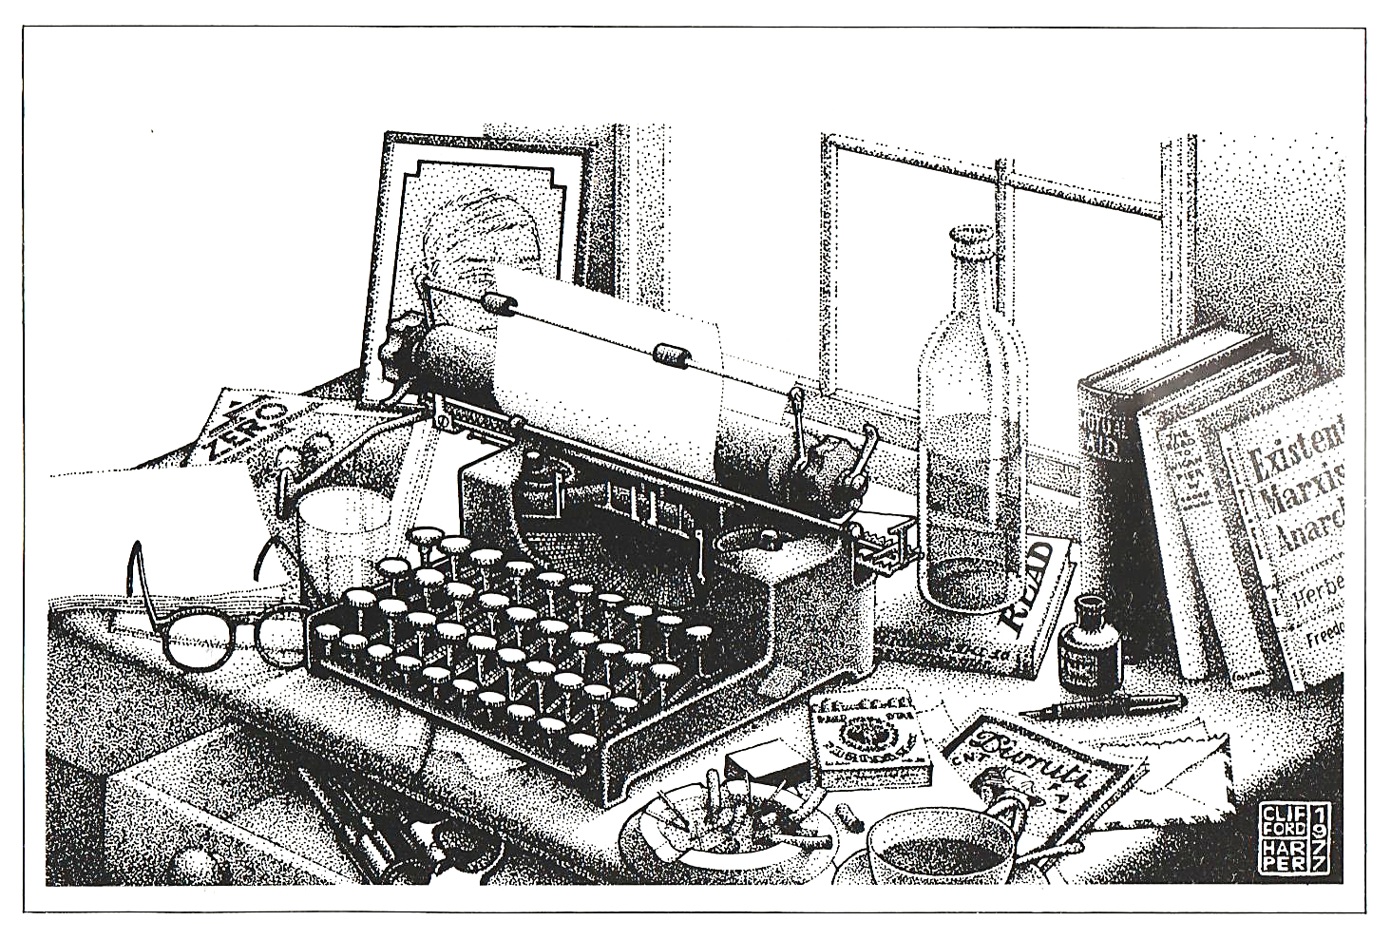

Slide 30
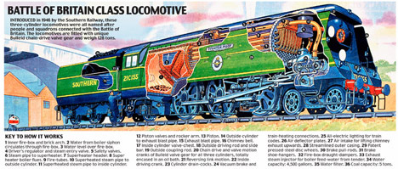
Picture 18
TECHNICAL DRAWINGS
Cliff liked technology and was inspired by the centre pages of the comic Eagle (fl. 50s and 60s) where complex chunks of engineering would be cut away to reveal their inner workings – see example above. He used this idea to illustrate the intended functioning of an experimental community in Wales. This is in his monochrome-pointilliste style, around 1972.
It was reproduced in the ‘Autonomy’ section of RT 1.0

Slide 31
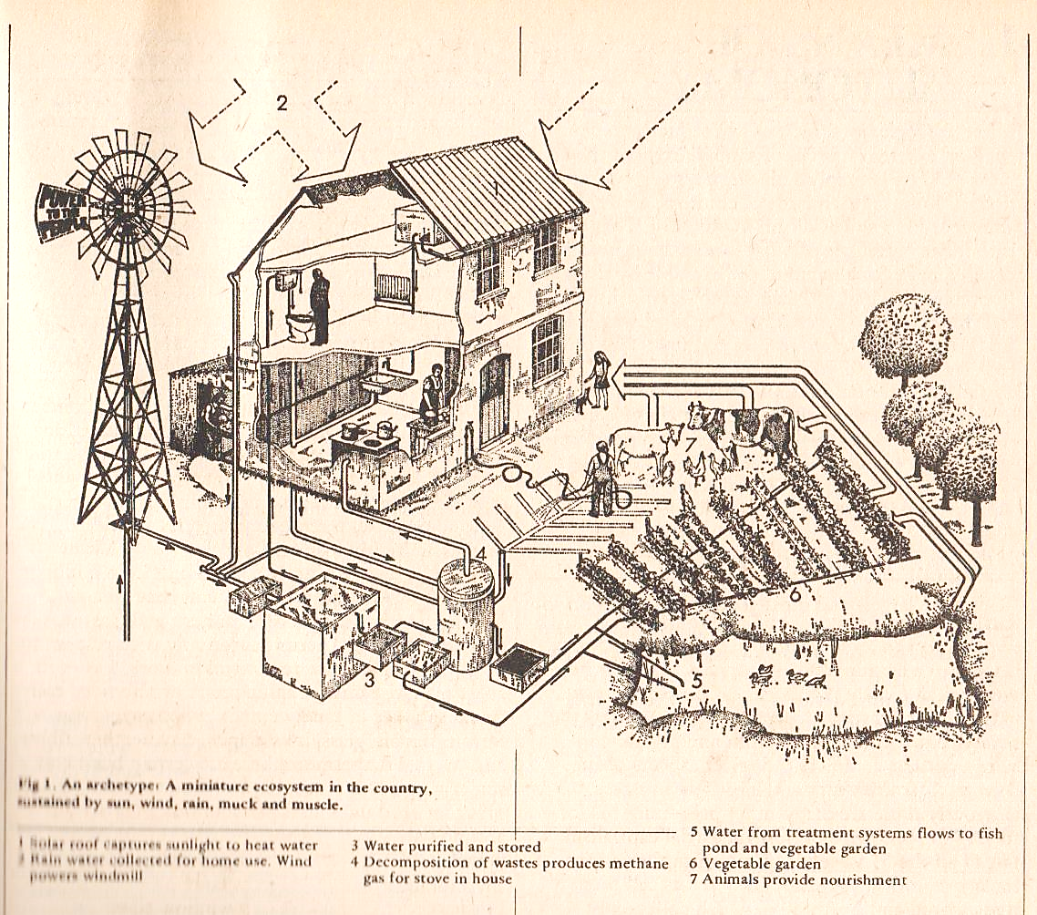

Slide 32
Picture 19
This is another cut-away that Cliff did for RT 1.0, of the celebrated trickling solar roof at the Biotechnic Research and Development (BRAD) project, also in Wales.
The same idea was adapted later for a much larger roof at the Centre for Alternative Technology.

Slide 33
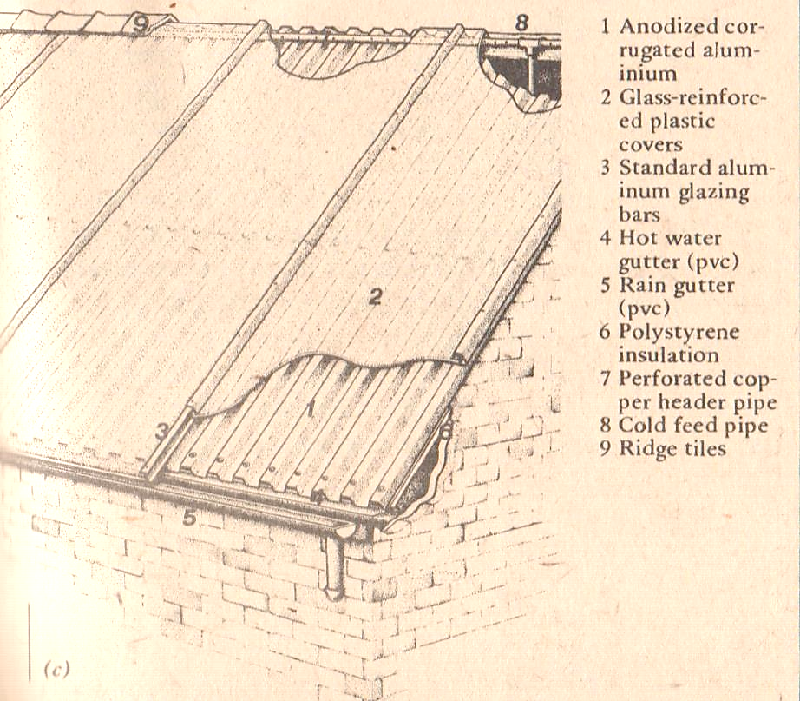

Slide 34
Picture 20
Cliff usually worked on commission, but had favourite clients. One was the Compendium Bookshop, for whose catalogue he produced a splendid cover featuring many of his favourite themes and people. Radicals of a certain age will easily recognise these heroines and heroes.

Slide 35
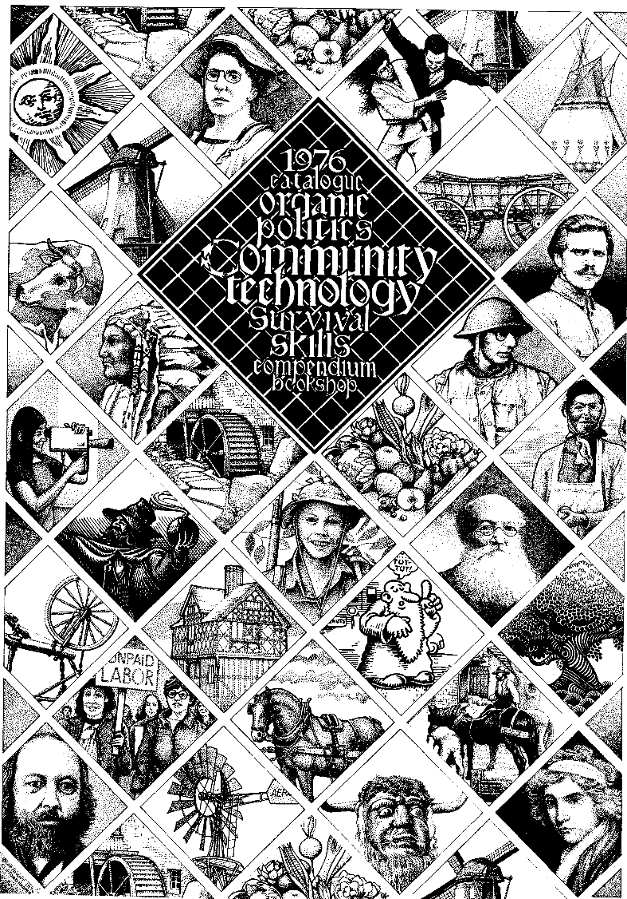

Slide 36
Picture 21
This affectionate portrait of the anarchist writer and thinker Colin Ward (who was also editor of Town and Country Planning) is a fine example of Cliff’s later ‘woodcut’ style

Slide 37
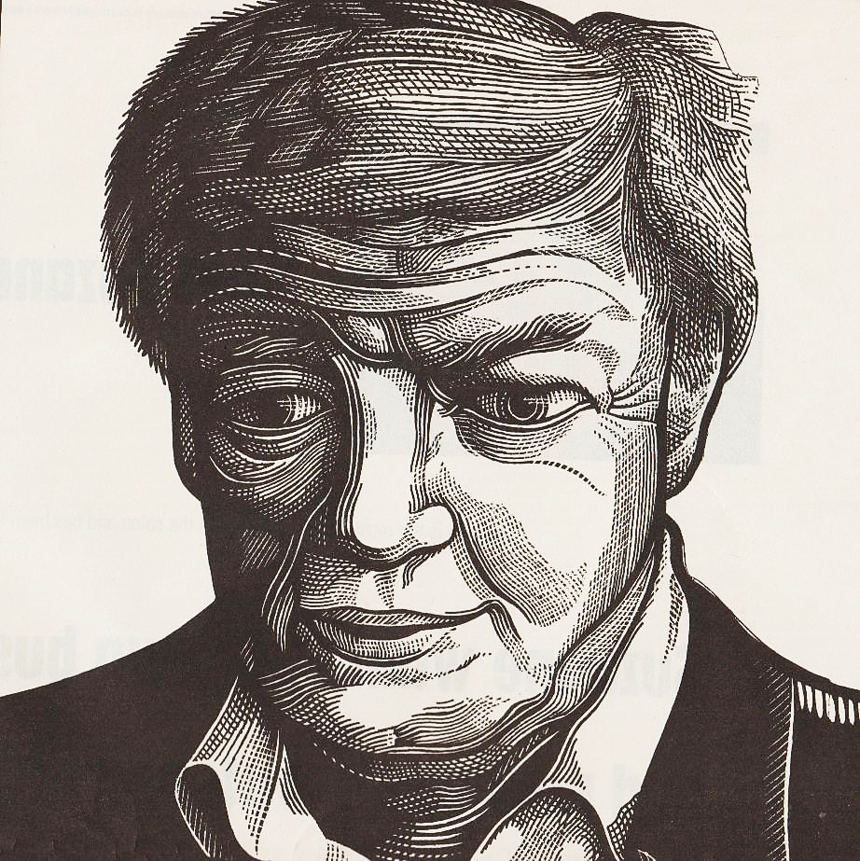

Slide 38
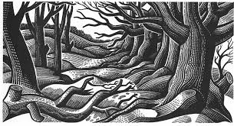
Cliff continued to develop this quasi-woodcut style, influenced by Eric Gill and Frans Masereels, later emphasising large areas of black and a tendency to minimise strokes. His work has become anonymously familiar through the long series of exquisite miniature illustrations for the Guardian’s Country Diary.

